Slide 1
Physics GRE 1996 #16 Worked Solution
m. k. fugate
fugate.52@osu.edu

Slide 2
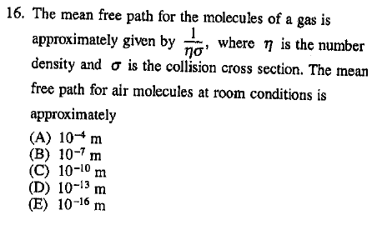
It seems as if this is a ridiculous thing to ask unless you have the number density and collision cross section of air memorized.
But, it is easy to solve if you know a little basic background info, and make an estimate based on orders of magnitude.

Slide 3
First, what is the collision cross section? To figure this out, you must know two facts:
Cross section tells you about how often particles collide. It is analogous to its area (i.e. how big of a target it is).
The length scale of atoms is the Angstrom, and $1 A={10}^{−10}m$. Of course you won’t be expected to memorize the radius of every element, but all you need to do here is estimate, so you assume the radius is about 1 Angstrom. This is a fact you should know, as it often comes in handy.
With this in mind:
$$σ=area=πr^{2}$$
Where r is the Angstrom

Slide 4
Now you know cross section, but what about the number density? This relies on you knowing two things:
The ideal gas law: PV = nKT (K is Boltzmann’s constant, which is given on the GRE formula sheet)
Standard temperature and pressure (STP)
0 degrees Celsius, which is 273 degrees Kelvin (always calculate with Kelvin)
10^5 Pascals. Remember, the Pascal is equal to one newton per square meter.
So, using two basic physics facts you should have memorized, you can derive the number density:
$PV=nKT$ → $η=\frac{n}{V}=\frac{P}{KT}$
Now put it all together:
$$\frac{1}{ησ}=\frac{KT}{Pπr^{2}}$$

Slide 5
$$\frac{1}{ησ}=\frac{KT}{Pπr^{2}}$$
You know everything you need now:
$$K=1.38 ∗{10}^{−23}J/k$$
$$T=273 k ≈3 ∗{10}^{2} k$$
$$P={10}^{5} N/M^{2}$$
$$πr^{2}≈3 ∗{10}^{−20}m^{2}$$
Now count the powers of ten:
$$\frac{1}{ησ}=\frac{KT}{Pπr^{2}}≈\frac{\left({10}^{−23}J/K\right)\left({10}^{2}k\right)}{\left({10}^{5}N/{M^{2}}\right)\left({10}^{−20}m^{2}\right) }={10}^{−6}m ≈B$$
We left off the specific values, but taking powers of ten got us close enough. Clearly, B is closest to our estimate, and it is indeed the correct answer.

Slide 6
The key to answering problems like this is:
Instant recall of certain basic facts (STP, the ideal gas law, about how big atoms are)
Not getting bogged down in arithmetic and realizing that a rough estimate using powers of ten is all you need (and all you have time for anyway)
With this in mind, problems like this should only take a minute or so. If your answer isn’t spot on to any choice, go with whichever is closest!

