Slide 1
Physics GRE 1996 #87
m. k. fugate
fugate.52@osu.edu

Slide 2
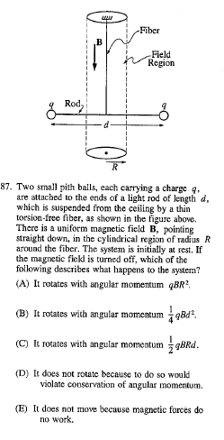
Only 6% of students got this correct. If people randomly guessed, it would be around 20%. This means most people did not just guess, but were actually attracted to wrong answers.
Probably, people guessed D or E, hoping it was a ‘trick question’ which does not require math.
The correct answer is A. Why?

Slide 3
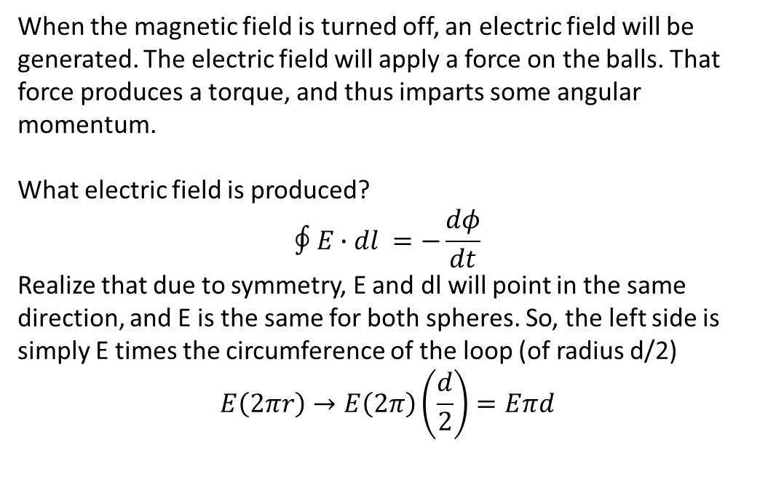
To do this problem you must know about:
Faraday’s Law (in which change in magnetic flux generates an electric field)
Torque and angular momentum
When the magnetic field is turned off, an electric field will be generated. The electric field will apply a force on the balls. That force produces a torque, and thus imparts some angular momentum.
What electric field is produced?
$$∮E∙dl =−\frac{dφ}{dt}$$
Realize that due to symmetry, E and dl will point in the same direction, and E is the same for both spheres. So, the left side is simply E times the circumference of the loop (of radius d/2)
$$E\left(2πr\right)→E\left(2π\right)\left(\frac{d}{2}\right)=Eπd$$

Slide 4
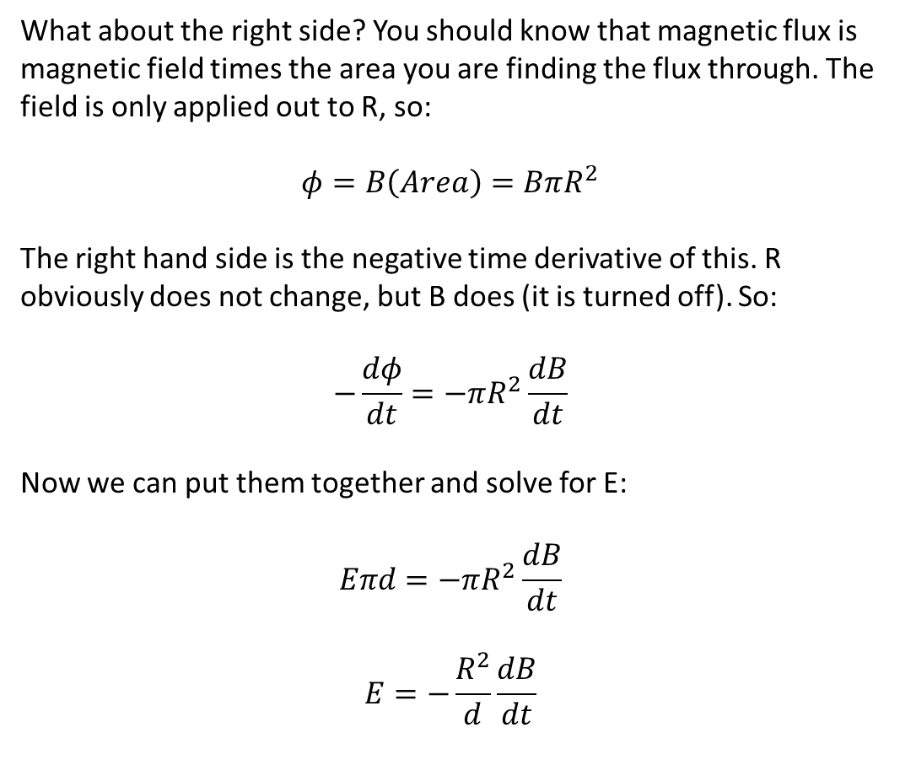
What about the right side? You should know that magnetic flux is magnetic field times the area you are finding the flux through. The field is only applied out to R, so:
$$φ=B\left(Area\right)=BπR^{2}$$
The right hand side is the negative time derivative of this. R obviously does not change, but B does (it is turned off). So:
$$−\frac{dφ}{dt}=−πR^{2}\frac{dB}{dt}$$
Now we can put them together and solve for E:
$$Eπd=−πR^{2}\frac{dB}{dt}$$
$$E=−\frac{R^{2}}{d}\frac{dB}{dt}$$

Slide 5
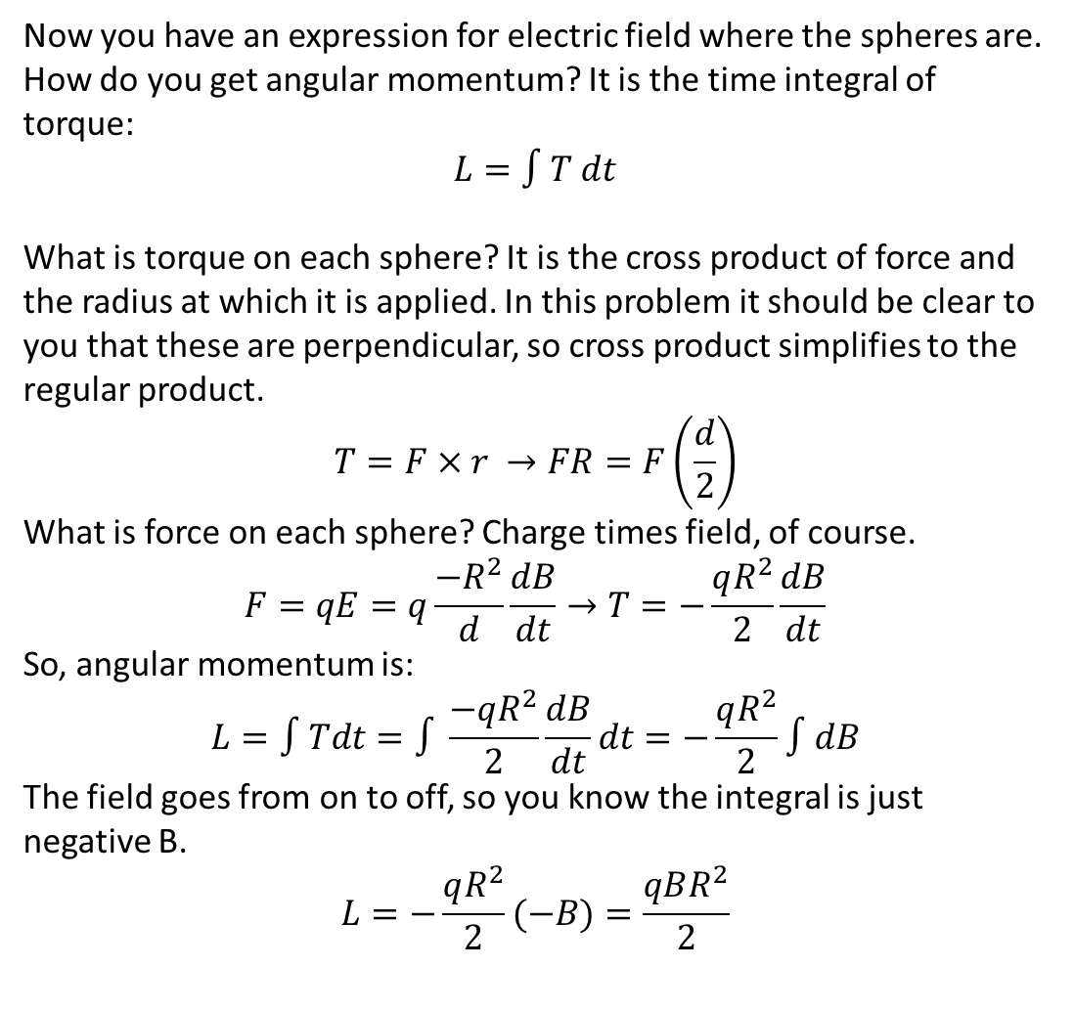
Now you have an expression for electric field where the spheres are. How do you get angular momentum? It is the time integral of torque:
$$L=∫T dt$$
What is torque on each sphere? It is the cross product of force and the radius at which it is applied. In this problem it should be clear to you that these are perpendicular, so cross product simplifies to the regular product.
$$T=F×r →FR=F\left(\frac{d}{2}\right)$$
What is force on each sphere? Charge times field, of course.
$$F=qE=q\frac{{−R}^{2}}{d}\frac{dB}{dt}→T=−\frac{qR^{2}}{2}\frac{dB}{dt}$$
So, angular momentum is:
$$L=∫Tdt=∫\frac{−qR^{2}}{2}\frac{dB}{dt}dt=−\frac{qR^{2}}{2}∫dB$$
The field goes from on to off, so you know the integral is just negative B.
$$L=−\frac{qR^{2}}{2}(−B)=\frac{qBR^{2}}{2}$$

Slide 6
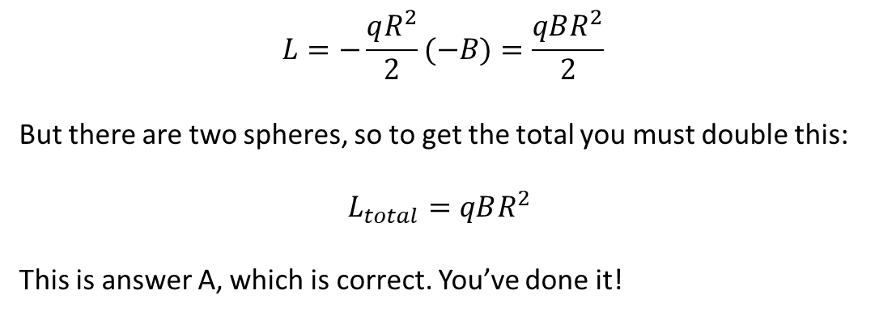
$$L=−\frac{qR^{2}}{2}(−B)=\frac{qBR^{2}}{2}$$
But there are two spheres, so to get the total you must double this:
$$L_{total}=qBR^{2}$$
This is answer A, which is correct. You’ve done it!

Slide 7
Maybe you are worried you will not have time to do all of this math. Is there a way you could have quickly guessed the answer, by ruling out all the ones which must be wrong?
You should know from your E&M course that a changing magnetic field induces an electric field, and electric fields impart forces on charged objects, which will in turn impart some angular momentum to the system.
So, D and E must be incorrect.
How can you decide between A, B, and C?

Slide 8
What is different about these answers?
A depends on R^2
B depends on d^2
C depends on Rd
Here is one way to deduce the answer:
Angular momentum is related linearly to torque
Torque is related linearly to force
Force is related linearly to electric field
Electric field is somehow related to magnetic flux
Flux depends on the area over which field is applied
Area depends on the square of R. There is no other part of the problem where R could come into play, so R squared must remain in the final answer. You may not know the exact expression, but A is the only choice that could work.
GRE problems should not require pages of math. If you find yourself lost in equations for too long, take a deep breath and look at the possible answers. What is different about the answers? How can you eliminate all but one?

