Slide 1
BEANFEST TUTORIAL
Please read through the instructions carefully!
Press the space bar when you are ready to continue

Slide 2
You are going to play a game called BeanFest.
The game involves beans and points.
Your point value can range from 0 to 100.
It can never be less than 0 or greater than 100.
You will begin the game with a point value of 50.
Press the space bar when you are ready to continue

Slide 3
The goal of the game is to choose beans in such a way so as to gain points and avoid losing points.
Some beans increase your points and some beans decrease your points.
Choosing beans that have a negative value will decrease your points while choosing beans that have a positive value will increase your points.
Press the space bar when you are ready to continue

Slide 4
So, you have to select beans with care.
You must discover which beans have a positive value and choose them in order to make gains.
You must discover which beans have a negative value and avoid them in order to avoid losing points.
Press the space bar when you are ready to continue

Slide 5
To learn which beans are good and bad, it is important to know that the beans vary in two ways:
Circular to oblong
Few to many speckles
Press the space bar when you are ready to continue

Slide 6
During a given trial of the game you will be presented with a bean in the upper portion of the screen
Use the k and d keys on your keyboard to select or not select a given bean
Press the space bar when you are ready to continue

Slide 7
Press the “D” to say no and NOT SELECT the bean
Press “K” to say yes and SELECT the bean
Press the space bar when you are ready to continue

Slide 8
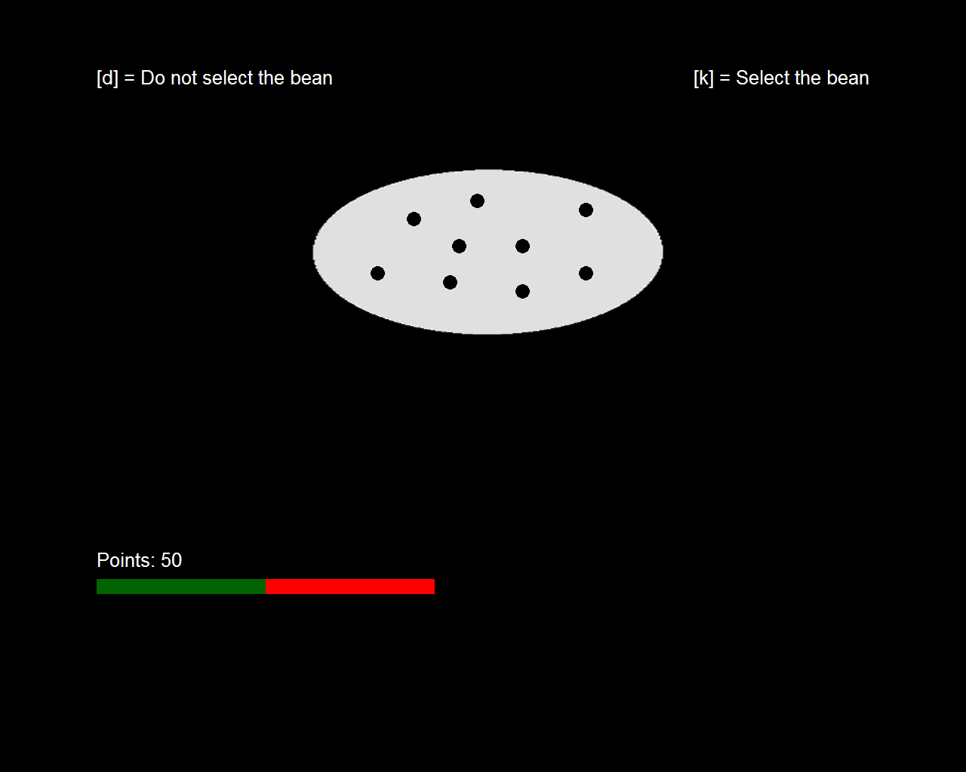
This is what a trial of the game looks like before you have pressed d or k:
To the left is your point meter. It displays your current points as a bar ranging from 0 to 100. Your specific point level is displayed numerically.
Press the space bar when you are ready to continue

Slide 9
If you choose not to select a presented bean, your point value will not change.
You will also see the effect the bean would have had on your point total.
Use this information to decide whether to approach or avoid this bean on future trials.
Press the space bar when you are ready to continue

Slide 10
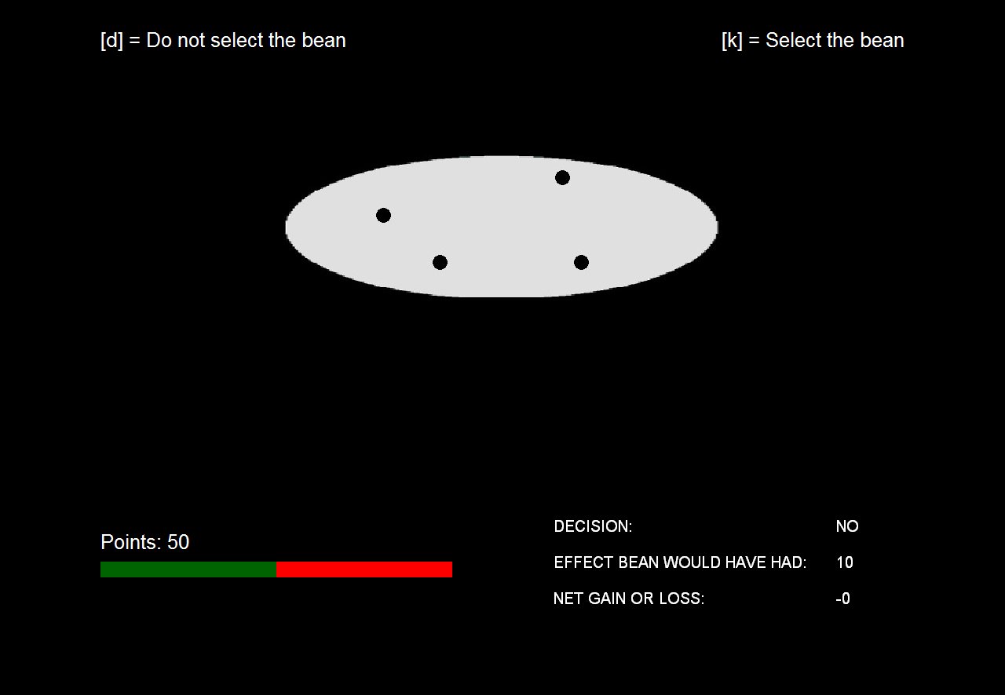
If you choose not to select a bean (press d) the display looks like this:
Here you see the effect the bean would have had
Press the space bar when you are ready to continue

Slide 11
If you choose to select the presented bean, your point value will change based on the value of the bean.
If the bean is negative your point value will decrease by 10.
If the bean is positive your point value will increase by 10.
Press the space bar when you are ready to continue

Slide 12
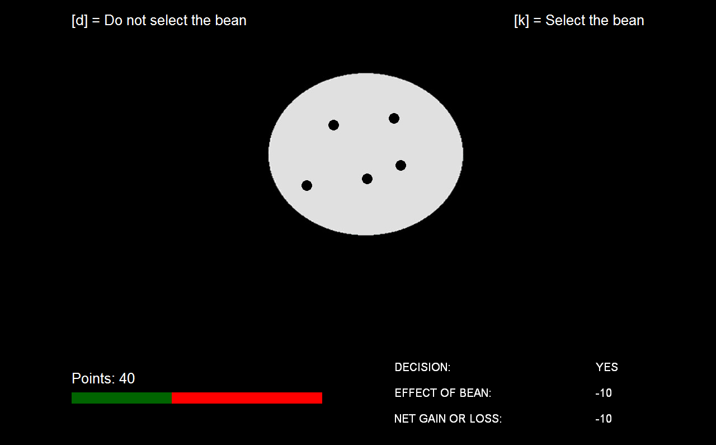
If you choose a negative bean the display looks like this:
Your point value will decrease by 10, your point bar will go down
Press the space bar when you are ready to continue

Slide 13
If you choose a positive bean the display looks like this:
Your point value will increase by 10, your point bar will go up
Press the space bar when you are ready to continue

Slide 14
Remember, you start the game with 50 points.
You should try to gain points and avoid losing points by making good decisions about which beans to select.
Reaching 100 points represents winning the game.
Reaching 0 points represents losing the game.
After either winning or losing, you will restart the game with 50 points.
Press the space bar when you are ready to continue

Slide 15
In any re-started game, the beans retain their original values.
That is, previously good beans continue to increase your points
And previously bad beans continue to decrease your points.
Press the space bar when you are ready to continue

Slide 16
The experiment begins with a short practice block of only 6 trials.
These 6 beans are just a few of the ones that you will see during the actual experiment.
But they are of the same type and have the same value as they will during the experiment.
The practice trials will provide you with an opportunity to familiarize yourself with the point meter and feedback displays.
Press the space bar when you are ready to continue

Slide 17
Once the practice block is over, you can press the space bar on the keyboard to begin the actual experiment.
The actual experiment is divided into 3 blocks, or sets of trials, which will give you a chance to rest in between blocks.
The screen will tell you when a block has ended, and when you are about to start a new block.
Press the space bar when you are ready to continue

Slide 18
The break between blocks is simply to rest; nothing changes in the experiment.
The beans have the same positive or negative value and point value that they had earlier and your point level remains the same as it was at the end of the last block.
Simply press the space bar to continue whenever you are ready.
Press the space bar when you are ready to continue

Slide 19
At the beginning of the experiment, you will probably select beans somewhat indiscriminately (at random), simply because you do not know any better.
You will need to learn which beans have positive values and which have negative values.
As you begin to learn, you can be more selective about which beans to choose and which to avoid, which is the only way to increase your points.
Try to get as many wins as possible and avoid losing!
Press the space bar when you are ready to continue

