Slide 1
Lecture 20 – 3D Structure 1

Slide 2
The effects of viewing distance
A bird’s eye view of an observer who is watching an object moving forwards and backwards in depth
This is how the object appears to the observer.
Object Size
Image Size ≈
Viewing Distance

Slide 3
The effects of viewing orientation
A bird’s eye view of an observer who is watching an object that is rotating in depth
This is how the object appears to the observer.

Slide 4
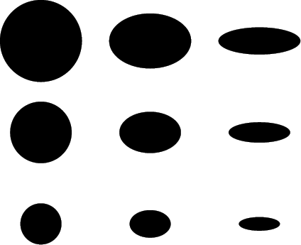
Changes in surface orientation causes projected shape to change (foreshortening)
Changes in surface depth causes projected size to change (scaling)

Slide 5
Sources of Information about 3D Structure
Ocular-motor Cues
Single Image Cues
Familiar Size
Linear Perspective
Texture Gradients
Shading and Shadows
Multiple image cues
Binocular Disparity
Motion

Slide 6
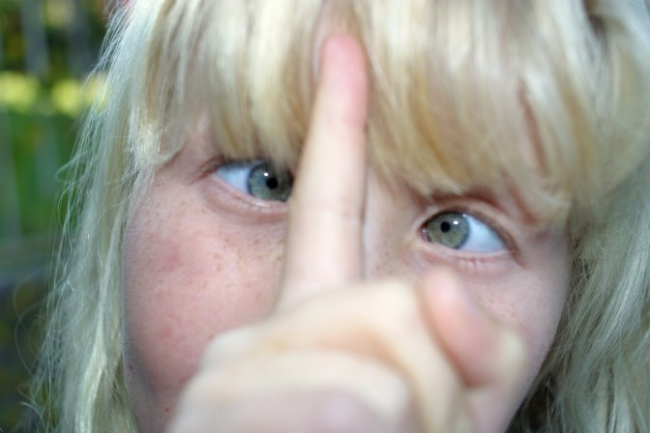

Slide 7
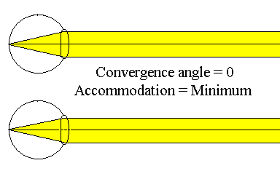
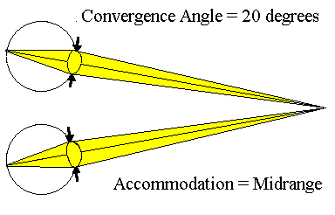
In principle, the distance of an object could be determined by the state of accommodation or convergence, but human observers are not very sensitive to this information

Slide 8
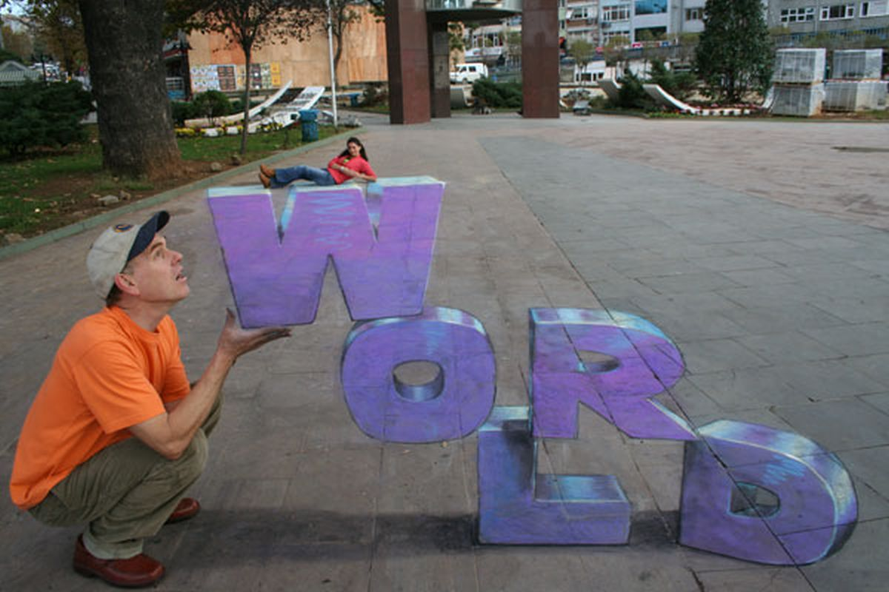
Familiar Size
In this case familiar size is overridden by other accidental properties

Slide 9
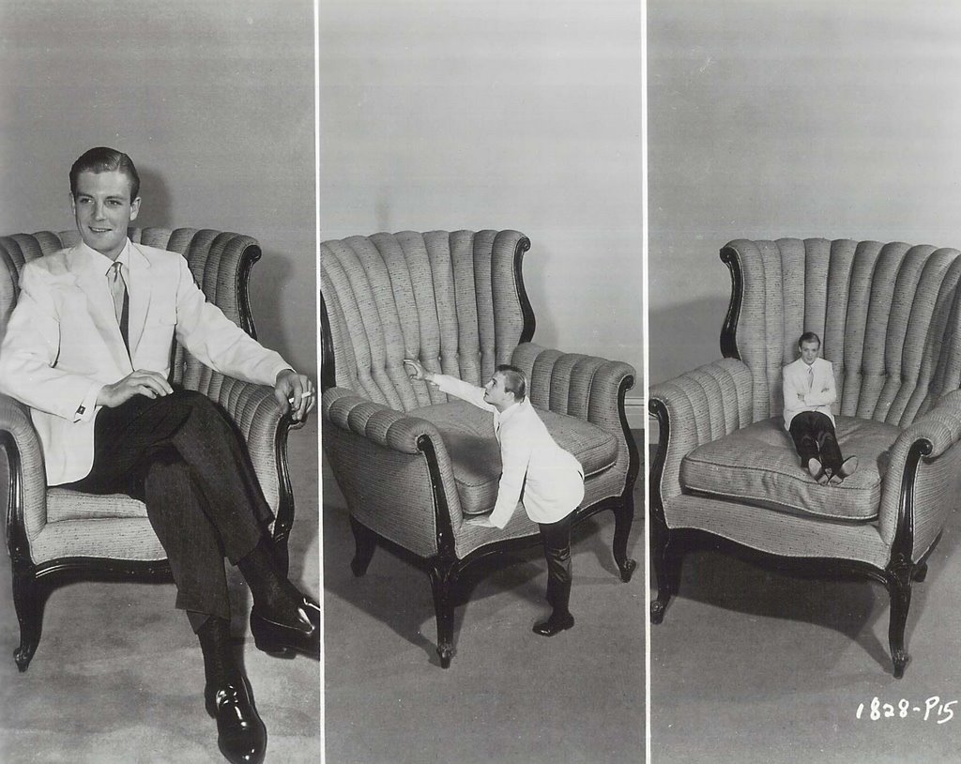

Slide 10
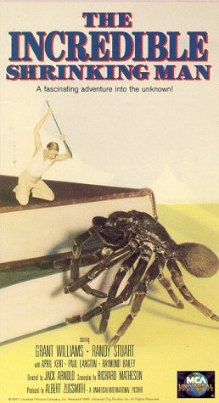
Overriding familiar size is the basis of many “B” science fiction movies
1957

Slide 11
1958

Slide 12
1993

Slide 13
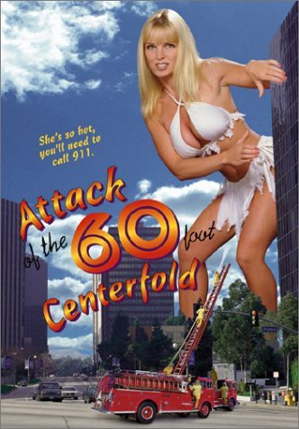
1981
1989
1995

Slide 16
Linear Perspective

Slide 17
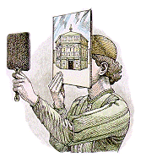
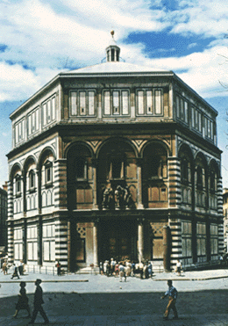
Brunelleschi’s Panel
Around 1413, Filippo Brunelleschi painted a picture of the Baptistry in Florence on a burnished silver surface, right on top of its own reflection. To demonstrate that his painting was an exact replica that could fool the eye, he drilled a small hole in the surface and then stood directly in front of the Baptistry, looking through the peephole to see the real building. He then held up a second, mirror in front of his painted panel. The second mirror blocked the view of the real building, but reflected his painted version. Observers were amazed that the two images appeared nearly identical.

Slide 18
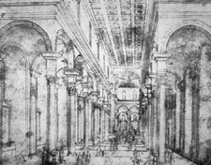
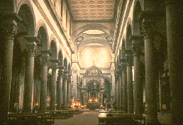
Brunelleschi, 1417
Drawing for Church of Santo Spirito.
In 1417, Brunelleschi was trying to obtain a commission to design the Church of Santo Spirito. He produced the drawing on the left to show his clients how the church would look after it was completed. A photograph of the actual church is shown on the right. Notice how the lines all converge to a vanishing point at the back of the church. This new technique, called linear perspective, was a revolutionary development in the history of art.

Slide 19
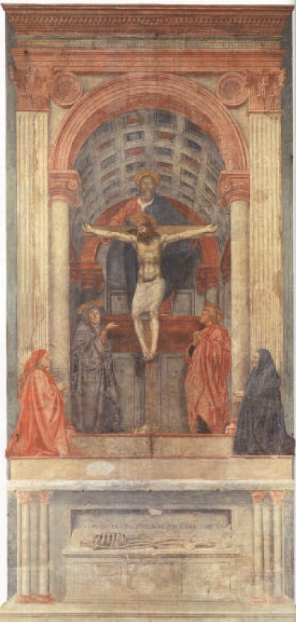
Masaccio, The Trinity, 1427
Tommaso Masaccio learned the technique of linear perspective from Brunelleschi, and he was the first to apply it to painting in a rigorous manner
This fresco is generally believed to be the first painting in which he employed the technique.
Note how the lines from the vault converge to a single vanishing point.

Slide 20
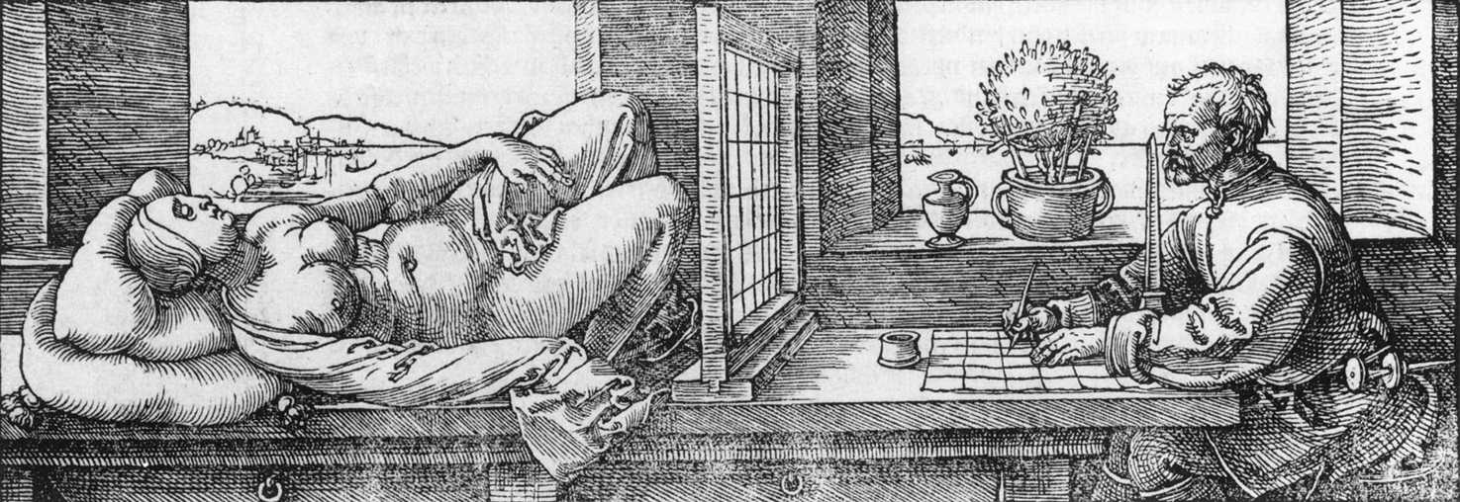
Draughtsman Drawing a Recumbent Woman, Albrecht Durer, 1525
We do not know how far Brunelleschi developed his system in mathematical terms, but it was not long before someone did. In 1435, Leon Battista Alberti published a treatise on perspective, Della Pitture. Alberti conceived of the canvas as an open window through which the subject to be painted is seen. The term perspective comes from comes from the Latin word perspectiva, which means a view through something. This idea of the drawing surface as a window, led to the development of special devices to aid the artist in producing more accurate perspective paintings.

Slide 21
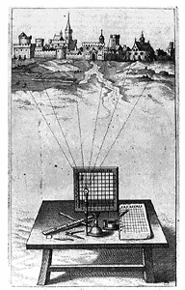
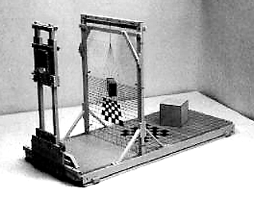
Examples of drawing aids used during the Renaissance that are based on the idea of Alberti’s window. The artist views the scene through a window with a grid and then reproduces the projection on a drawing surface that has a corresponding grid.

Slide 22
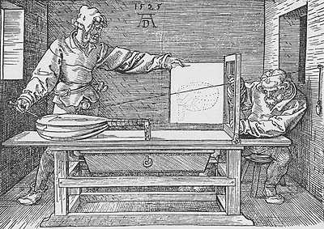
Albrecht Dürer , Man Drawing a Lute, 1525
Hieronymus Rodler (1531)
Renaissance woodcuts that depict the use of Alberti’s window in order to produce more realistic drawings.

Slide 23
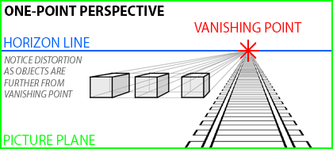

Slide 24
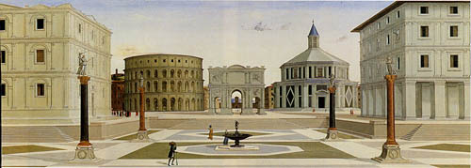
View of an Ideal City, Unknown Artist, c. 1490-1500

Slide 25
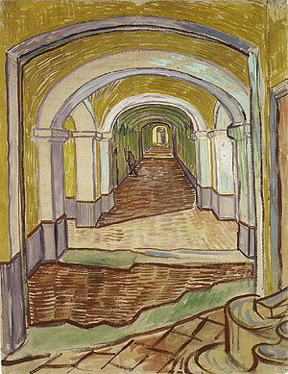
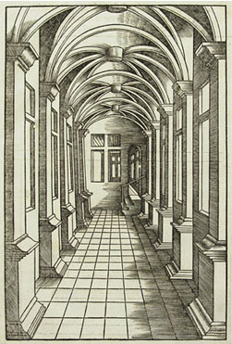
A Corridor in the Asylum, Vincent van Gogh, 1889
A Vault the way you’d like it, Hieronymus Rodler, 1531

Slide 26
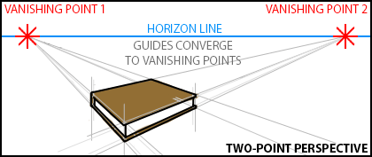

Slide 27
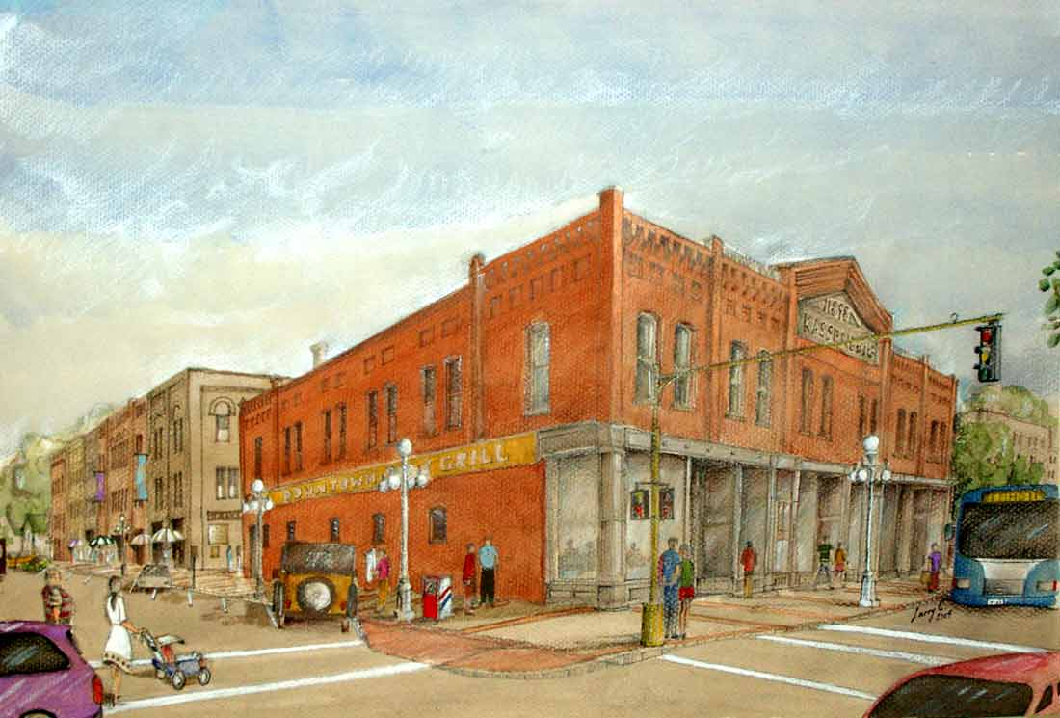

Slide 28
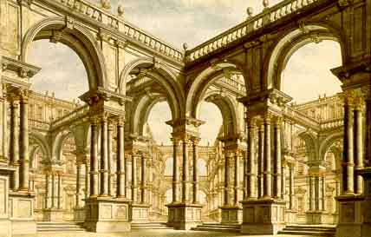
Corte con Arcate, Giuseppe Galli Bibiena , 1746

Slide 29
The Yellow House, Vincent van Gogh, 1888

Slide 30
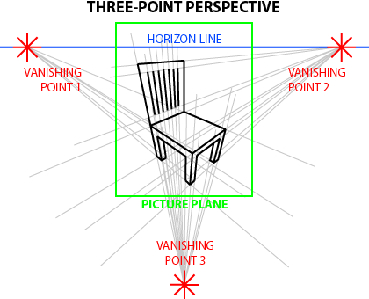

Slide 31
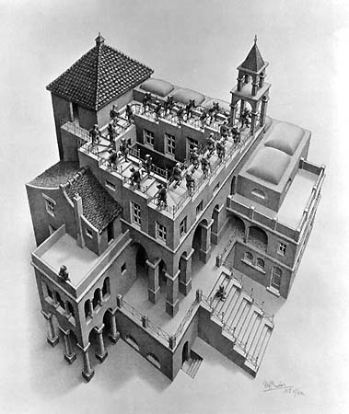
Ascending and Descending, M. C. Escher, 1960
Note the use of a never ending impossible staircase

Slide 33
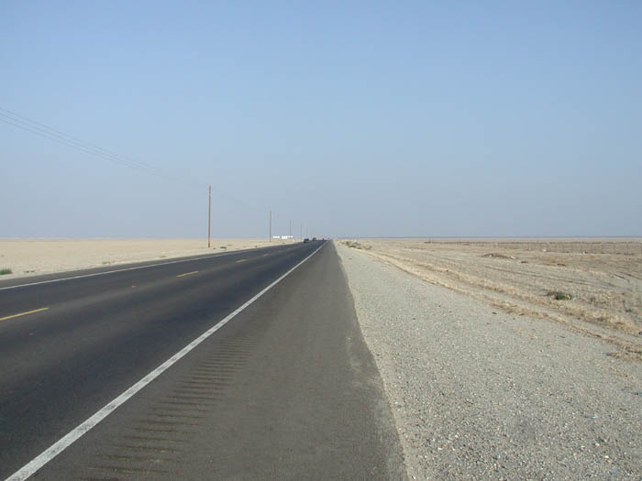
The Horizon Ratio
Which object is taller?

Slide 34
The Horizon Ratio
The ratio of an object’s projected height relative to the height of the horizon specifies physical size in units of eye height.
Taller than eye height
Shorter than eye height

Slide 35
The height of an object’s base with respect to the horizon specifies its distance in depth.
Farthest
This assumes that objects are in contact with the ground
Nearest

Slide 36
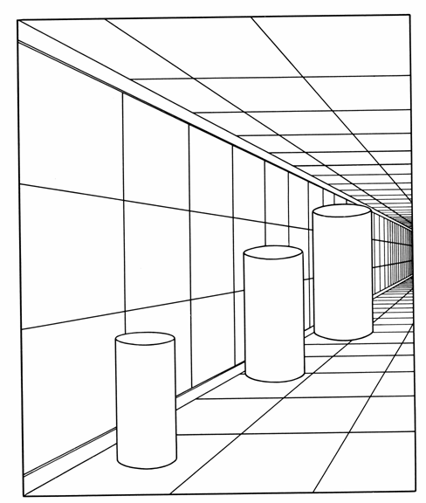
Apparent distance can have a strong effect on apparent size.
The projected sizes of all three cylinders are the same, yet their apparent sizes are quite different.

Slide 37
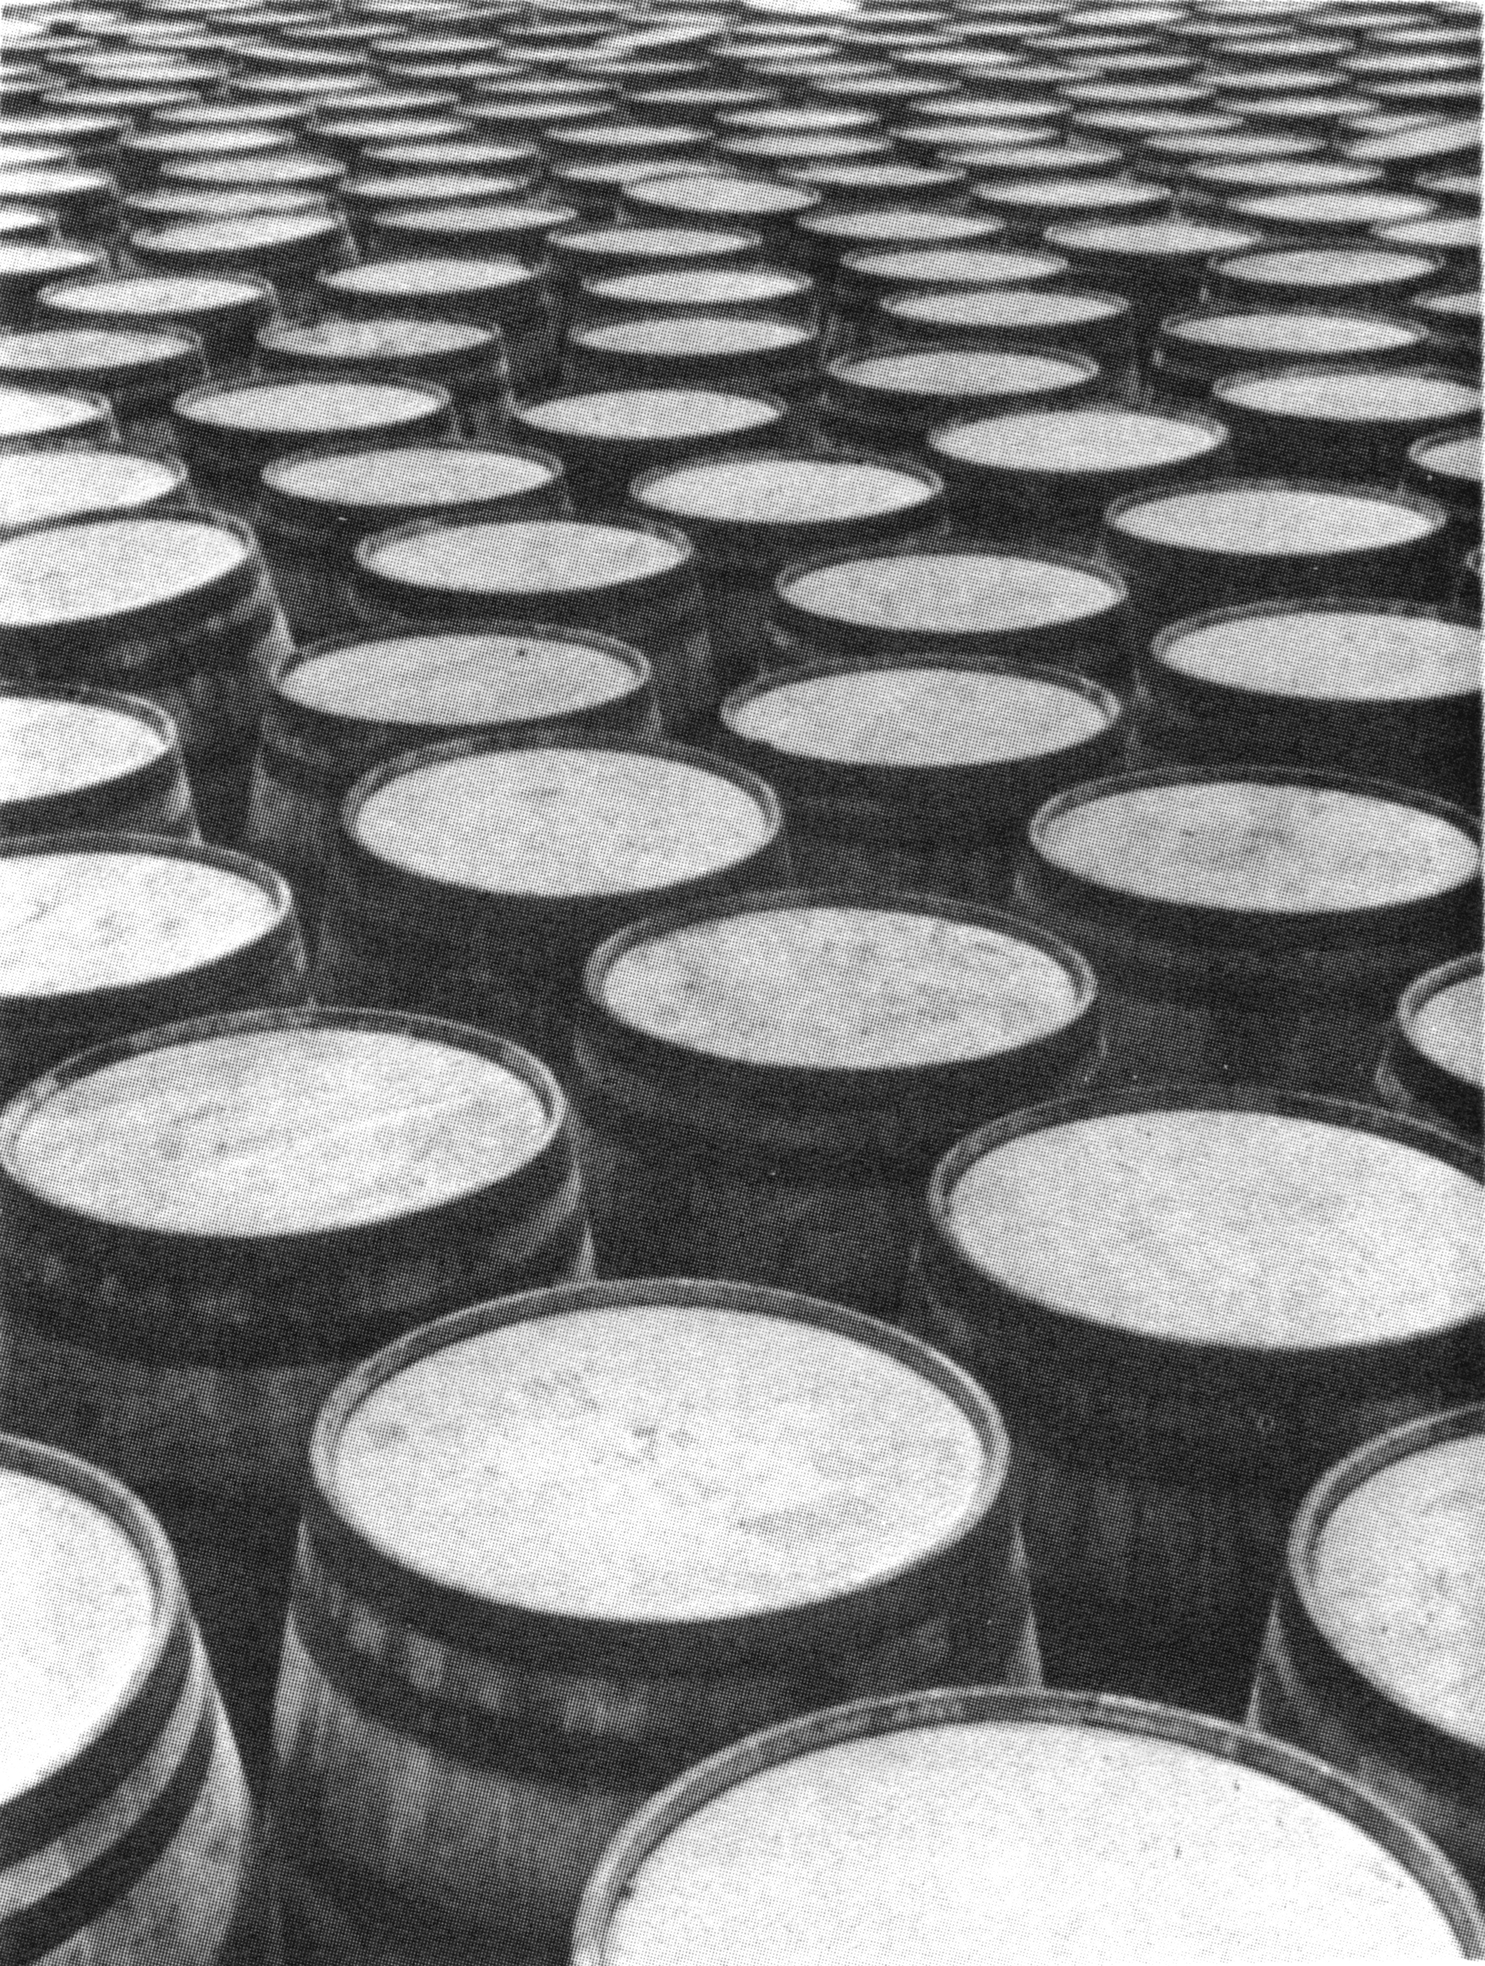
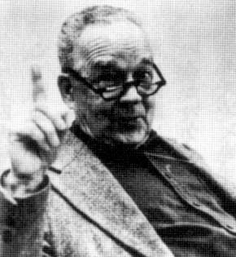
Shape from Texture
James J. Gibson, 1904-1979
From the “Perception of the Visual World” 1950

Slide 38
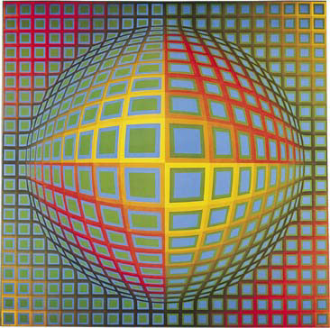
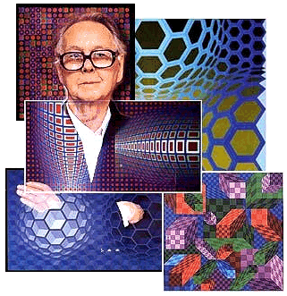
Victor Vasarely, 1906-1997
Vega-Nor, 1969

Slide 39
Victor Vasarely, Dyss, 1971

Slide 40
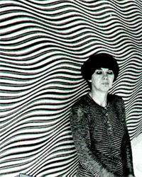
Bridget Riley
Green, Blue and Red Dominance, 1977

Slide 41
Bridget Riley, Winged Curve, 1966

