Slide 1
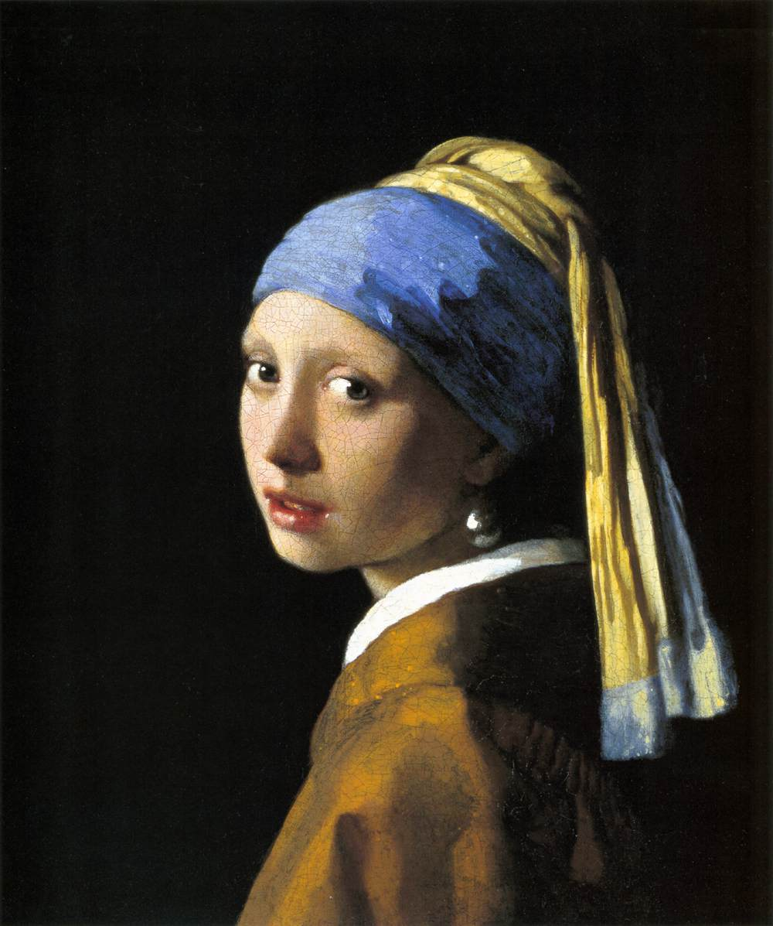
Lecture 21 – 3D Structure 2

Slide 2
Sources of Information about 3D Structure
Ocular-motor Cues
Single Image Cues
Familiar Size
Linear Perspective
Texture Gradients
Shading and Shadows
Multiple image cues
Binocular Disparity
Motion

Slide 3
Shape from Shading
Shading provides information about 3D shape, material properties and the pattern of lighting.

Slide 4
Medieval Shading
No light source, or at eye of viewer
Techniques:
Change in the SHADE: add black as surface faces away from viewer
Change in the TINT: add white as surface faces viewer
Or change in saturation of color

Slide 5
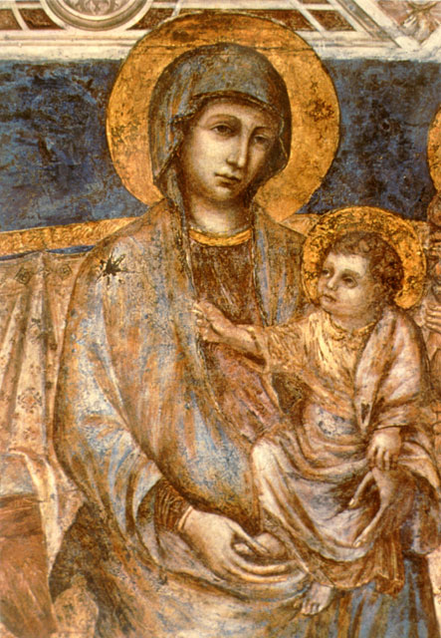
Cimabue (1200) Madonna and Child

Slide 6
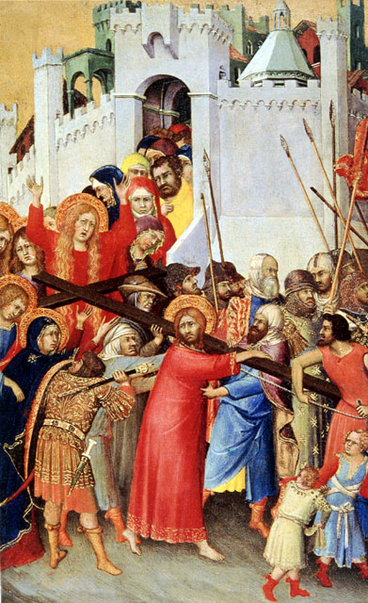
Martini (c. 1340) The road to Calvary

Slide 7
Renaissance shading
Chiaroscuro (light and dark)
Shading varies with orientation of surface to light source, not viewer
Consistent lighting direction
Use of the light to:
Unify the scene
Give 3D appearance to the objects (modeling)
Create emotional effects

Slide 8
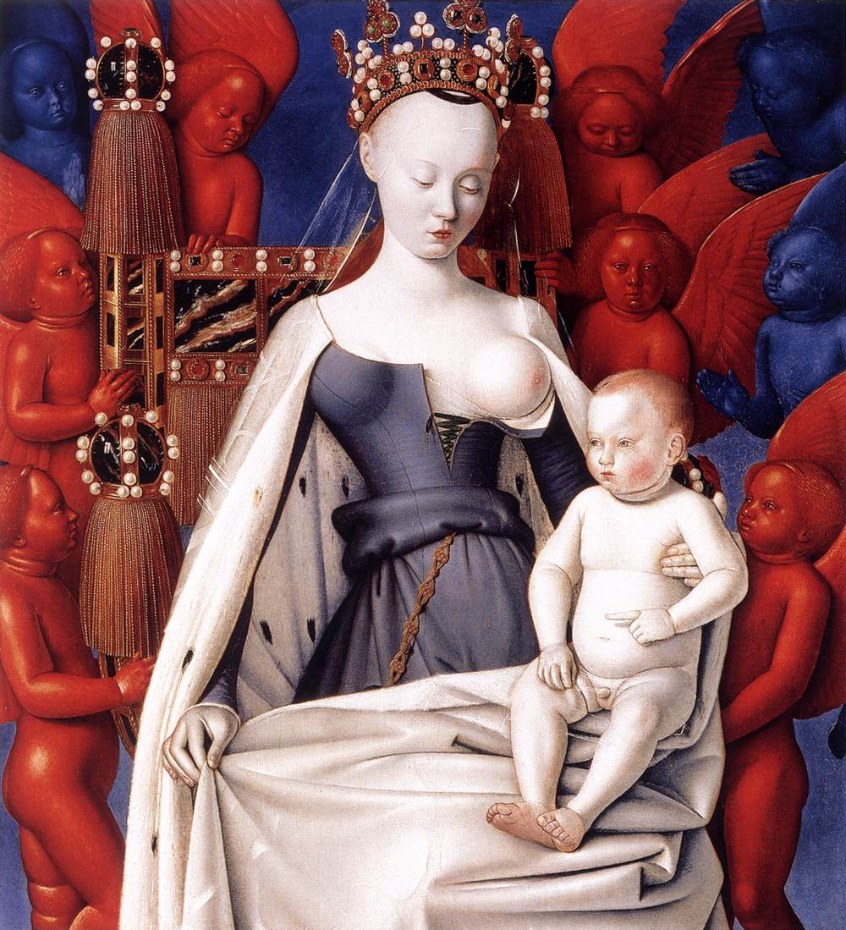
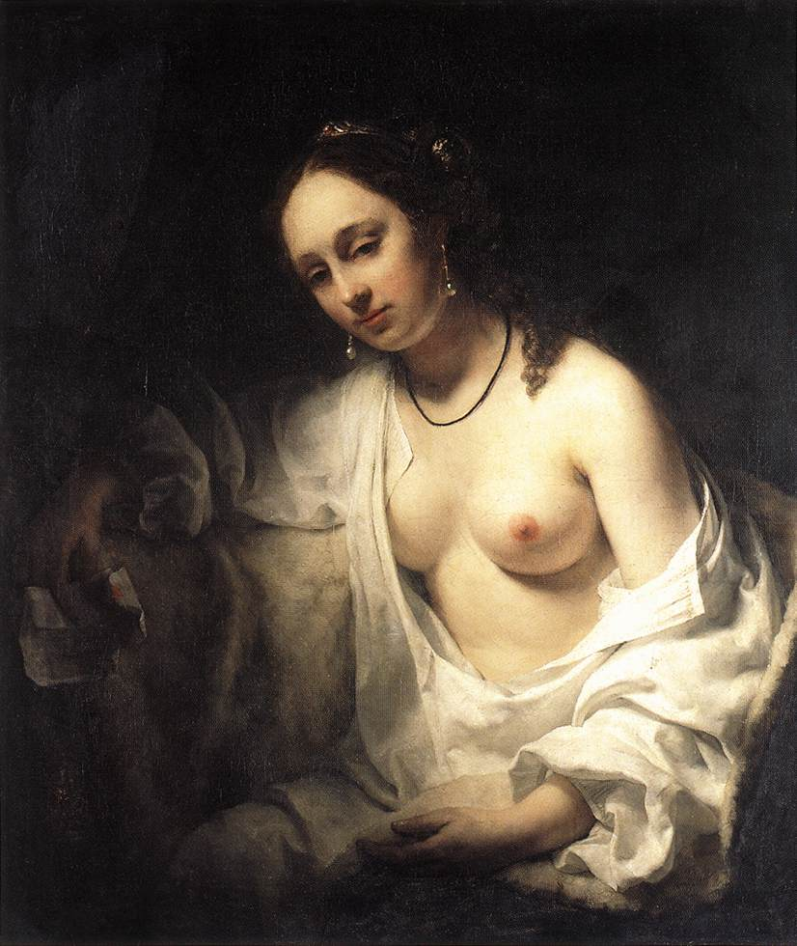
Jean Fouquet, Virgin and Child Surrounded by Angels, 1450, Koninklijk Museum, Antwerp
Willem Drost (1654) Bathsheba, Louvre, Paris.

Slide 9
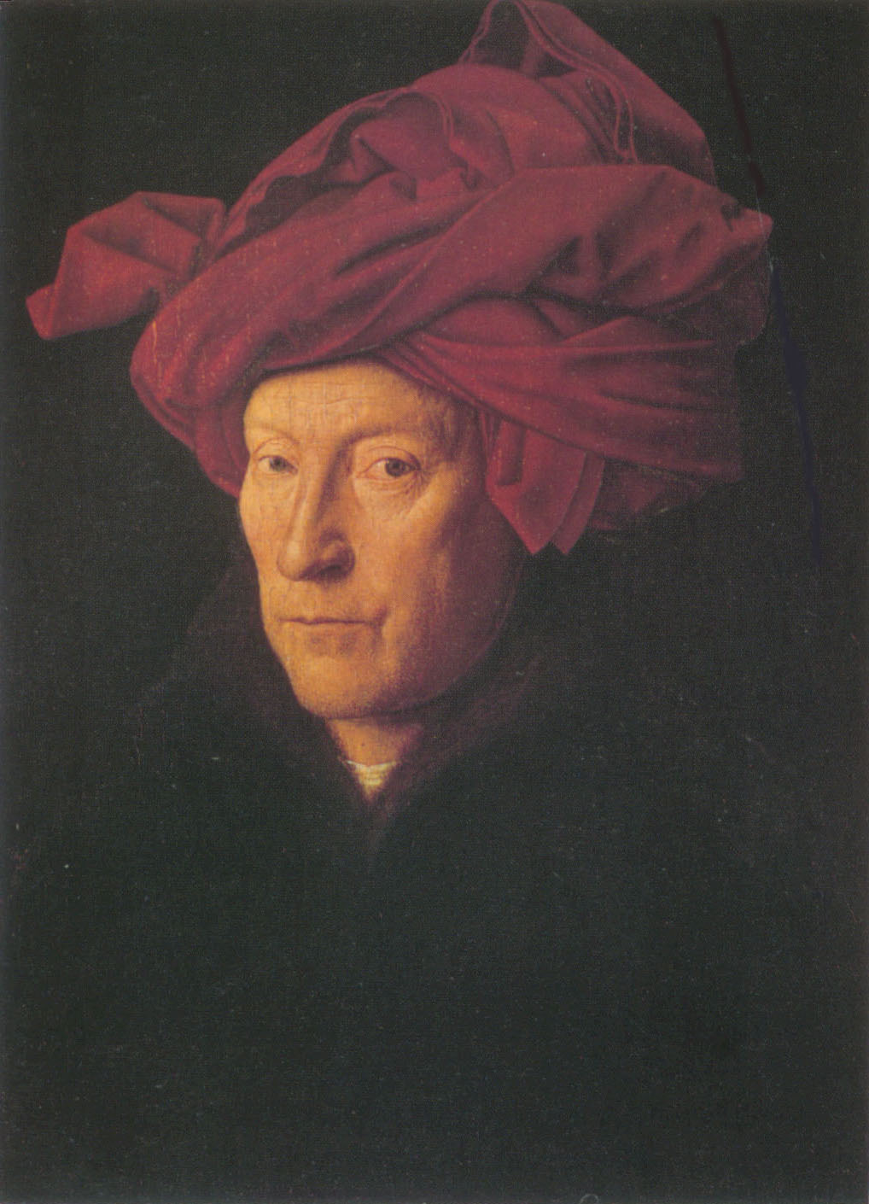
Van Eyck (1433) Man in red turban

Slide 10
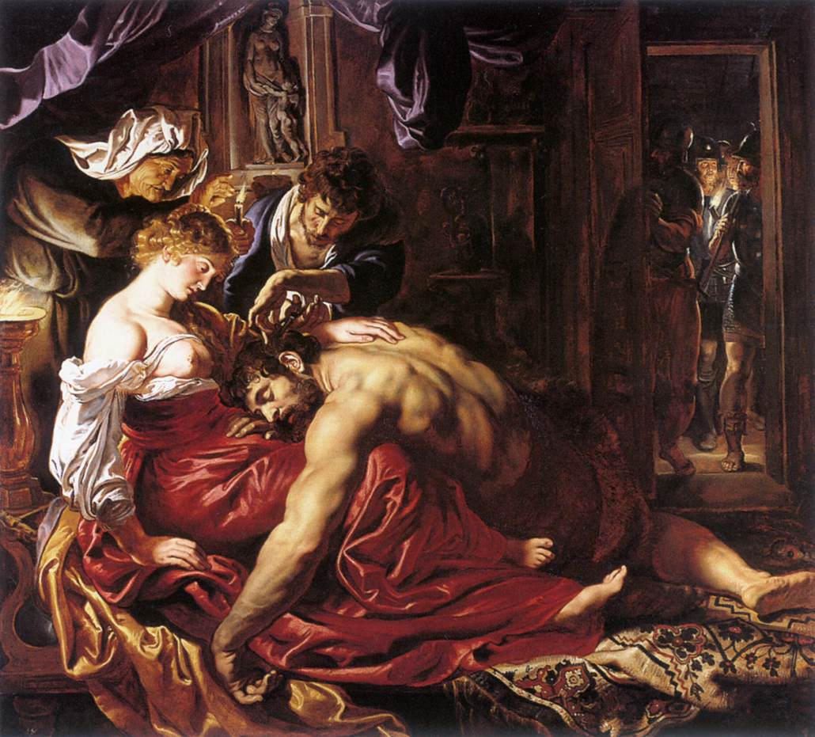
Rubens, Samson and Delilah, 1609, National Gallery, London

Slide 11
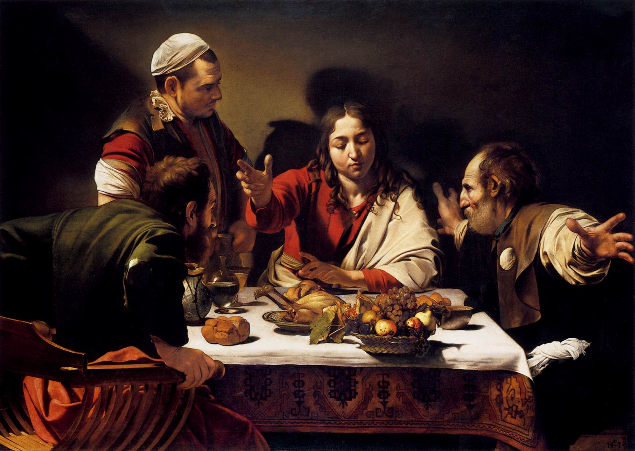
Caravaggio, Supper at Emmaus, 1601, National Gallery, London

Slide 12
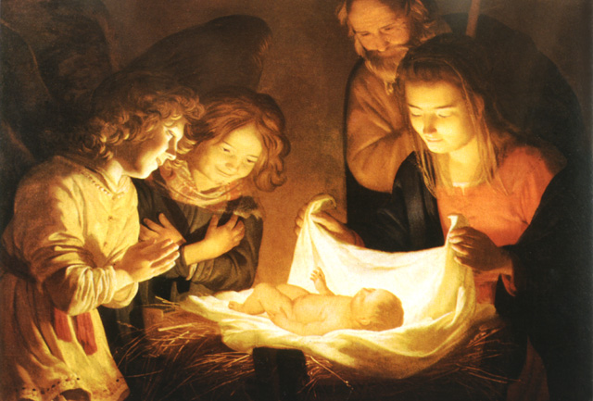
Van Hontorst (1620) Nativity

Slide 13
Johannes Vermeer, Girl with a Pearl Earring, 1665, Mauritshuis, The Hague

Slide 14
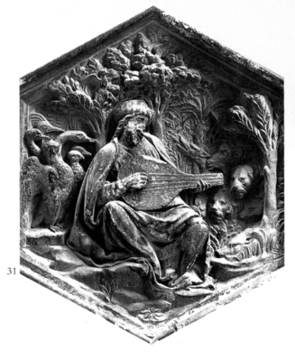
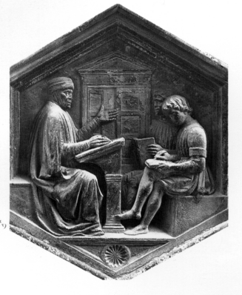
Bas-Relief
This is a type of sculpture in which the relief of the depicted objects is much flatter than would ordinarily be the case. Note, however, that this has relatively little effect on the perceived 3D structure.

Slide 15
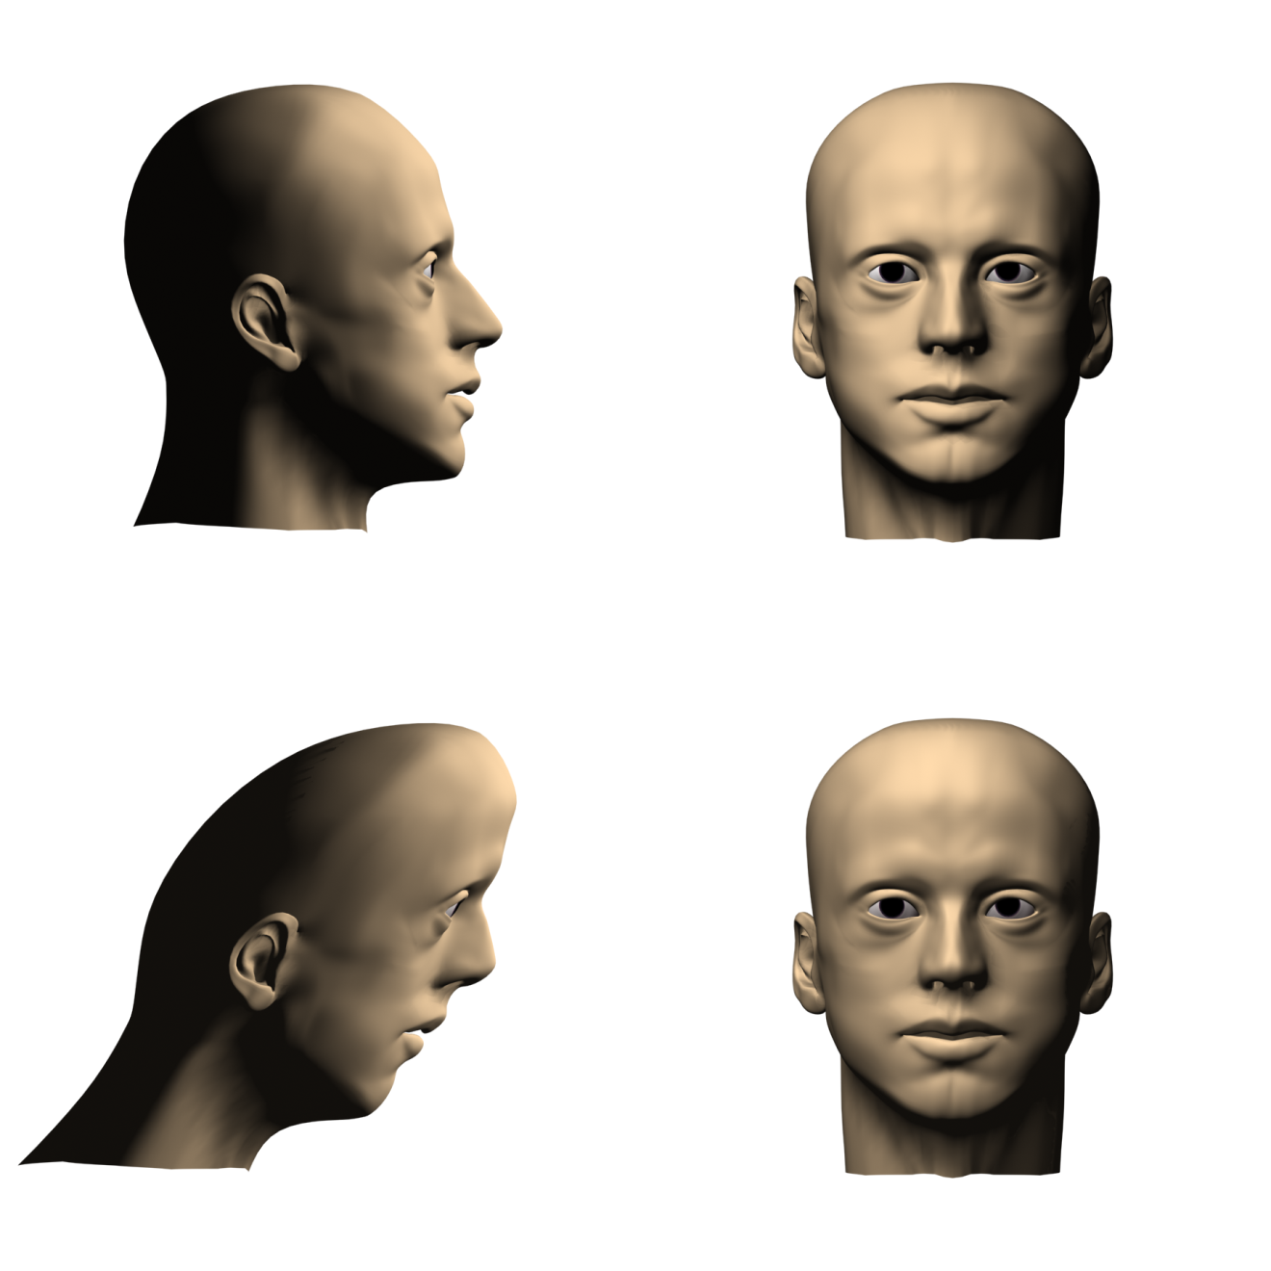
Object 1, side view
Object 1, front view
Object 2, side view
Object 2, front view
Shading information is inherently ambiguous up to a stretching or shearing transformation in depth. It is not yet known how a single perceived surface is selected for the set of possible alternatives.

Slide 16
Binocular Disparity

Slide 17
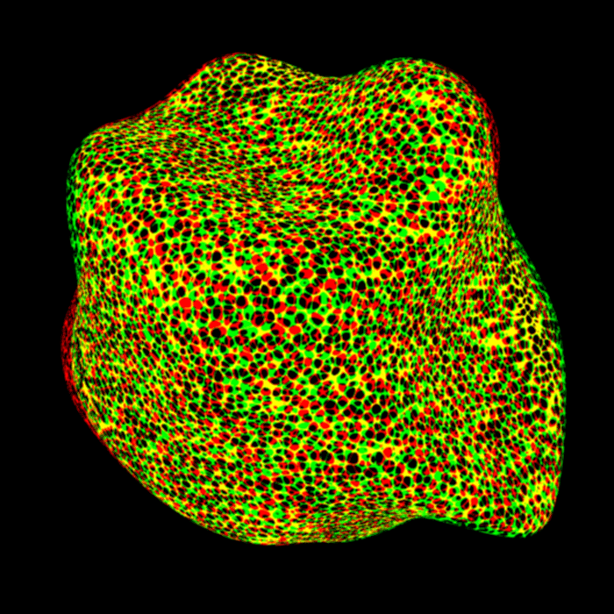

Slide 18
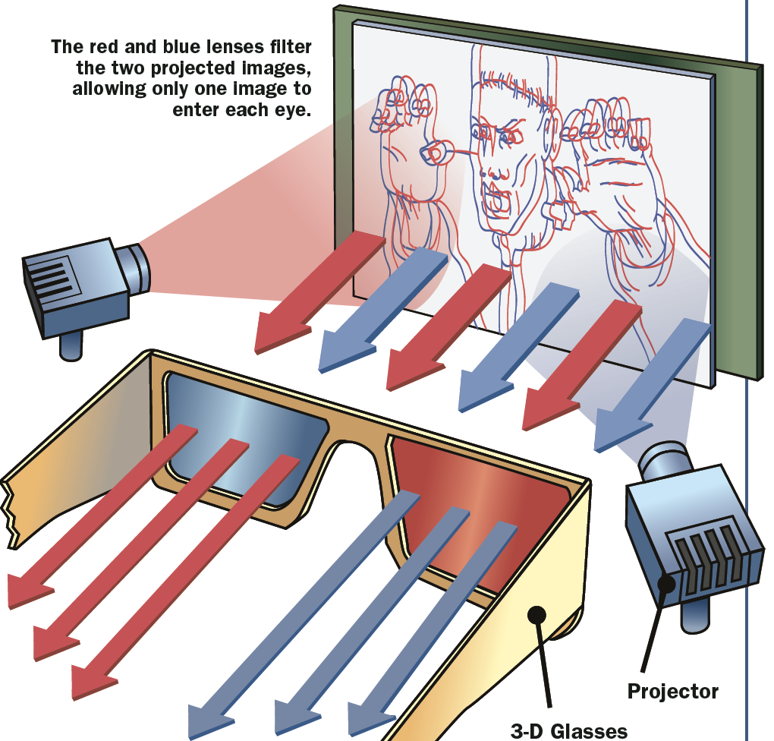
Anaglyph Stereograms

Slide 19
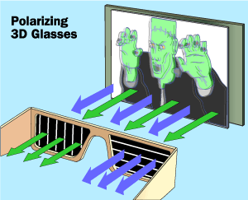
Light waves involve oscillations in electric and magnetic fields
Polarized lenses only pass light whose oscillations are oriented in a particular direction

Slide 20
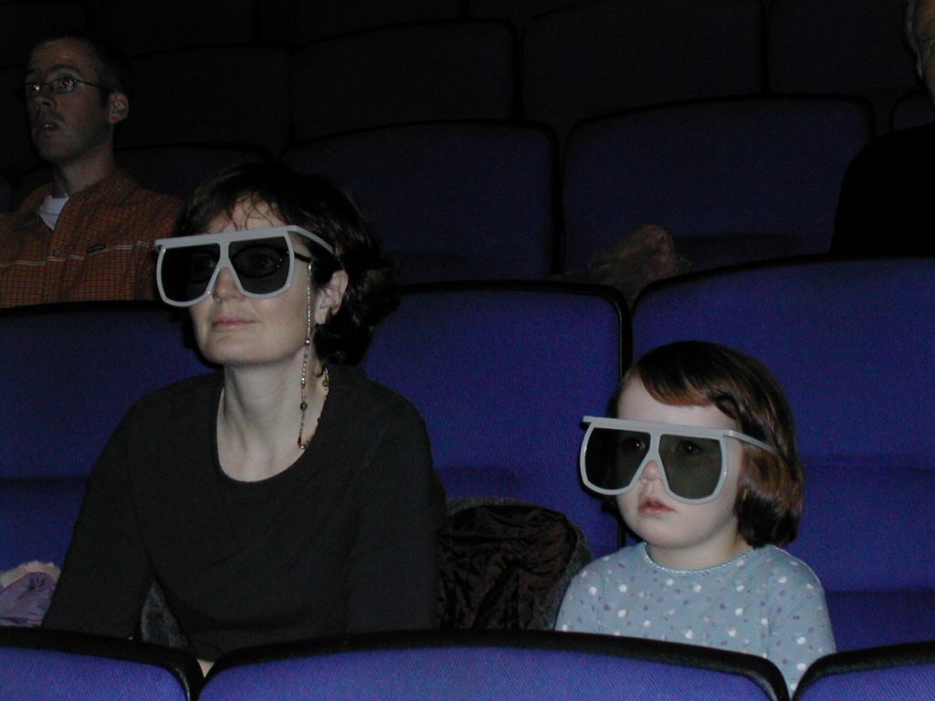
Companies like IMAX© use polarized glasses to show movies in stereo

Slide 21
Zero Disparity – right eye’s image and the left eye’s image are at the same location. Point is located in the the image plane.

Slide 22
Crossed Disparity – right eye’s image is to the left of the left eye’s image. Point is in front of the image plane.

Slide 23
Uncrossed Disparity – right eye’s image is to the right of the left eye’s image. Point is behind the image plane.

Slide 24
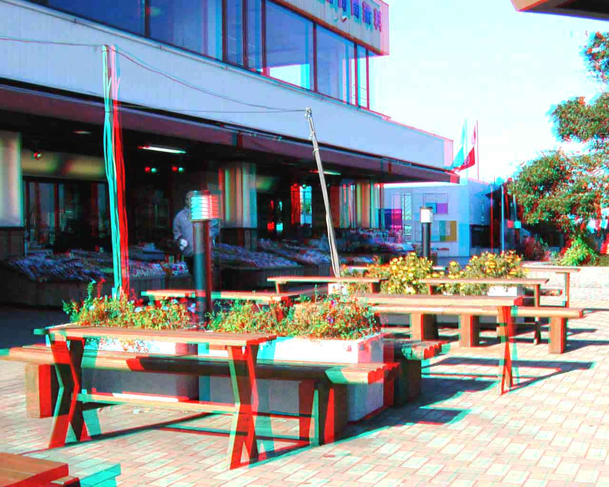

Slide 25
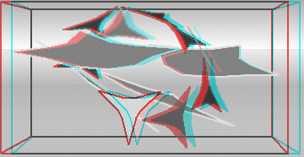

Slide 26
It is possible to experience stereopsis by crossing (or diverging) your eyes to make the images visually fuse.
The following two examples are designed for convergent viewing. To see the stereo effect you must cross your eyes (i.e., converge to a point in front of the image) so that you see three equally wide panels. Many observers find this to be quite difficult, so it is possible that you will be unable to achieve the effect

Slide 27
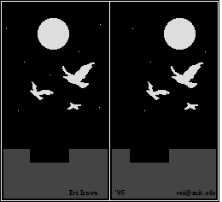

Slide 28
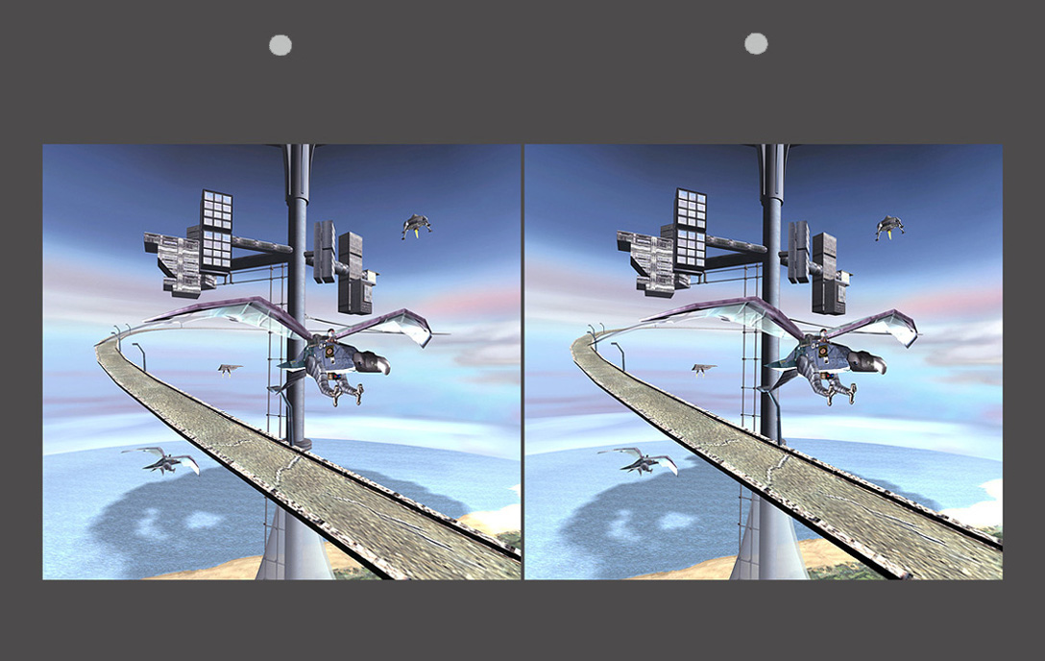

Slide 29
The Correspondence Problem: For random dot stereograms like the one shown above, the visual system must figure out which dot in one eye should be paired with which dot in another. That is why many observers find it easier to see stereo in images with identifiable features.

Slide 30
The following stereogram is designed for divergent viewing. In order to see it correctly you must point your eyes to a point that is behind the image. If you do this correctly you will see two star shaped donuts floating in front of the background.
It helps to have a visible object behind the monitor to help you focus your attention. If instead you see a surface with spikes sticking out then you have fused it by converging your eyes rather than divergence.

Slide 31
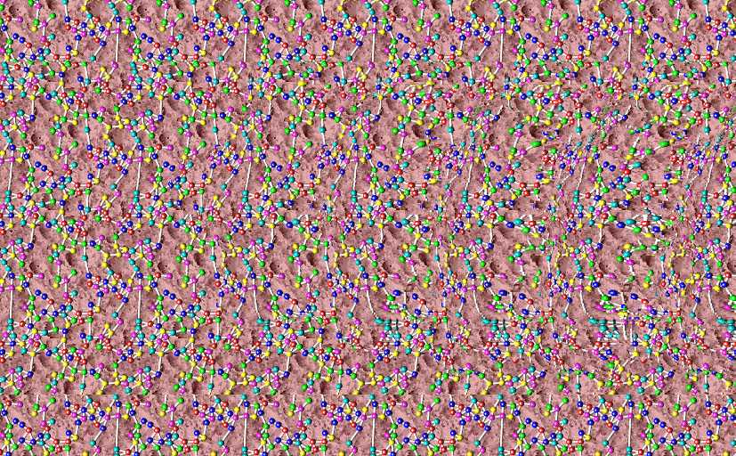

Slide 32
Corresponding retinal points
Points at the same position on each eye correspond to one another – i.e. they have the same retinal coordinates.

Slide 33
The Horopter
The locus of distal points that produce corresponding points on the retinas of the two eyes is called the horopter. The horopter depends on the point of fixation. Thus, binocular depth perception will be relative to the point of fixation.

Slide 34
Non-corresponding retinal points
Distal points that are not on the horopter will be projected to non-corresponding points on the two retinas. The direction of the disparity indicates whether a distal point is in front of the horopter (crossed disparity) or behind the horopter (uncrossed disparity).

Slide 35
The angle of disparity
The angle of disparity for any given point is typically defined as the difference in retinal coordinates between the optical projections of that point in the left and right eye.

Slide 36
3D Structure from Motion
A 2D pattern can appear 3D when observed in motion. Click the pattern to start or stop the motion. This effect works best when viewed with one eye.

Slide 37
When this display is observed in motion it creates the impression of a smoothly curved surface. Note how the surface recedes into the background when the motion stops.

Slide 38
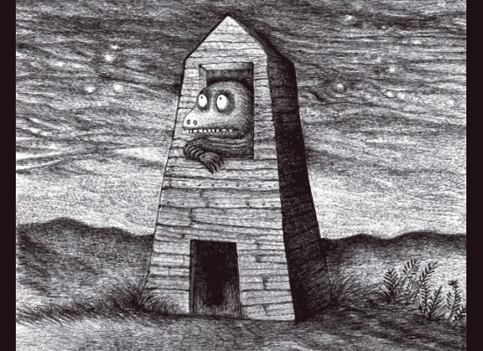
Dain Fagerholm

Slide 39
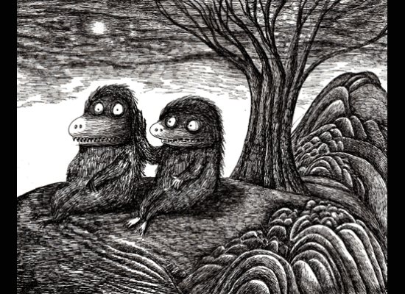
Dain Fagerholm

Slide 40
The Ball in the Box
In this demonstration the perceived motion of the ball is influenced by the motion of its shadow. When the shadow moves with the same trajectory as the ball, the ball appears to be rolling on the ground. When the shadow moves with a different trajectory, the ball appears to be rising above the ground.

Slide 41
Shadow Induced Motion in Depth
In this demonstration the green square undergoes no changes whatsoever. However, the changes of its shadow creates the impression that the square is moving forward and backward in depth.

