Slide 1
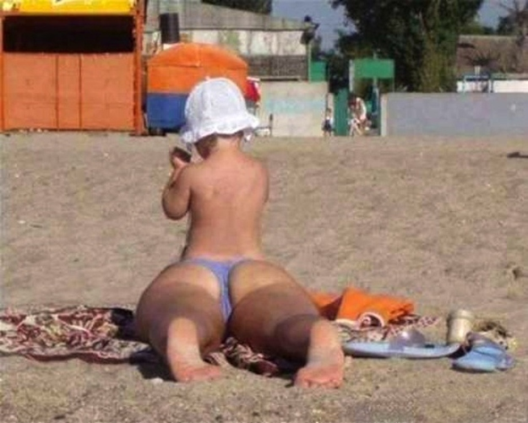
Lecture 17 – Biases in Perception

Slide 2
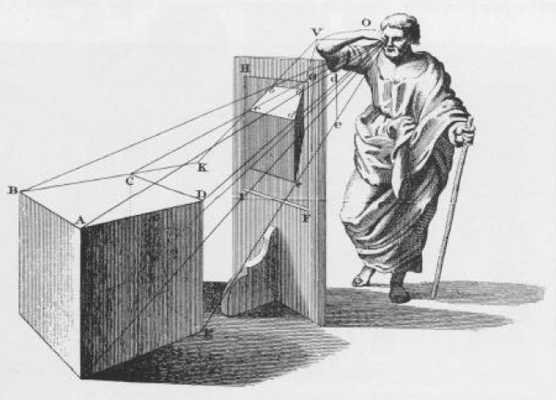
Projective Geometry
Projective geometry investigates the mathematical relationships between objects in the environment and their optical projections on the retina or on a picture.

Slide 3
Structure of the Environment Φ
Λ = f(Φ)
Structure of light Λ
Physiological Processes
Computational Algorithms
Prior Knowledge
A Miracle Occurs
Perception of the Environment Ψ

Slide 4
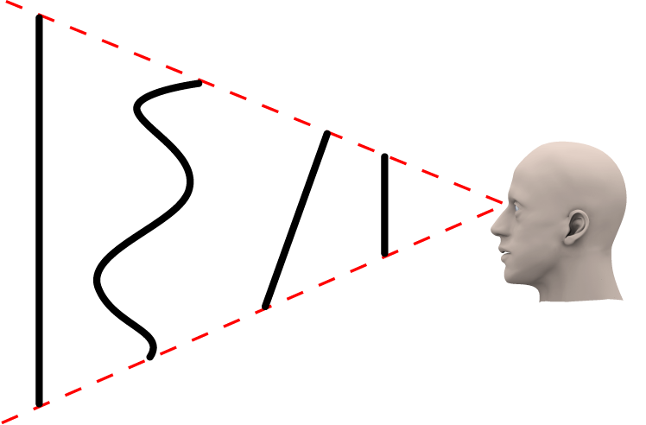
The optical projections of objects are inherently ambiguous. For example, all of the black lines shown below would produce exactly the same image on the observer’s retina. One of the great mysteries of perception is how the visual system is able to resolve this ambiguity to accurately perceive the 3D structure of the environment.

Slide 5
The effects of viewing distance
A bird’s eye view of an observer who is watching an object moving forwards and backwards in depth
This is how the object appears to the observer.
Object Size
Image Size ≈
Viewing Distance

Slide 6
The effects of viewing orientation
A bird’s eye view of an observer who is watching an object that is rotating in depth
This is how the object appears to the observer.

Slide 7
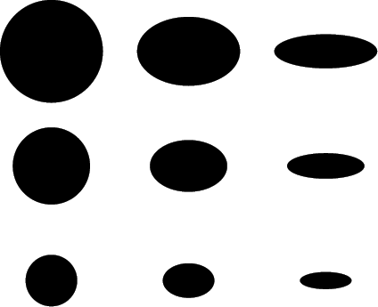
Changes in surface orientation causes projected shape to change (foreshortening)
Changes in surface depth causes projected size to change (scaling)

Slide 8
Foreshortening
Scaling

Slide 9
In order to resolve projective ambiguities, human observers are biased to perceive the interpretation that is statistically most likely in the natural environment.
There are many different biases that can influence the perception of 3D scenes. For example,
Unless there is information to the contrary, objects will be perceived as resting on the ground.
There is a strong bias to interpret scenes such that depth increases with height in the viewing plane.
Convex interpretations are preferred over concave ones.
Interpretations involving generic views are preferred over those that require a specific vantage point.

Slide 10
There is a strong bias to perceive objects in contact with the ground unless there is clear evidence to the contrary,

Slide 11
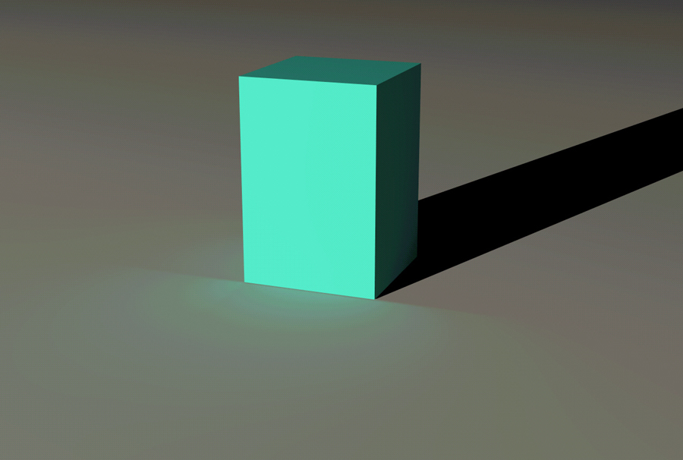

Slide 12
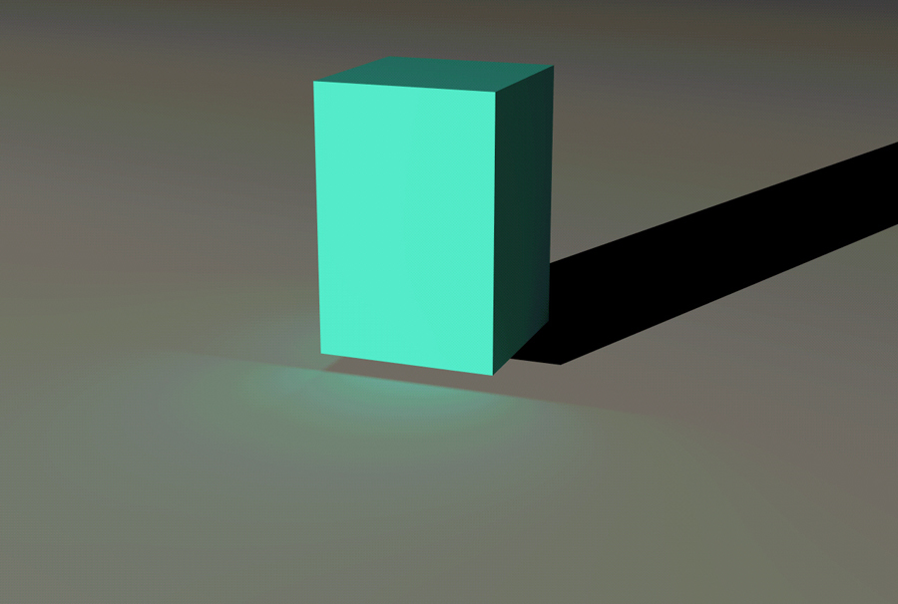
Information from shadows or indirect illumination can override the bias to perceive objects to be in contact with the ground

Slide 13
There is a strong bias to interpret scenes such that depth increases with height in the viewing plane.

Slide 17
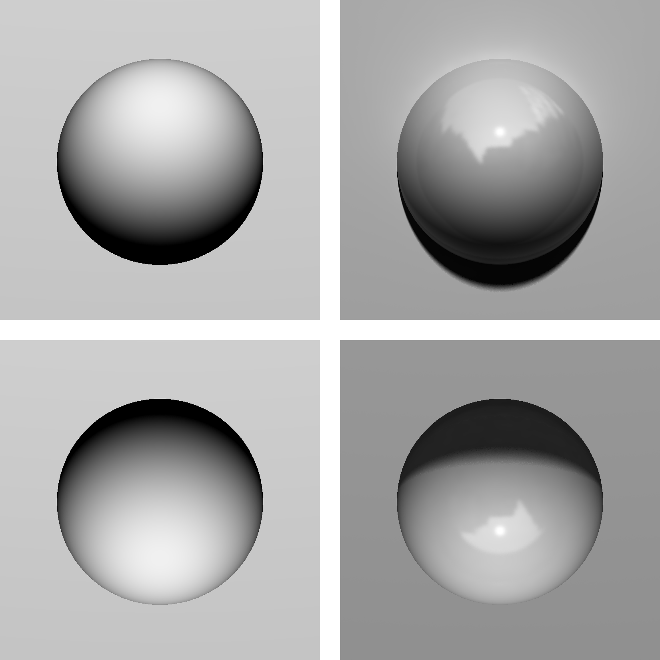
Convex interpretations are preferred over concave ones.
Convex
Concave
Note how the concave regions can appear perceptually as convex, even when there is potential information from the cast shadow to specify the correct sign of relief.

Slide 18
Interpretations involving generic views are preferred over those that require a specific vantage point.
Accidental view
Generic view
Rock Sculpture in Blackhawk, CO

Slide 19
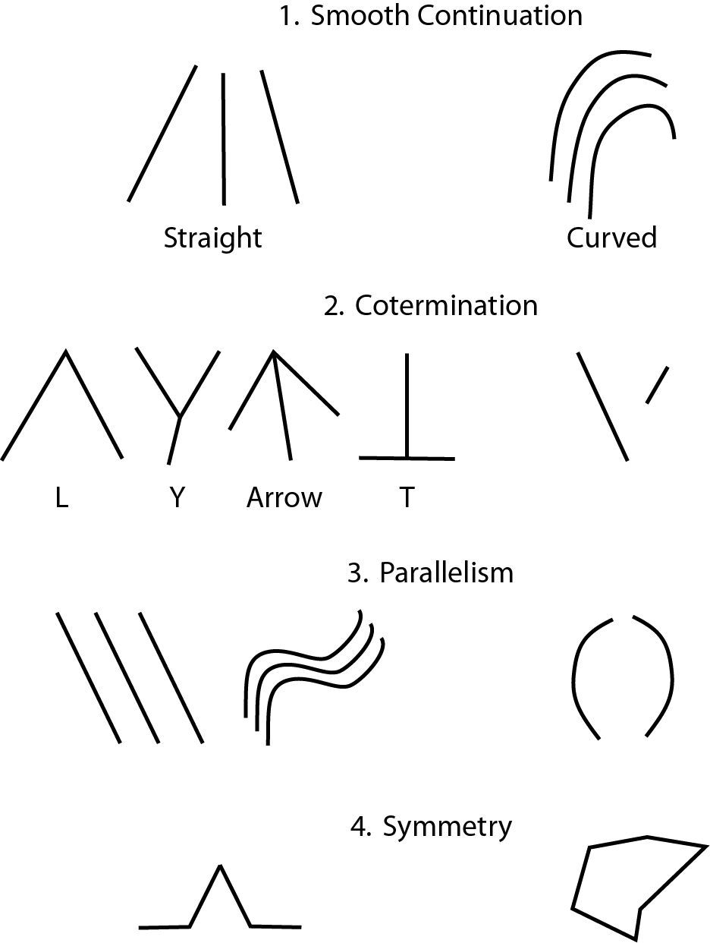
Nonaccidental Properties – are properties of an image such as co-linearity, co-termination or parallelism that seldom occur by accident within optical projections. Thus, if lines in an image are parallel (or co-terminate), they will be interpreted perceptually as if they are parallel (or co-terminating) in the 3D environment.

Slide 21
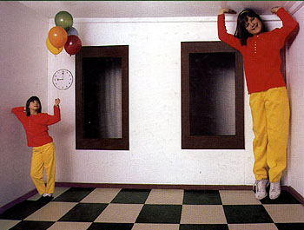

Slide 22
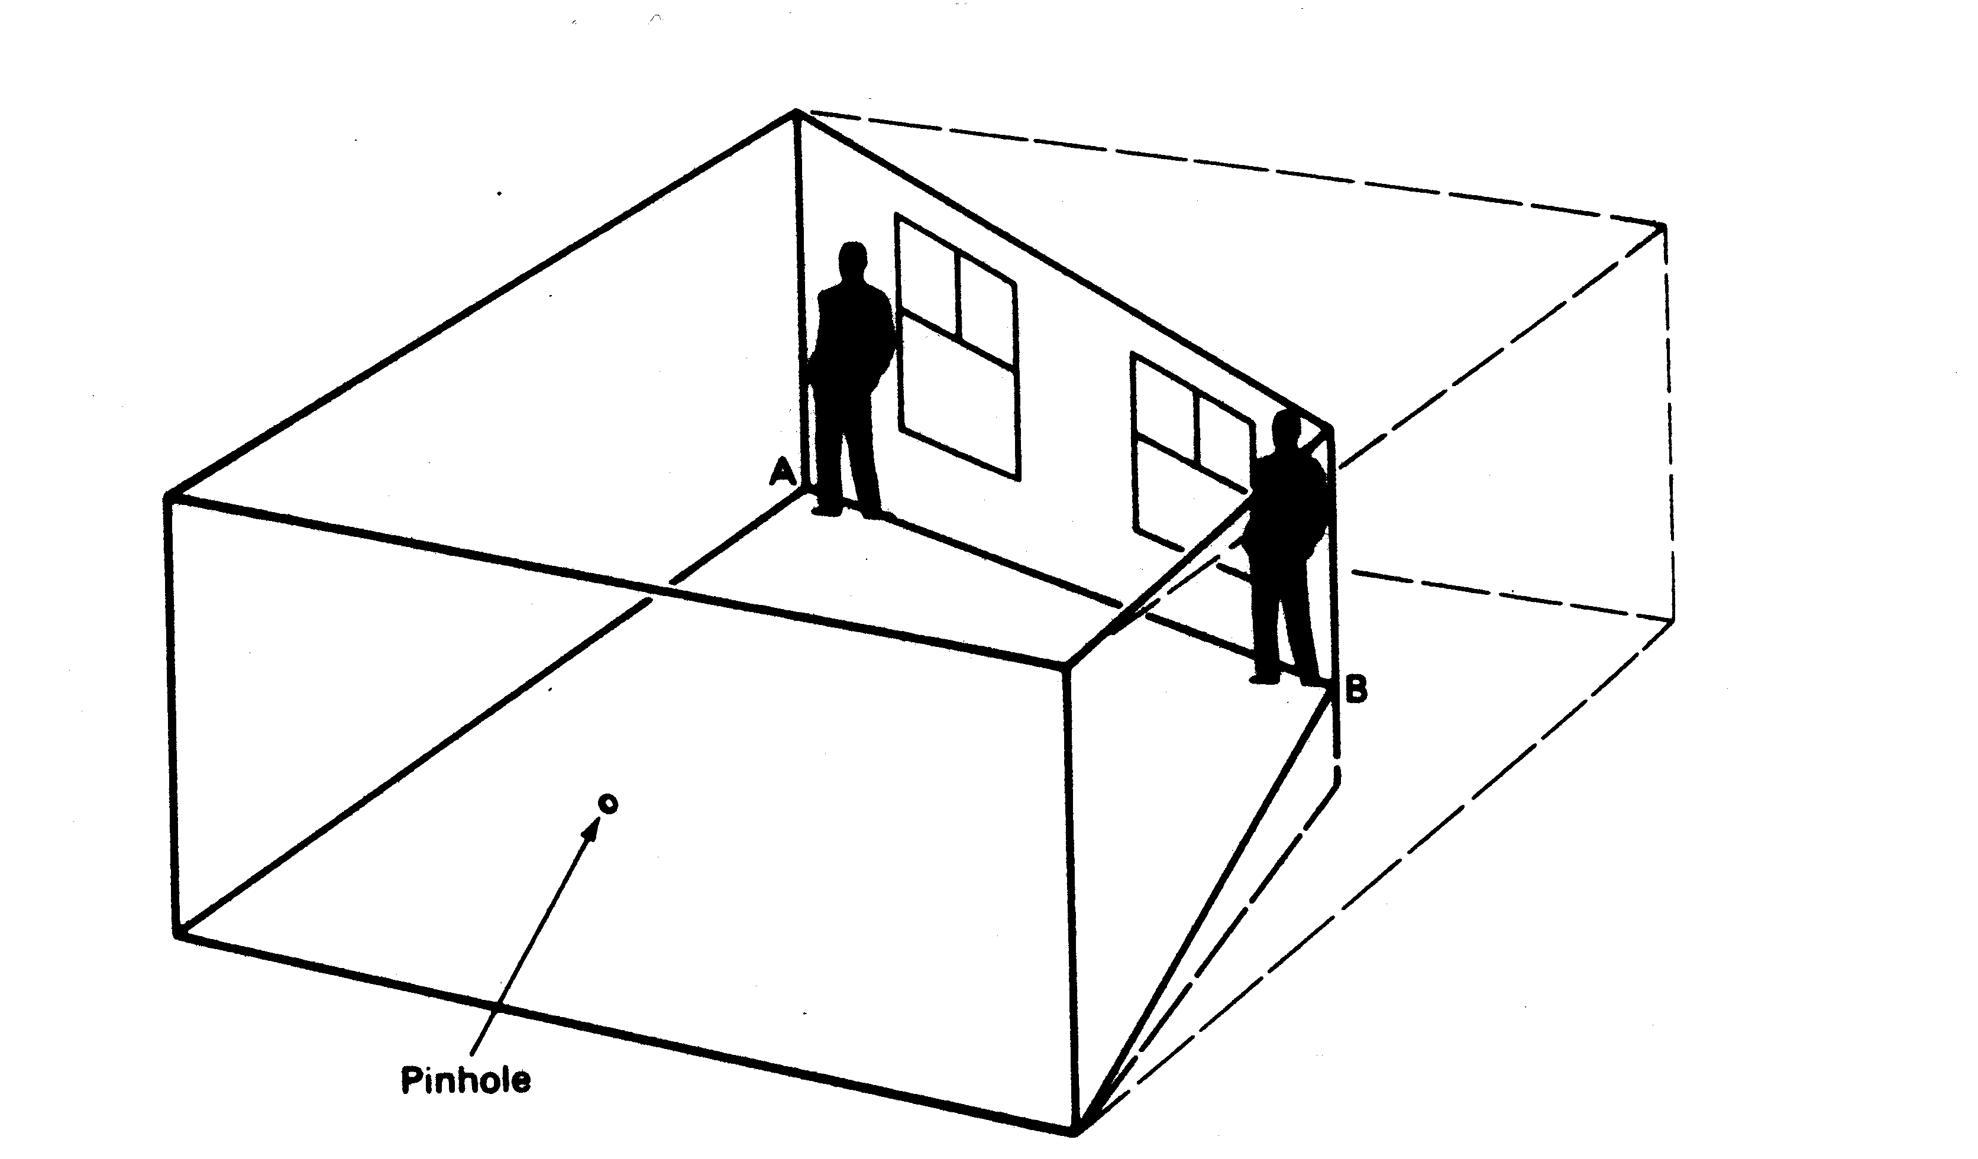
The trapezoidal shape of the room causes an accidental parallel alignment of the back wall when viewed through the peep hole.

Slide 24
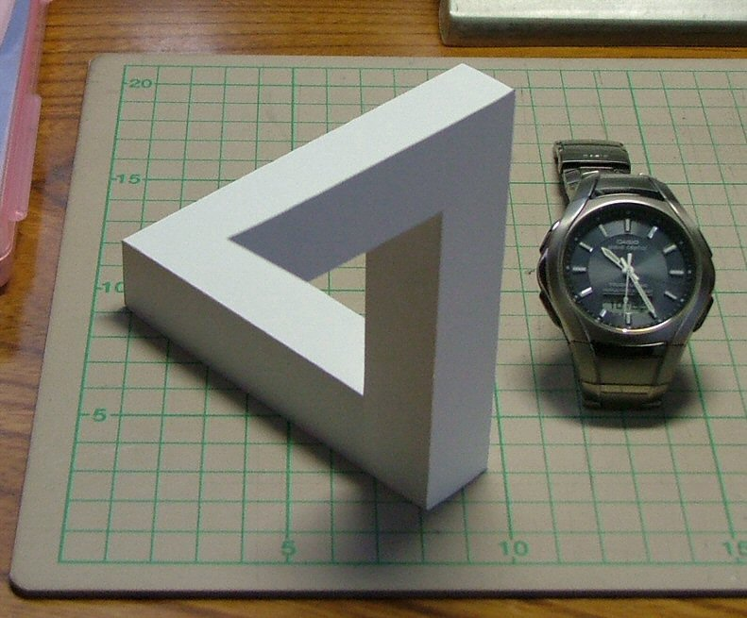
An Impossible Figure – This is a photograph of a real object, but its apparent shape is geometrically impossible. This illusion is created by having an accidental co-termination of the object’s edges.

Slide 25
An Impossible Figure – Here is another animated version of the impossible figure. Adjust the slider to see how the object looks from different viewpoints.

Slide 26
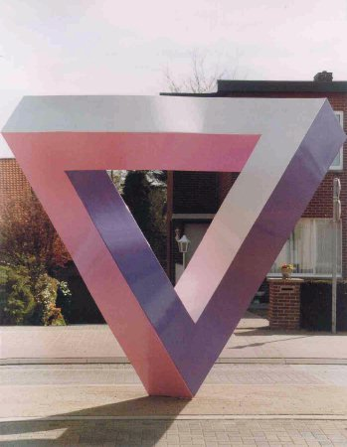
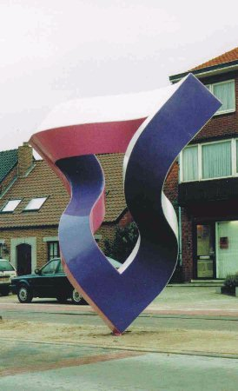
Unity, Mathieu Hamaekers
In this version of the impossible triangle there is an accidental view of curved edges so that they are perceptually interpreted as straight.

Slide 27
An accidental view of curved edges that produces the perception of an Impossible Cube.
Mathieu Hamaekers

Slide 28
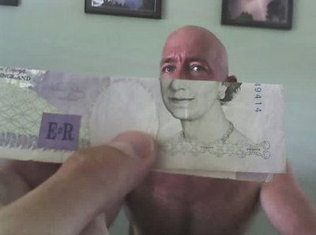
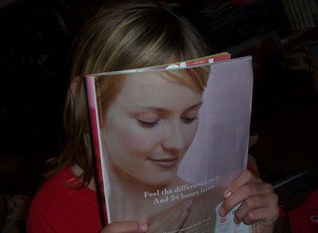
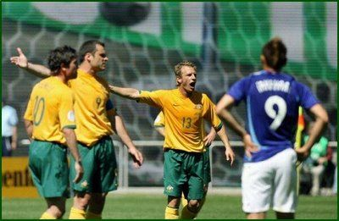
These images all exploit accidental smooth continuations.

Slide 29
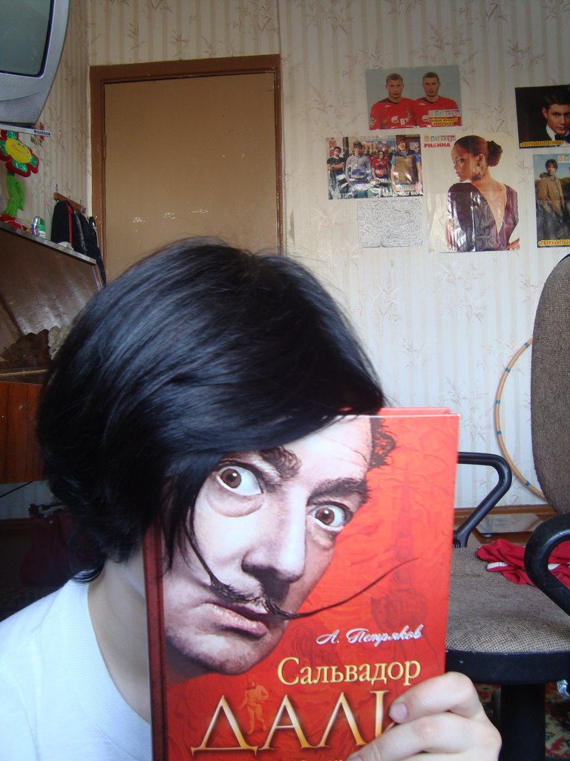
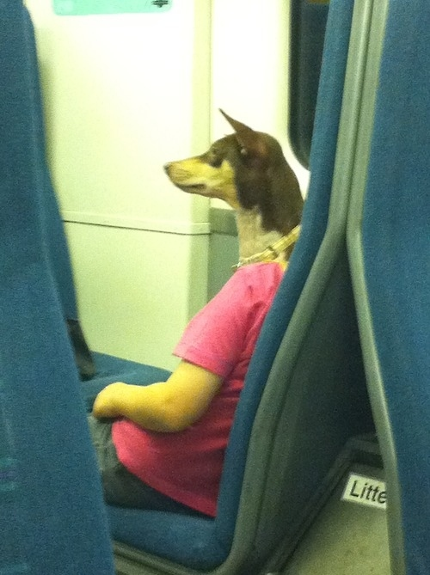

Slide 30
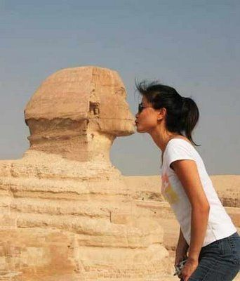
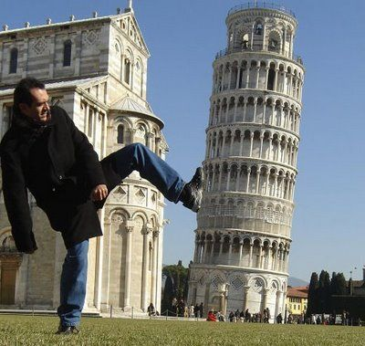
These images both contain accidental co-terminations.

Slide 31
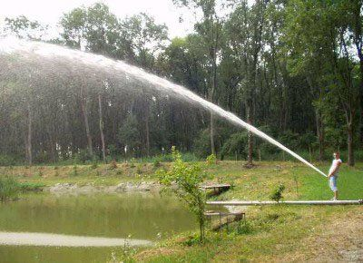
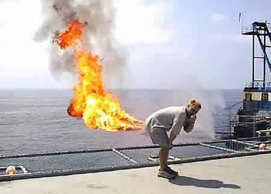
Two more humorous examples of accidental co-termination.

Slide 32
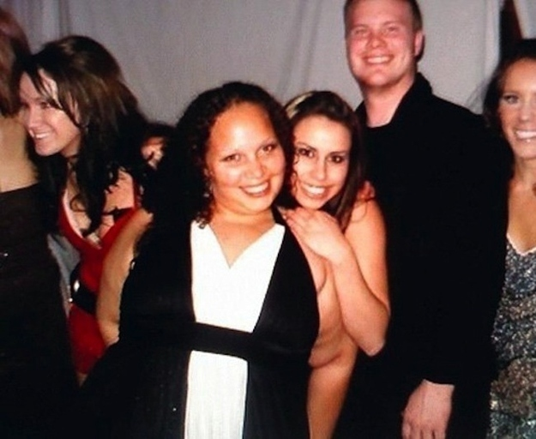
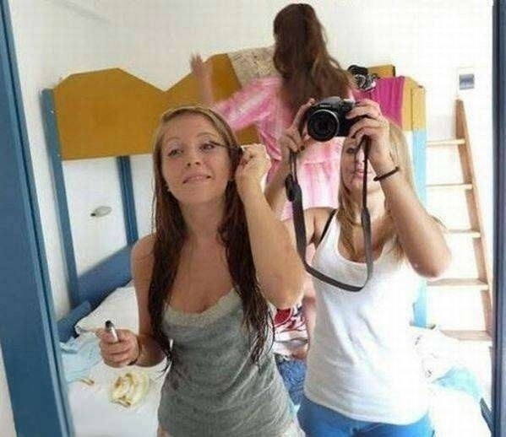

Slide 33
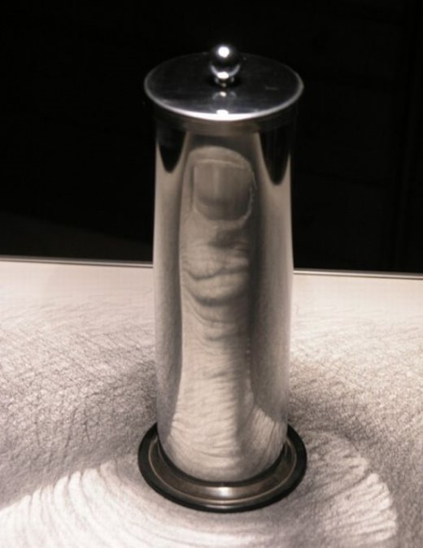
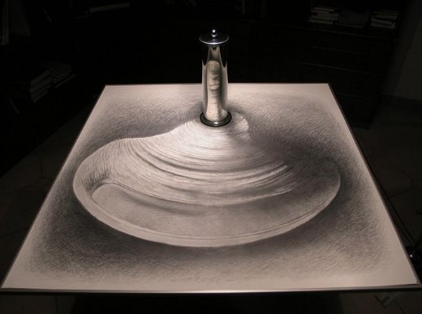
Accidental properties in art
An anamorphosis is a distorted projection or perspective; especially an image distorted in such a way that it becomes visible only when viewed in a special manner. "Ana - morphosis" are Greek words meaning "formed again."
István Orosz

Slide 34
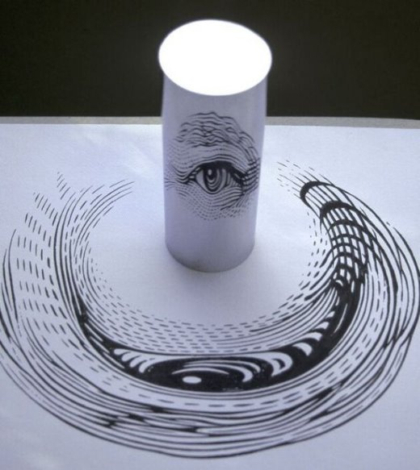

Slide 35
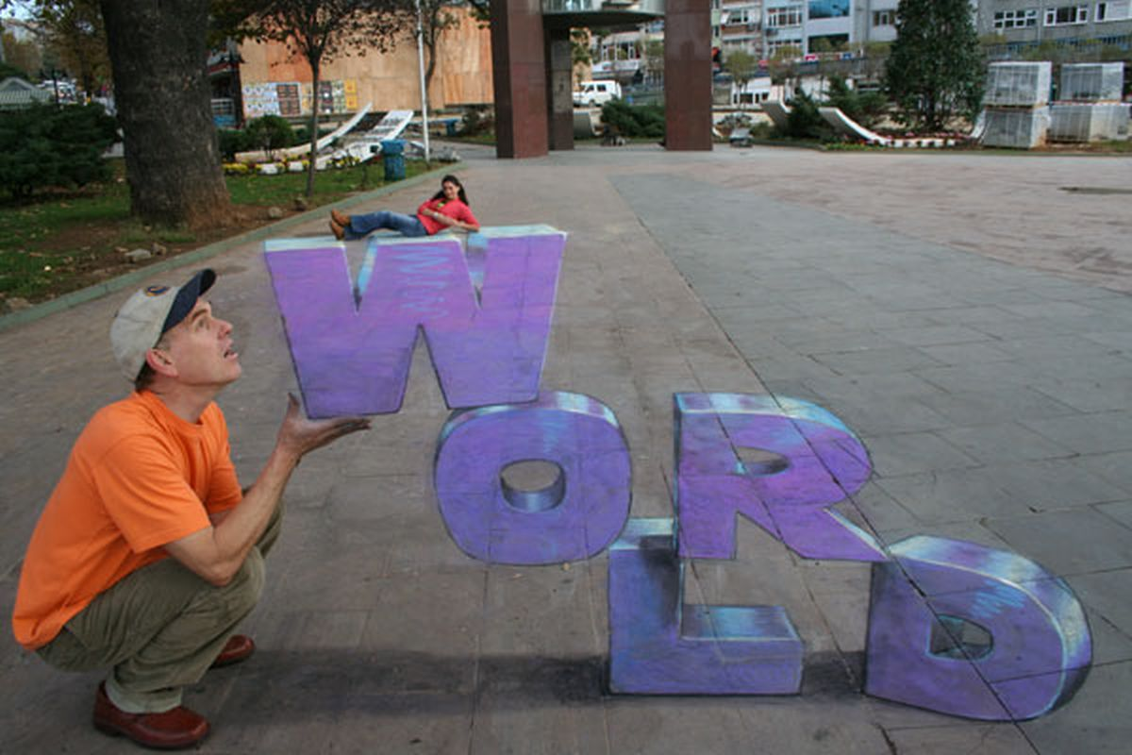
Julian Beever, English chalk artist

Slide 37
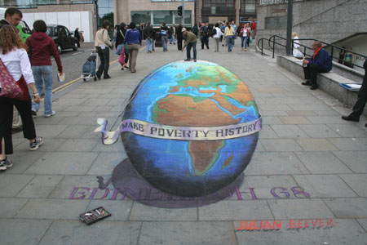
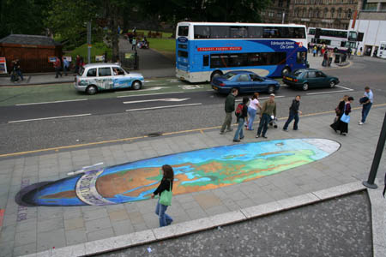

Slide 38
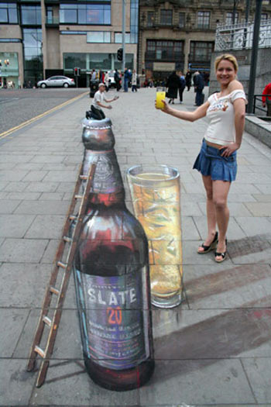
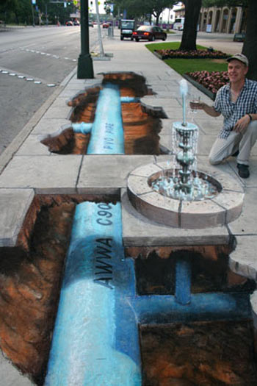

Slide 39
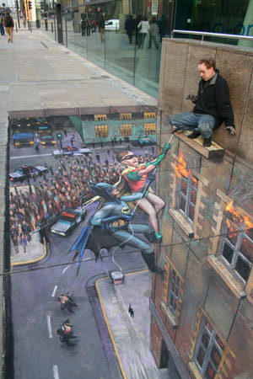
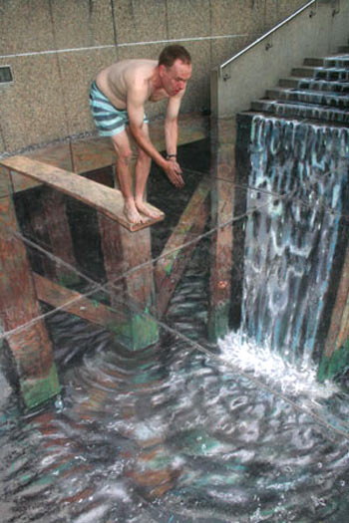

Slide 40
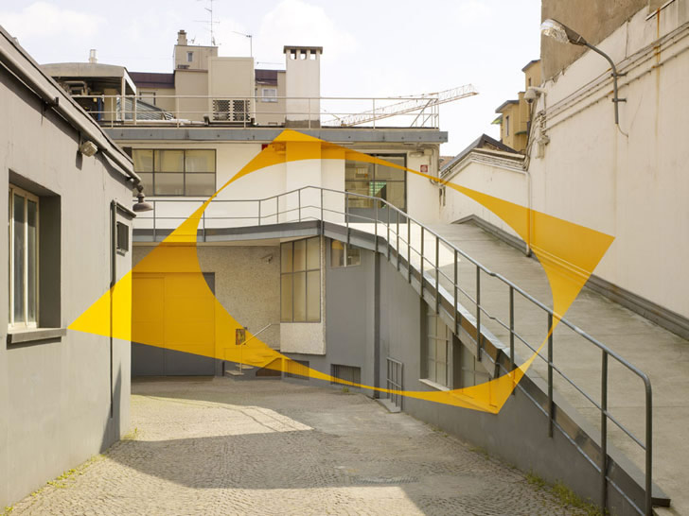
Felice Varini

Slide 41
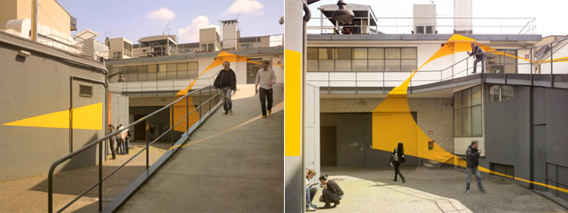

Slide 42
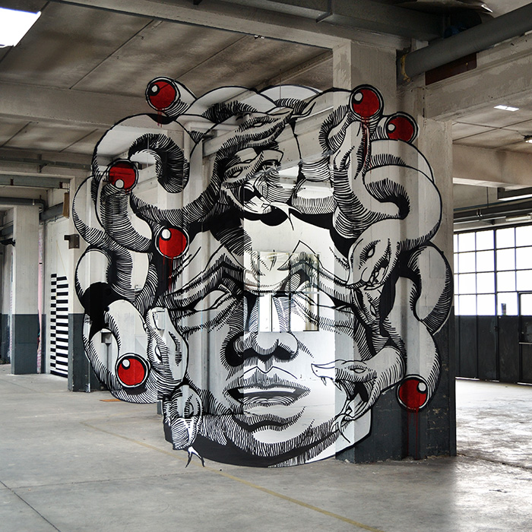

Slide 43
