Slide 1

Lecture 18 – Recognition 1

Slide 2
Visual Recognition
Contours
Objects
Faces
Scenes

Slide 3
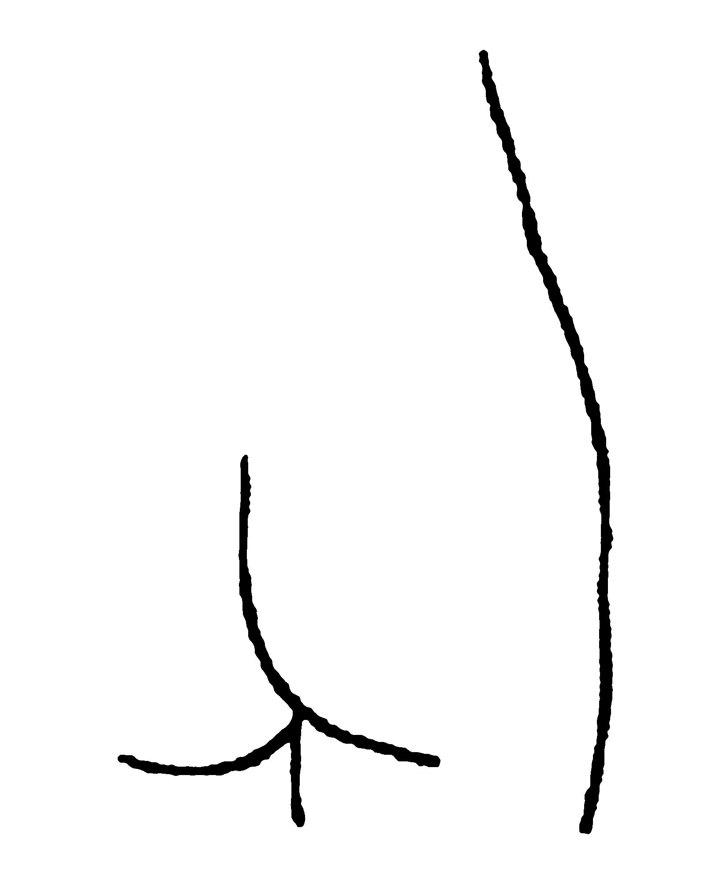
Edges and Vertices
Femme, Pablo Picasso

Slide 4
Types of Contours
Reflectance Contours
Illumination Contours (e.g. Shadows or Spot Lights)
Sharp Edges (Concave or Convex)
Occlusions (Smooth or Edge)
Specular Highlights and Reflections

Slide 5
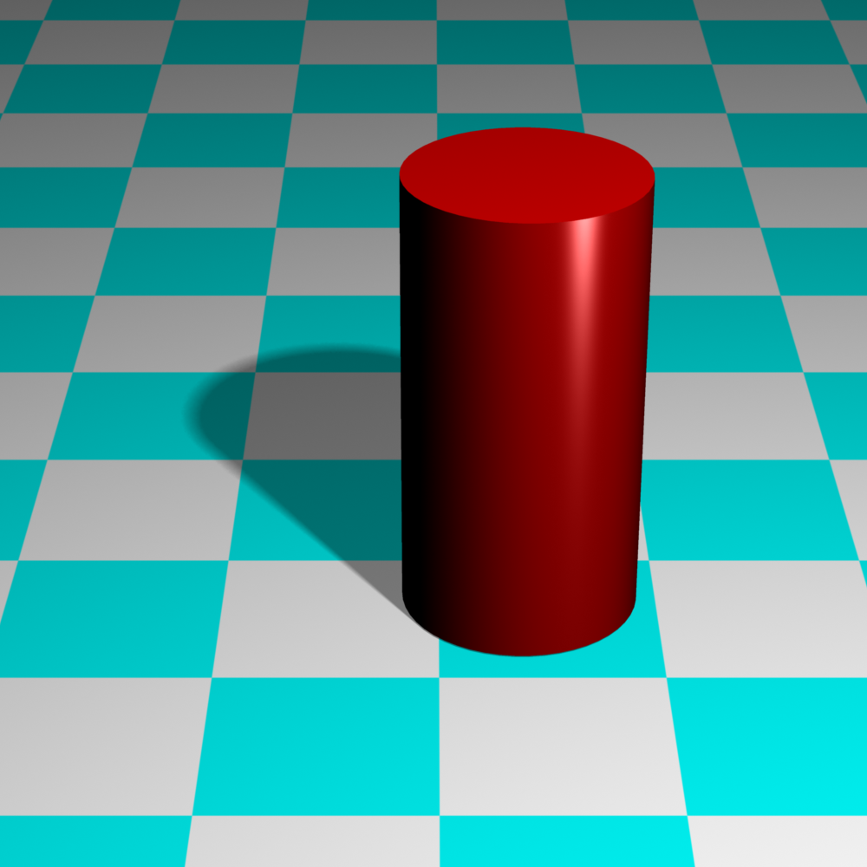
Reflectance Contour
Edge Occlusion
Specular
Highlight
Convex Corner
Shadow
Smooth Occlusion
Concave Corner

Slide 6
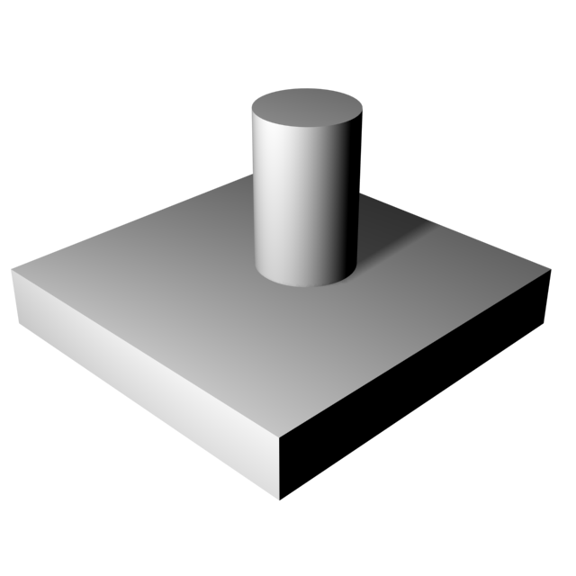
Occlusion
Unattached Side
Attached
Side

Slide 7
Smooth
Occlusion
Edge
Occlusion
Concave
Edge
Convex
Edge

Slide 8
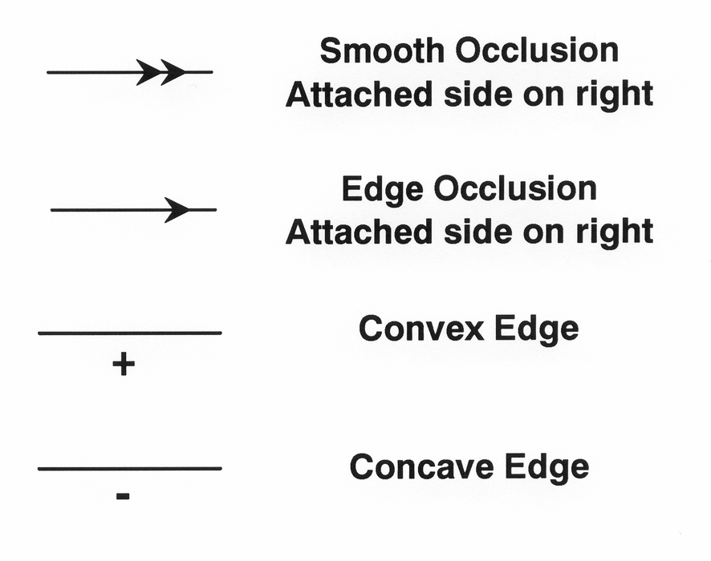
Edge Labeling: Jitendra Malik, 1987

Slide 9
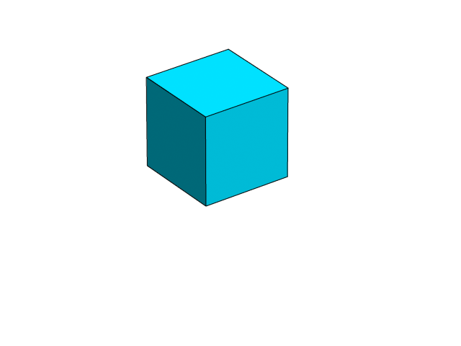
Vertices
The types of vertices in a figure constrain how it can be interpreted as a 3D shape.

Slide 10
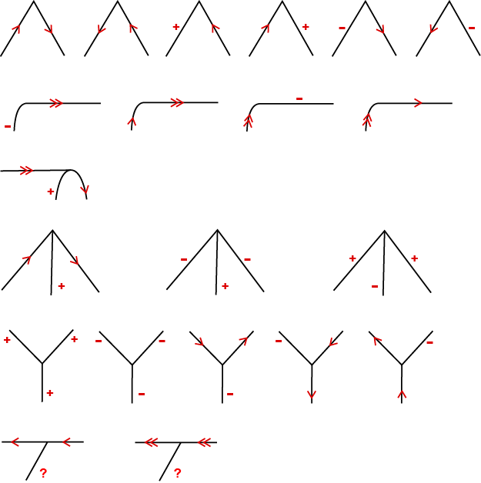
Vertex types and their possible interpretations
L
Curved L
3-Tangent
Arrow
Y
T

Slide 11
Edge Labeling
Note that every contour on an object is bounded on both ends by a vertex
Problem – Select a possible interpretation for each vertex so that every contour has a consistent labeling from both of its vertices
Consistent interpretations are not always unique, and may sometimes be impossible to achieve

Slide 12
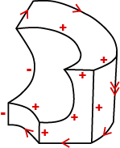
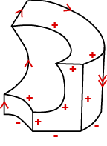
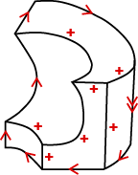
Alternative interpretations of an object
Attached to wall
Floating in air
Attached to ground

Slide 13
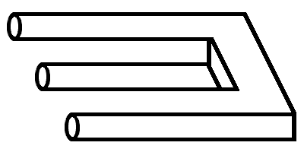
The 3-tangent vertex indicates that this is a smooth occlusion contour, and that the occluded region is above the contour.

Slide 14
The pattern of vertices indicates that this is either a concave edge, or an edge occlusion contour where the occluded region is below the contour.
-
or

Slide 15
An impossible object does not allow a consistent interpretation of its edges
-
or

Slide 16
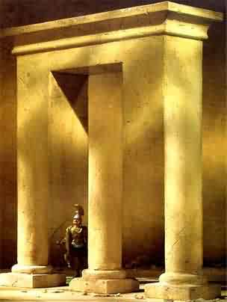

Slide 17
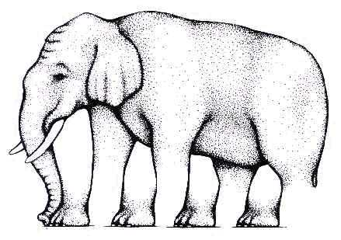
L'Egs-istential Quandary, Roger Shepard

Slide 18
Occlusion
T Vertex
The region attached to the cross bar of a T vertex is in front.

Slide 19
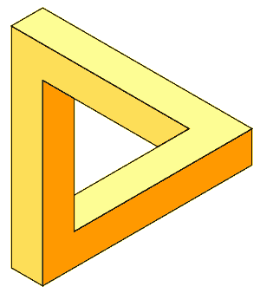
C is closer than A
C
A
A is closer than B
C
B
A
B
B is closer than C
A < B < C < A This does not compute!

Slide 20
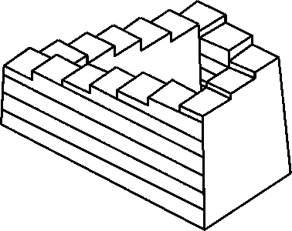
The never ending staircase

Slide 21
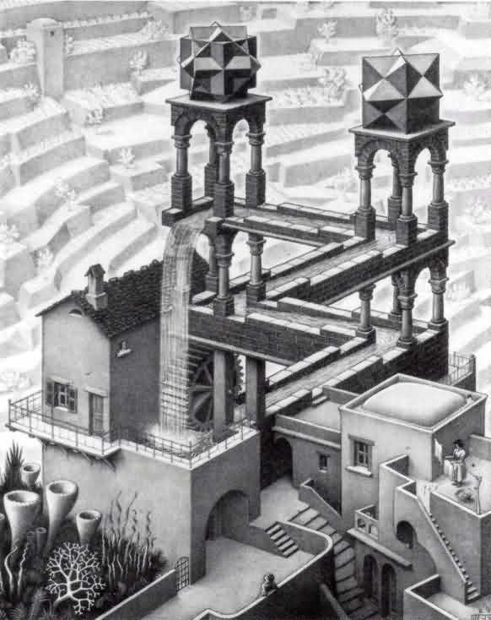
Waterfall, M. C. Escher
In this image, Escher incorporates a never ending staircase in the form of a waterfall.

Slide 22
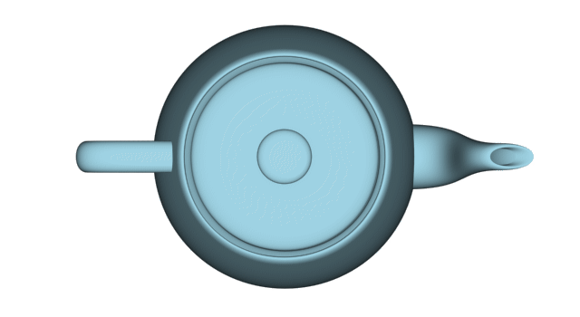
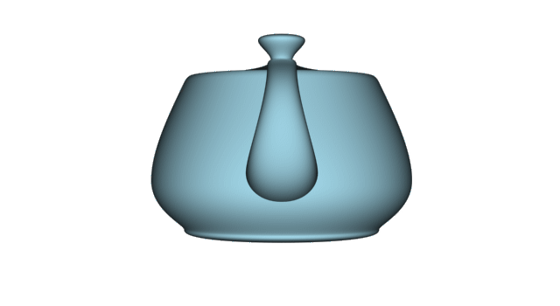
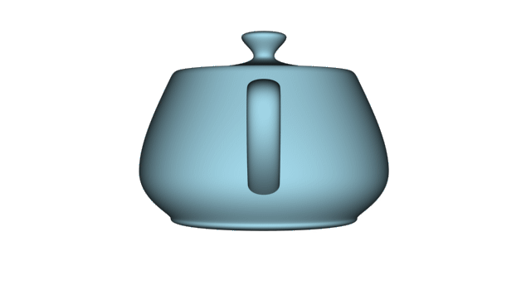
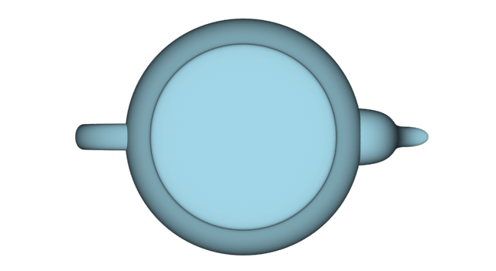
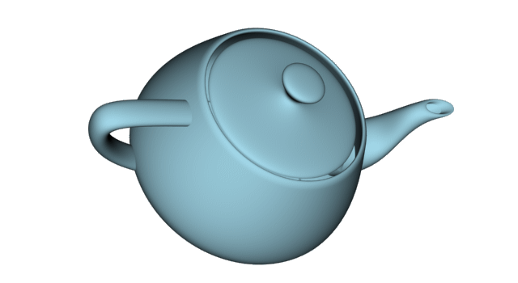
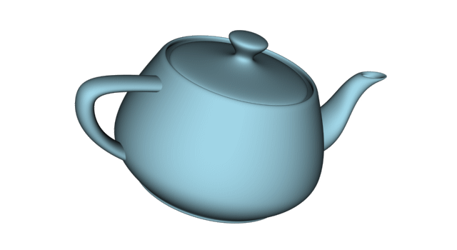
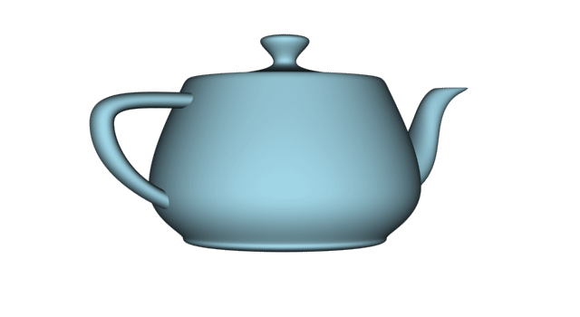
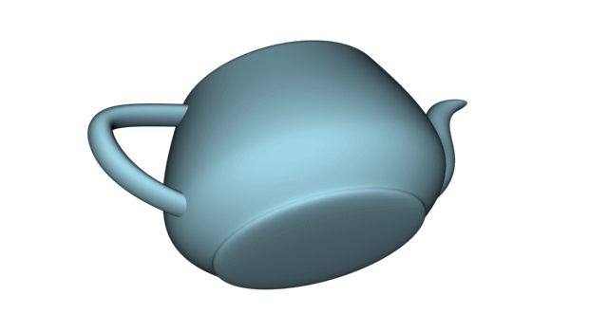
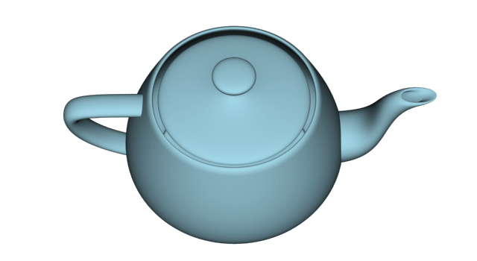
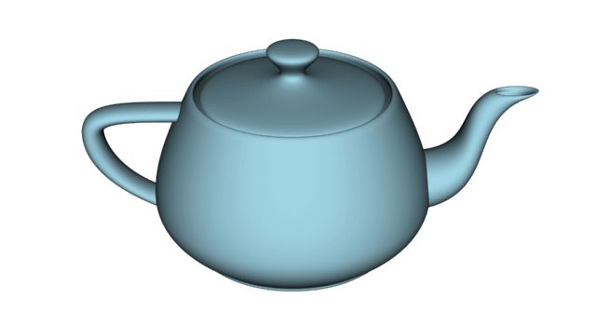
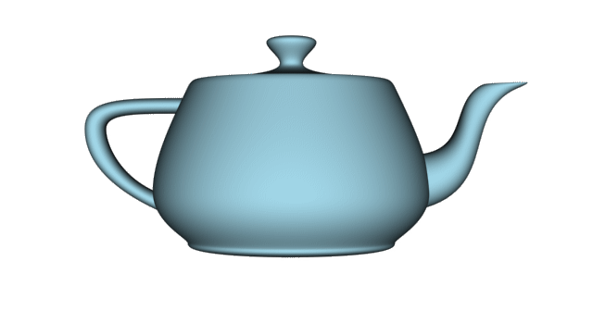
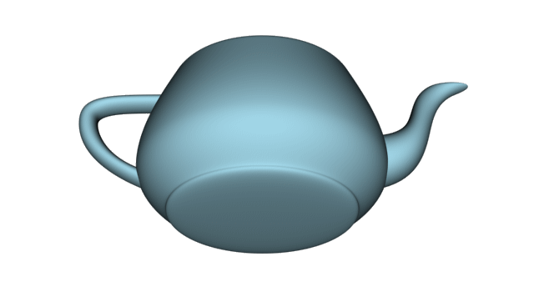
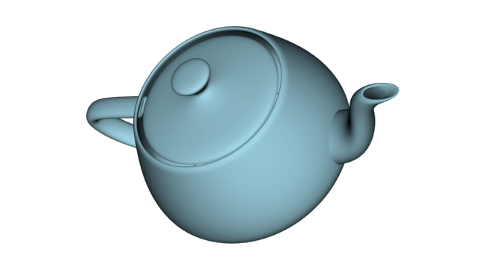
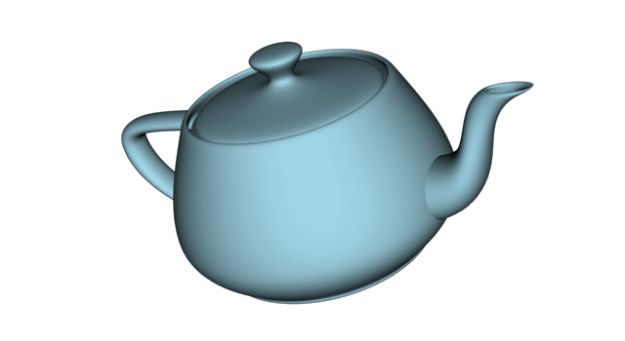
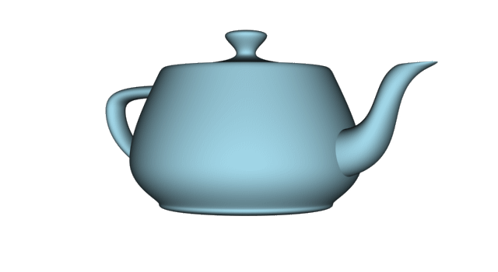
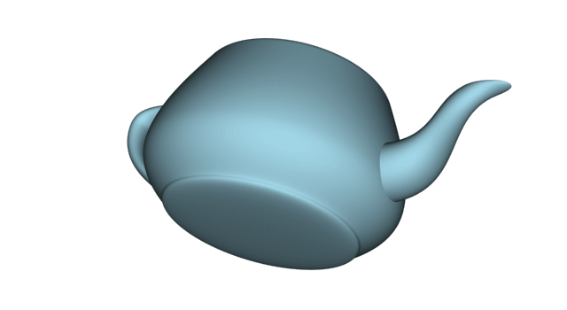
Object Recognition
How is it possible to recognize objects from different vantage points when their optical projections can vary so dramatically?

Slide 23
Models of Object Recognition
Template (or view based) Models: Maintain a memory of many different views for each object we need to recognize.
Structural Description Models: Exploit those properties that can distinguish most objects from one another, yet remain relatively stable over changes in view.

Slide 24
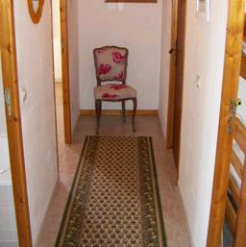
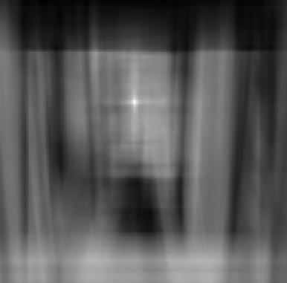
Template Models
Find the chair in this image
Output of normalized correlation
This is a chair

Slide 25
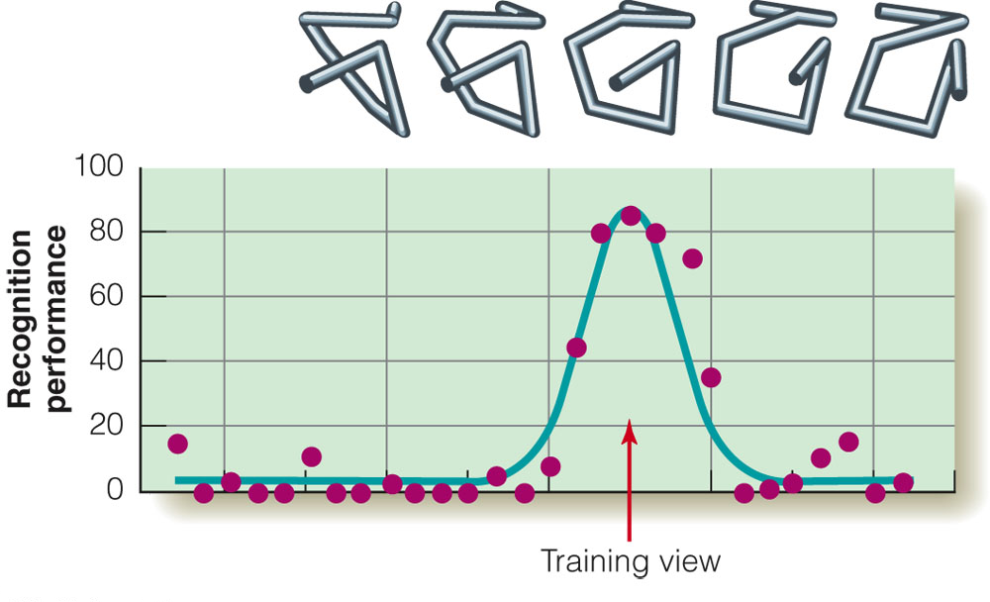
For some objects, recognition is only possible for viewpoints that are close to those that were observed during training.

Slide 26
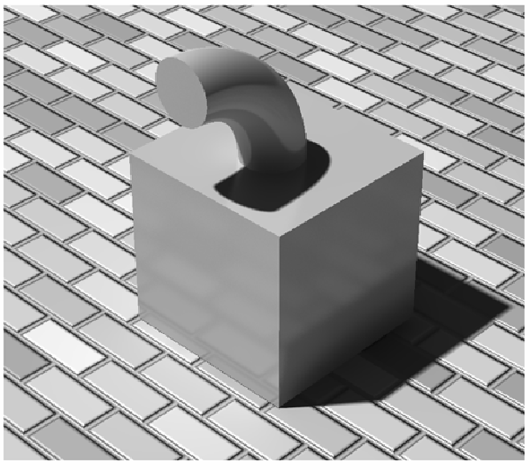
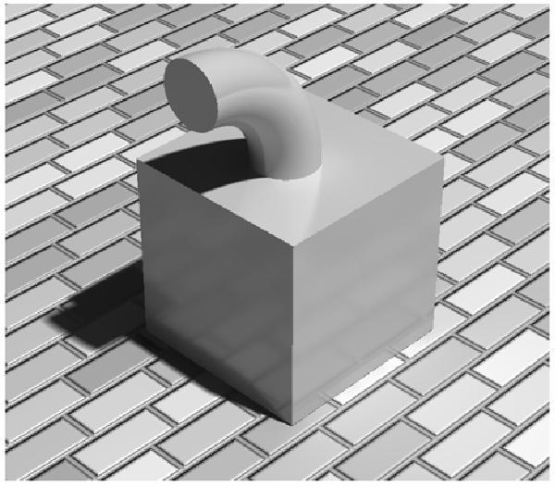
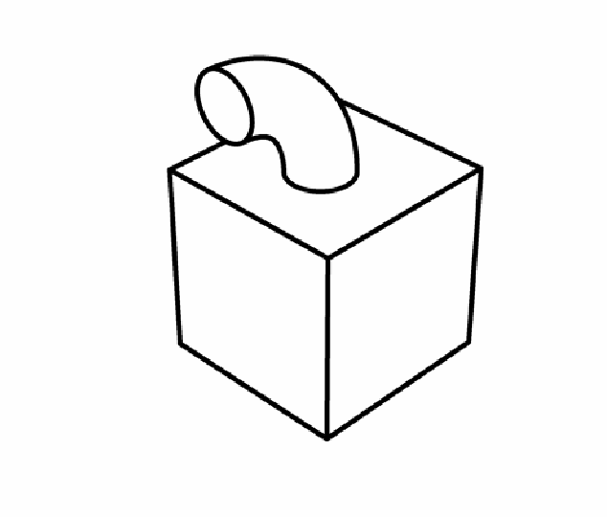
Image based approaches to object recognition cannot distinguish relevant image changes from those that are irrelevant.

Slide 27
Describe this object
When asked to describe a novel object, observers typically do so by identifying different parts.
Funnels
Spring
Handle
Box
Wheel
Hose

Slide 28
Object recognition by components Biederman (1987)
Objects are defined as configurations of qualitatively distinct parts called Geons.
Geons are defined by configurations of non-accidental properties.

Slide 29
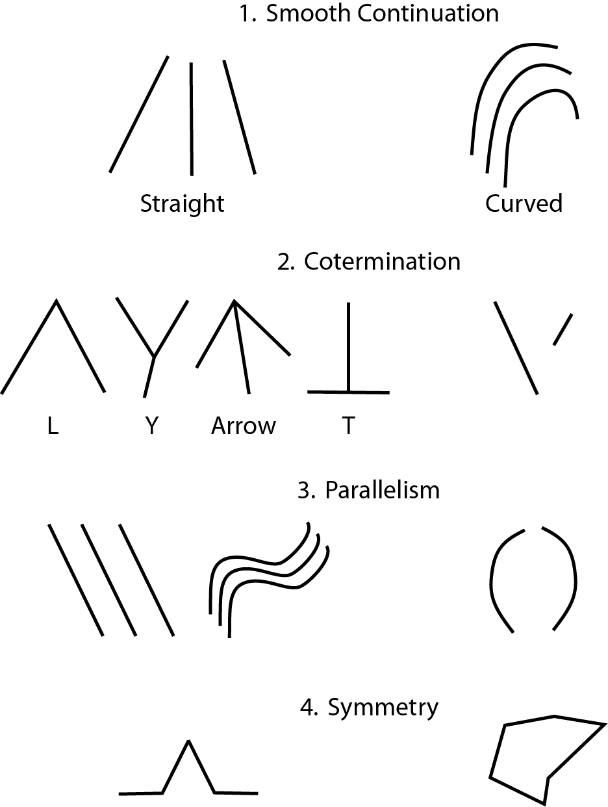
Nonaccidental Properties – are properties of an image such as co-linearity, co-termination or parallelism that seldom occur by accident within optical projections. Thus, if lines in an image are parallel (or co-terminate), they will be interpreted perceptually as if they are parallel (or co-terminating) in the 3D environment.

Slide 30
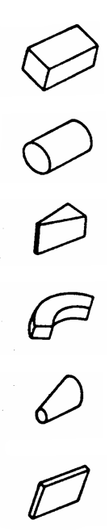
Geons are distinguished by their non-accidental properties
the number of straight and curved edges
which edges are parallel to one another
the number of vertices of each type
the presence of symmetries

Slide 31
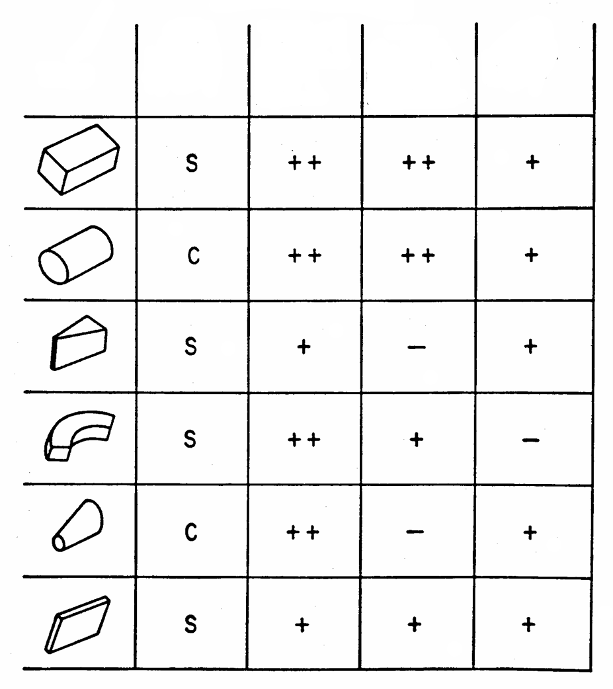
Partial tentative geon set based on non-accidental relations
Cross section
Edge
Straight S
Curved C
Symmetry
Rot + Ref ++
Ref +
Asymm -
Size
Constant ++
Expanded -
Exp & Cont --
Axis
Straight +
Curved -

Slide 32
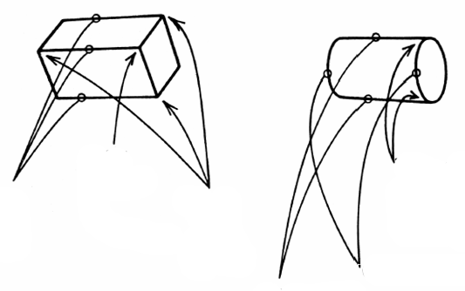
Geons
Some non-accidental differences between a brick and a cylinder
Brick
Cylinder
Inner Y vertex
Two tangent Y vertices
Three parallel edges
Three outer arrow vertices
Two parallel edges
Curved edges

Slide 33
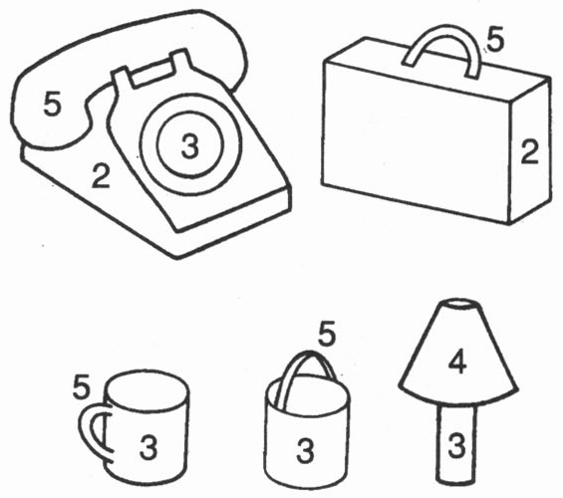
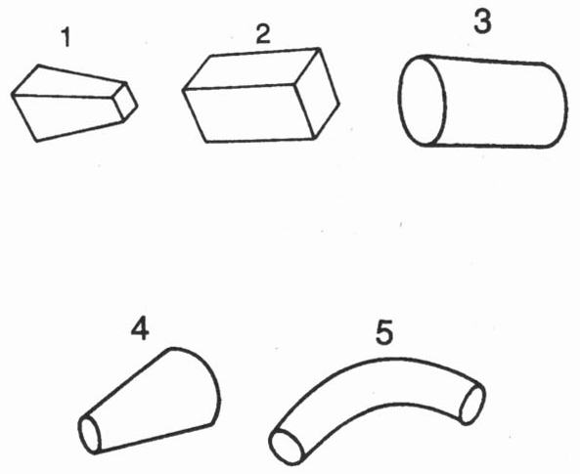
Geons
Objects
Each type of geon is defined by a particular configuration of non-accidental properties.
Each type of object is defined by a particular configuration of geons.

Slide 34
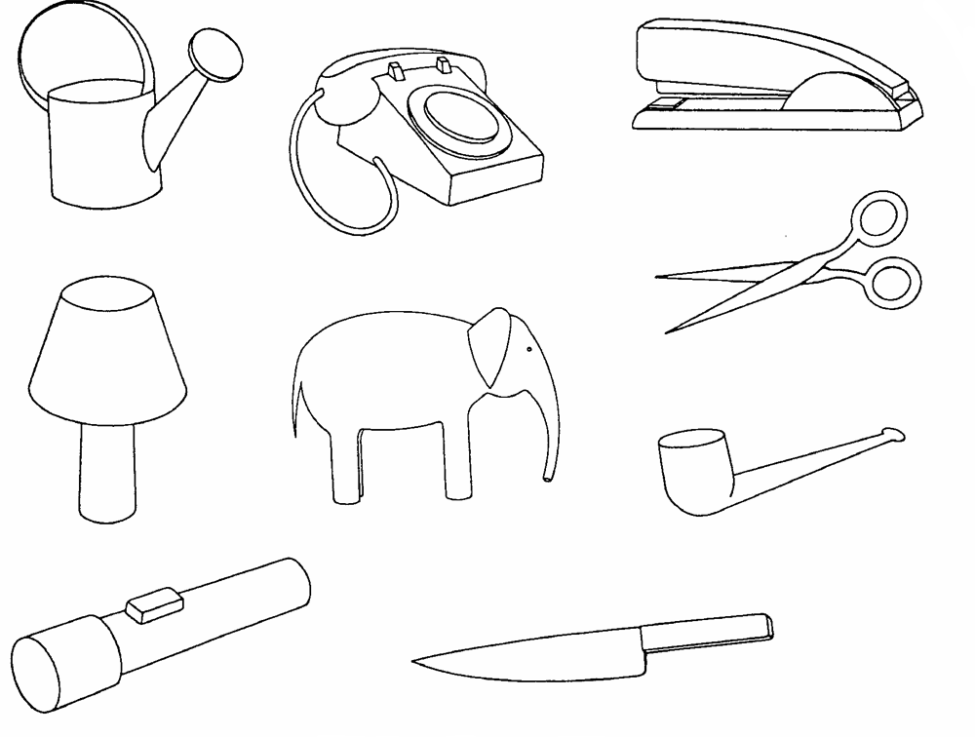

Slide 35
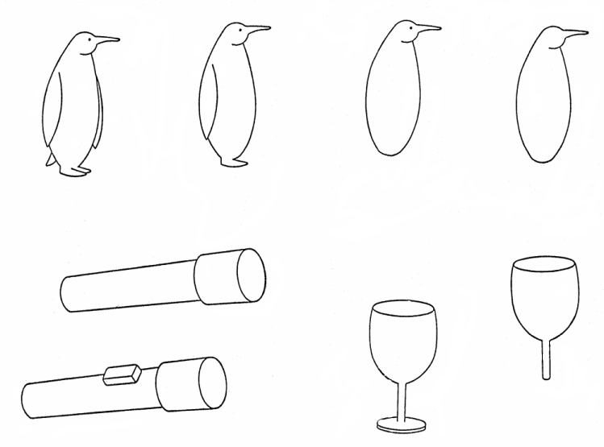
Geon Deletion
On average, observers require approximately three geons to reliably recognize an object.

Slide 36
Contour Deletion
Prediction
Deletion of contours in an image should have the greatest effect on recognition performance if it masks non-accidental properties or geons.

Slide 37
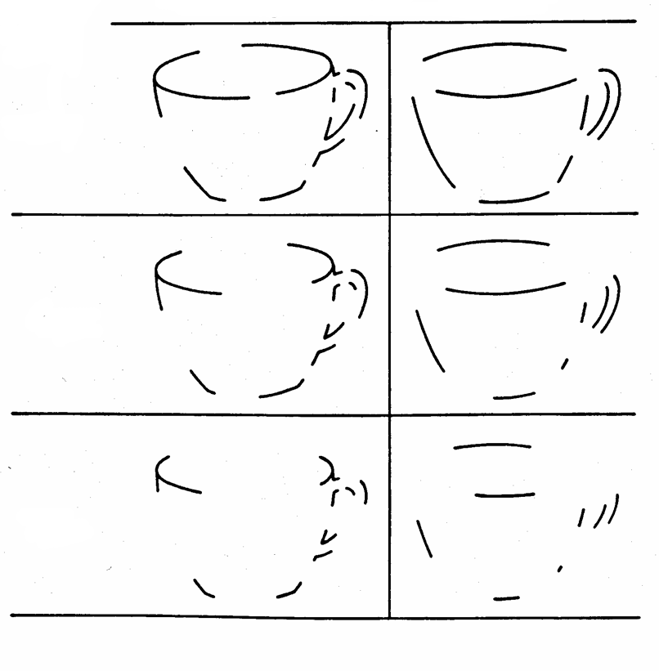
Location of Deletion
At Midsection
At Vertex
25%
Proportion of Contours Deleted
45%
65%

Slide 38
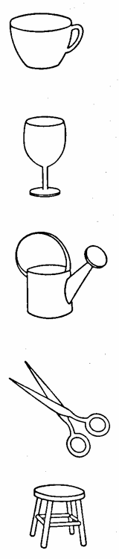
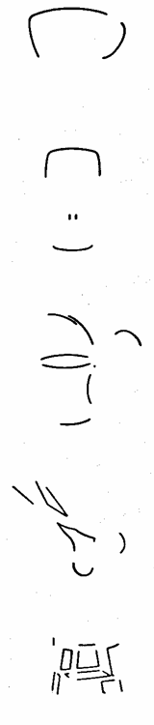
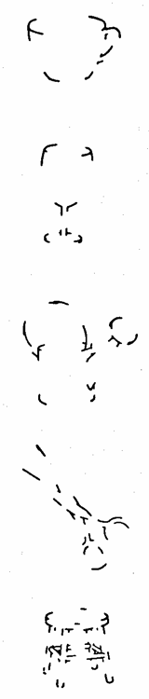
Midsection
Deletion
Vertex Deletion
Intact
Task: Subjects are presented with an intact or contour deleted object, and they are asked to name it as quickly as possible. Recognition performance is more severely impaired by vertex deletion than by midsection deletion.

Slide 39
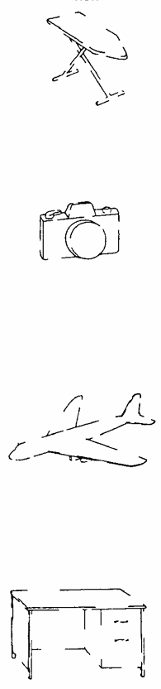


Midsection
Deletion
Geon Deletion
Intact
Task: Subjects are presented with an intact or contour deleted object, and they are asked to name it as quickly as possible. Recognition performance is more severely impaired by geon deletion than by midsection deletion.

