Slide 1
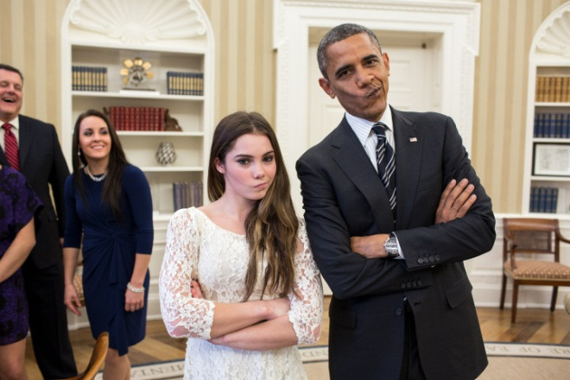
Lecture 19 – Recognition 2

Slide 2


Attractiveness
Age
Human
face
Identity
Grammar
Emotions
Gender

Slide 3
Face Recognition Difficulties
Identify similar faces (inter-class similarity)
Accommodate intra-class variability due to:
  head pose
  illumination conditions
  expressions
  facial accessories
  aging effects
Cartoon faces
Notes:
O
O Face recognition can be categorized into appearance-based, geometry-based, and hybrid approaches.

Slide 4
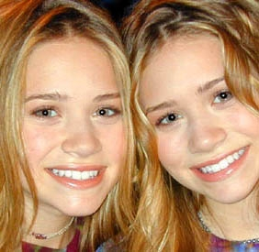
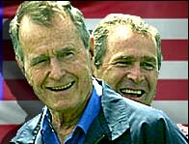
Inter-class Similarity
Different persons may have very similar appearance
www.marykateandashley.com
news.bbc.co.uk/hi/english/in_depth/americas/2000/us_elections
Twins
Father and son
Notes:
O
O Face recognition can be categorized into appearance-based, geometry-based, and hybrid approaches.

Slide 5


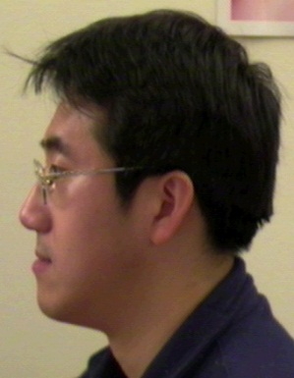







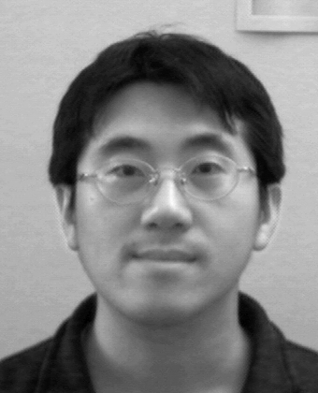
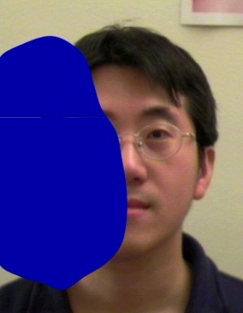
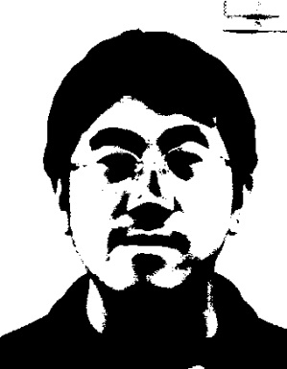
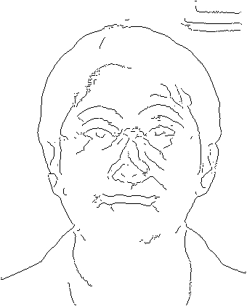
Intra-class Variability
Faces with intra-subject variations in pose, illumination, expression, accessories, color, occlusions, and brightness
Notes:
O
O Face recognition can be categorized into appearance-based, geometry-based, and hybrid approaches.

Slide 6
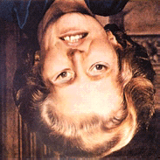
Wholistic Processing

Slide 7
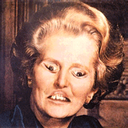
Wholistic Processing

Slide 8
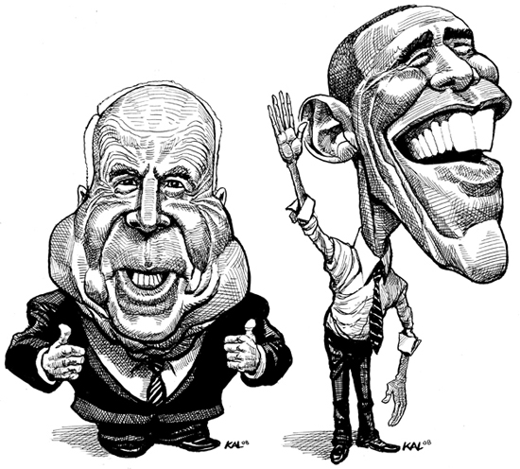

Slide 9
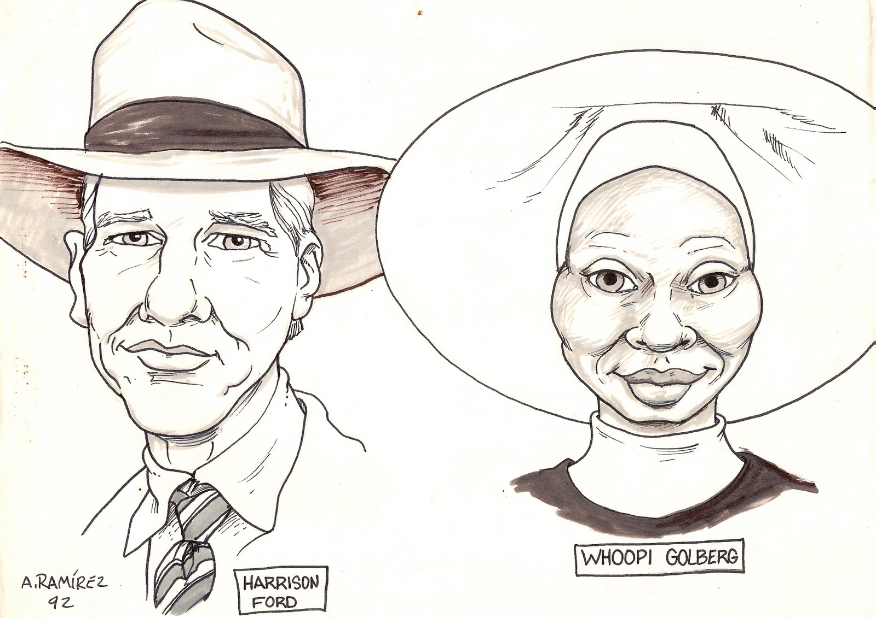

Slide 10
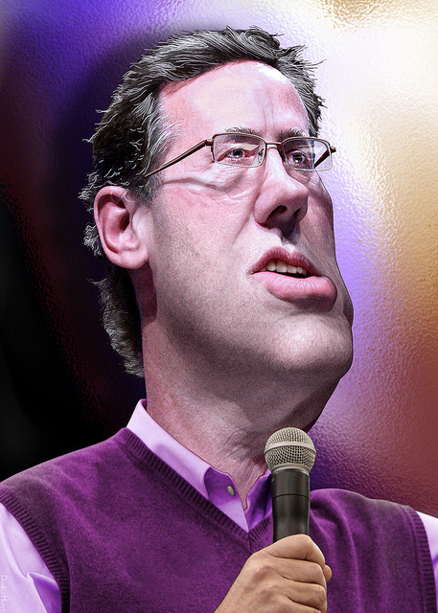


Slide 11
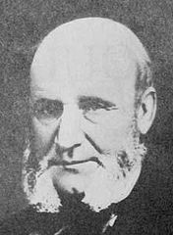
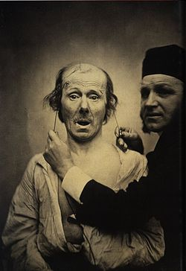
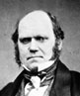
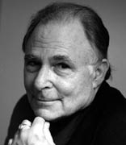
Facial Expressions of Emotion
Guillaume-Benjamin-Amand Duchenne
1806—1875
Charles Darwin
1809—1882
Paul Ekman
1934

Slide 12
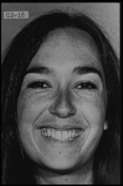
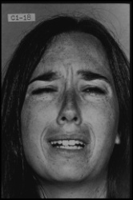
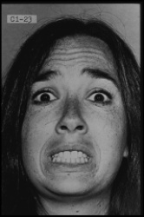
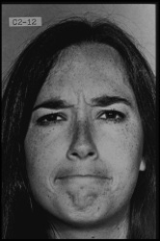
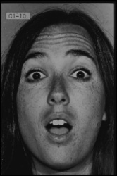
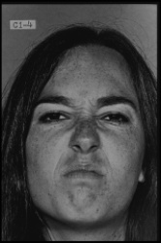
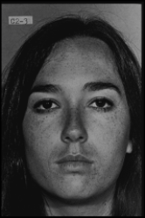
Facial Expressions of Emotion

Slide 13
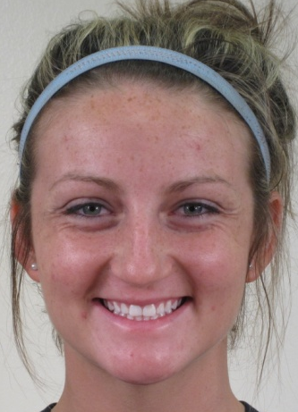
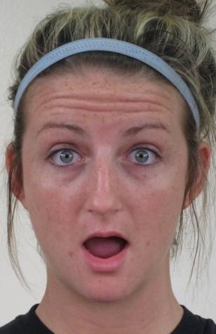

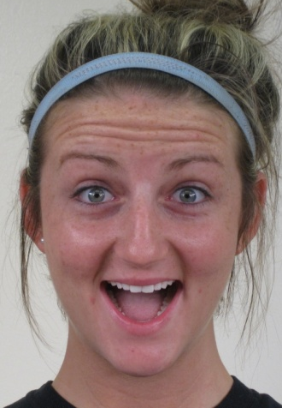

Happy
Surprised
Angry
Happily surprised
Angrily surprised

Slide 14
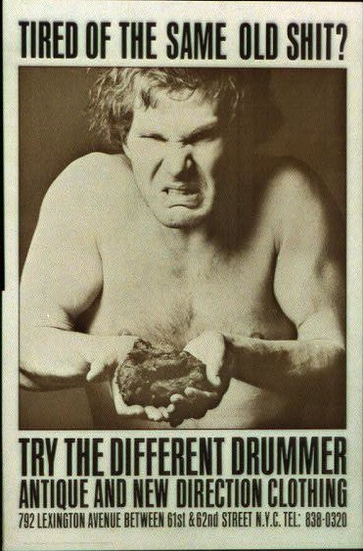

Slide 15
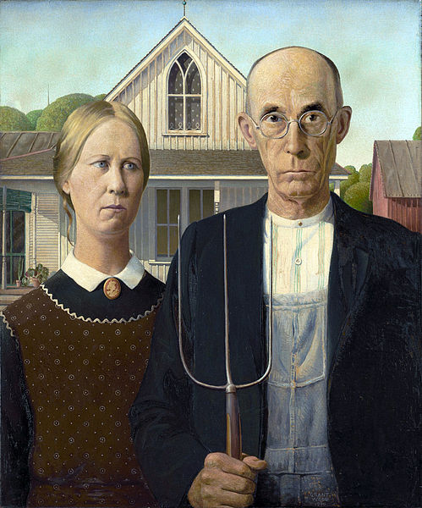
American Gothic, Grant Wood, 1930

Slide 16

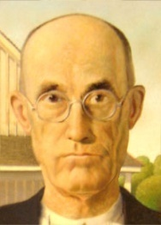
American Gothic Illusion
Neth & Martinez, Vision Research, 2010

Slide 17
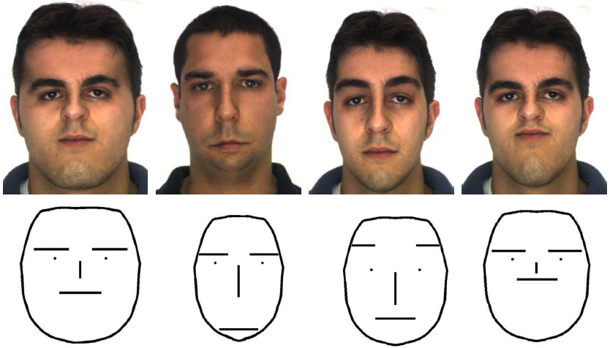
Configural Features
Martinez & Du, JMLR 2012; Martinez, CVPR 2011
anger sadness surprise disgust

Slide 18
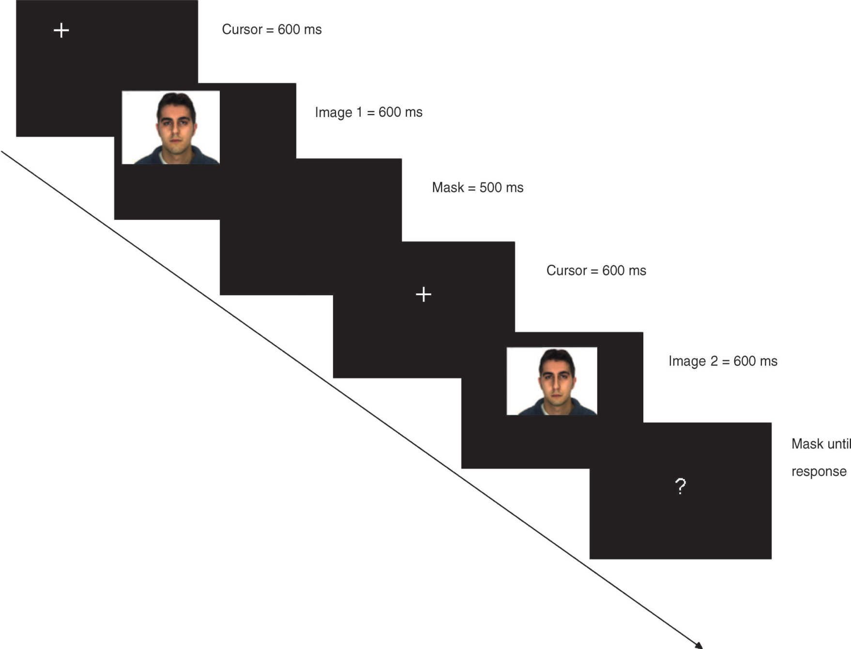

Slide 19
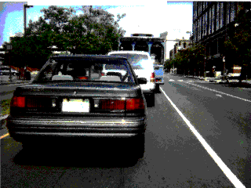
Scene Recognition
Notes:
What is changing here?
White lines.
What is happening is that when the small shapes flash up, your attention is drawn to in resulting in a rapid eye movement or SACCADE.
During the saccade, the changes are missed.

Slide 20

Notes:
What about here?
Focus on the bar.

Slide 21
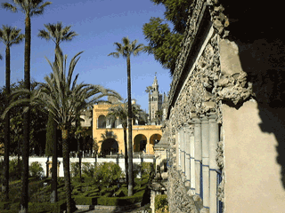
Change Blindness shows that your conscious perception of a fully complete scene at each moment in time is really a mental construction. You only have detailed information about the small region around where your eyes are fixated.
Notes:
And again, a similar one but the movements occurs faster.
Focus on the trees in the top left.
You are missing these changes because of the introduction of these irrelevant transients. These can be things such as a flash between images or an occlusion occurring to mask the change, or forcing a saccade as in the previous example.

Slide 22
Automatic Processing of Scenes

Slide 23
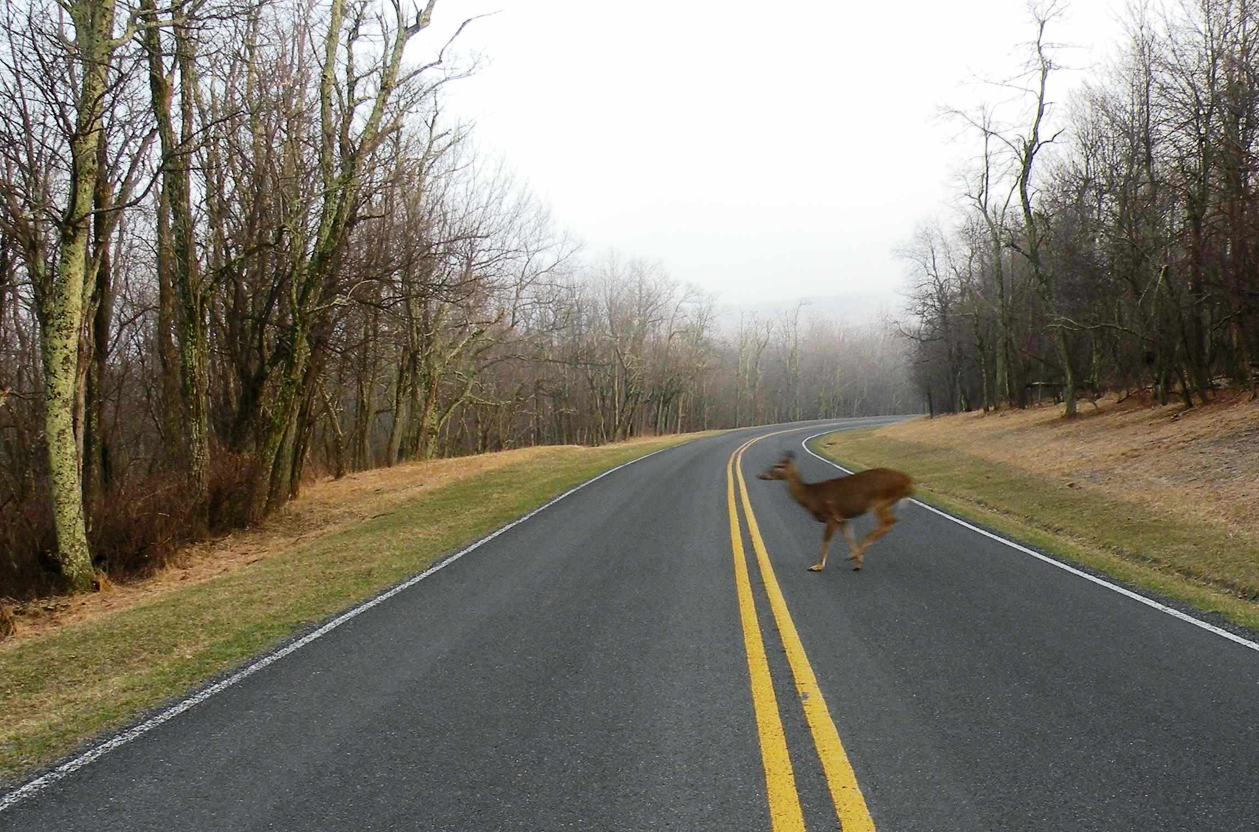
Scene context matters!

Slide 24
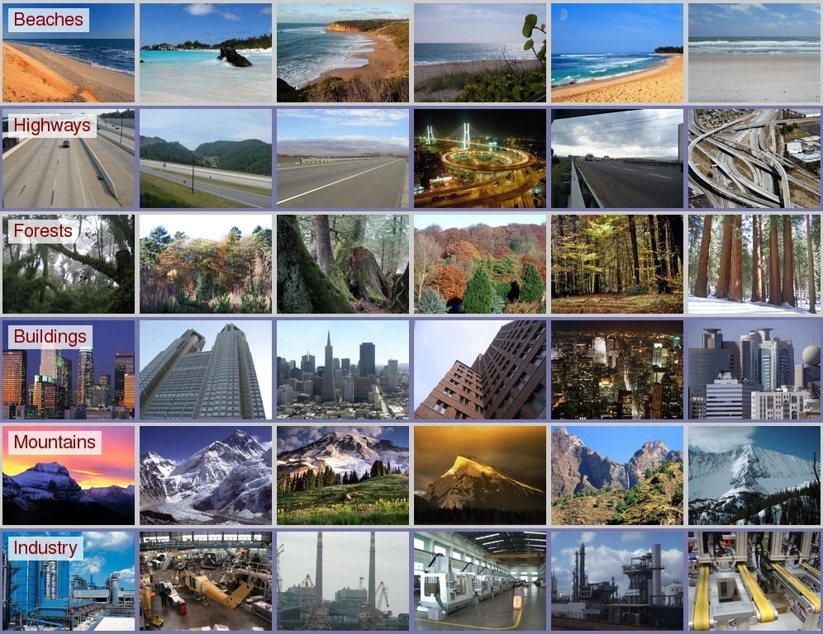

Slide 25

We can very quickly understand scenes…
Notes:
Demonstrate ability to recognize pictures (Figures 8.22 and 8.23).
SPEND ABOUT one second on each picture!!

Slide 26


which are old? which are new?
Notes:
Figure 8.23.
Pretty good recognition!! High-capacity visual memory for scenes.
98% correct with 612 pictures!
90% correct one week later!
2500 pictures for 2 seconds a piece: 85% correct.

Slide 27
Picture Memory
We can identify scenes in about 125 ms!!
(Potter 1969)
People can remember up to 2500 and even 10000 pictures at a rate of one image every 2 seconds.
But can we? what kind of detail do we process/remember?
Notes:
Figure 8.23.
Pretty good recognition!! High-capacity visual memory for scenes.
98% correct with 612 pictures!
90% correct one week later!
2500 pictures for 2 seconds a piece: 85% correct.

Slide 28

Potter et al. 1976

Slide 29
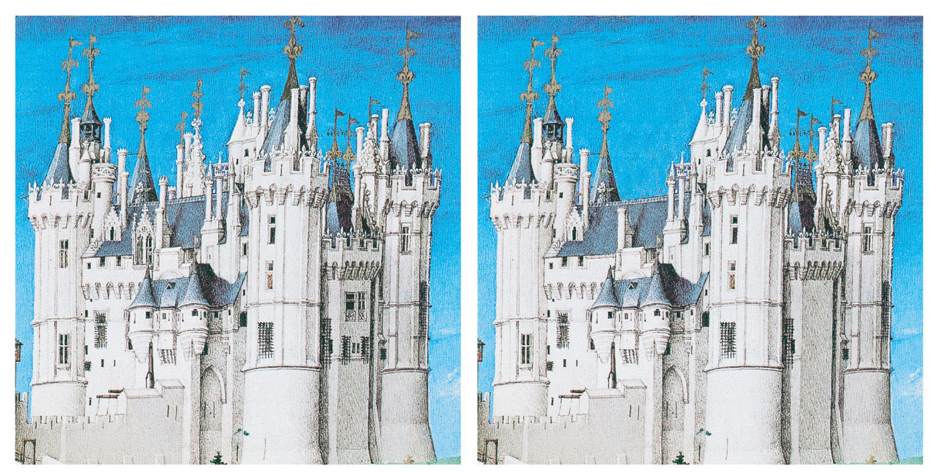
differences between pictures?
Notes:
Figure 8.24.

Slide 30
Relational Violations
Five Relational Violations that can slow down object or scene processing according to Biederman et al. (1982):
Support: Object does not appear to be resting on a surface
Interposition: The background appears to pass through the object
Probability: The object is unlikely to appear in the scene.
Position: The object is likely to occur in that scene but is unlikely to be in that particular position.
Size: The object appears too large or too small relative to other objects in the scene.

Slide 31
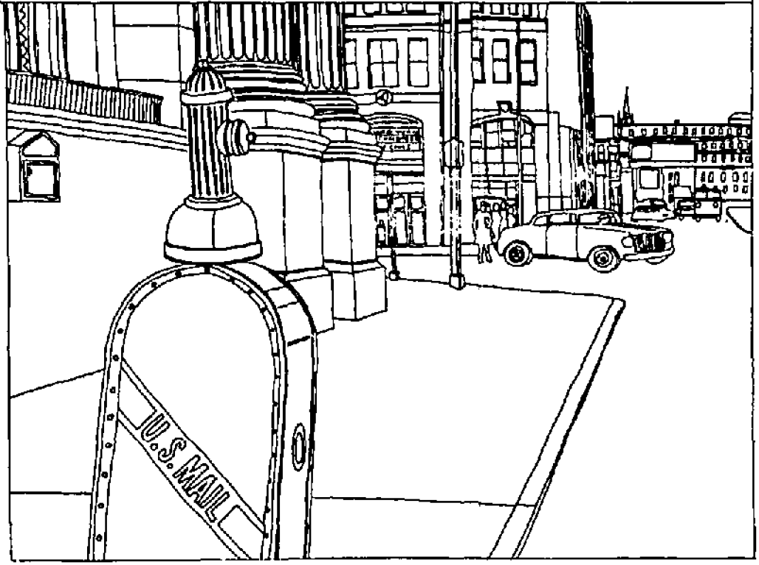
Position violation
Biederman et al., 1981
Notes:
Position violation

Slide 32
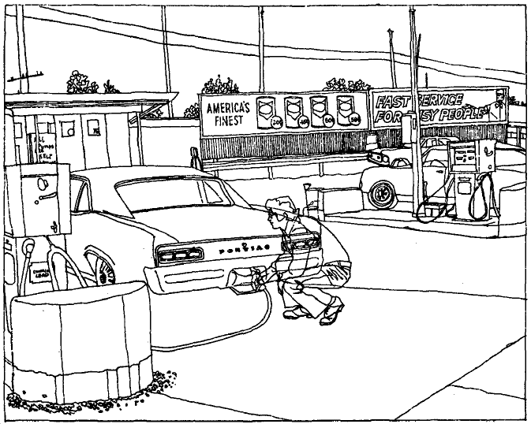
Interposition violation
Notes:
Interposition violation

Slide 33
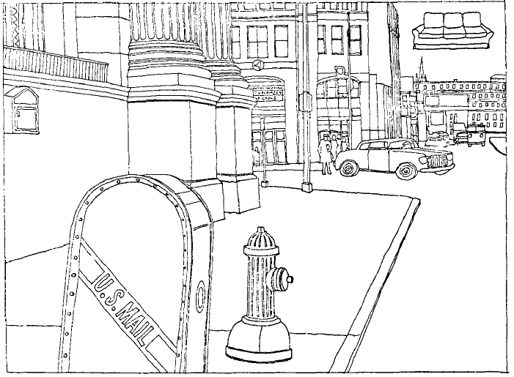
Support, size, and probability violation
Notes:
Support and size violation

