Slide 1
Lecture 16 – Lightness Perception

Slide 2
Physical Measures of Light
Luminous flux – light / unit area / unit time
Illumination (illuminance)– light that falls on a surface / unit area / unit time
Luminance – light that is reflected from a surface / unit area / unit time
Reflectance (albedo) – proportion of incident light that is reflected

Slide 3
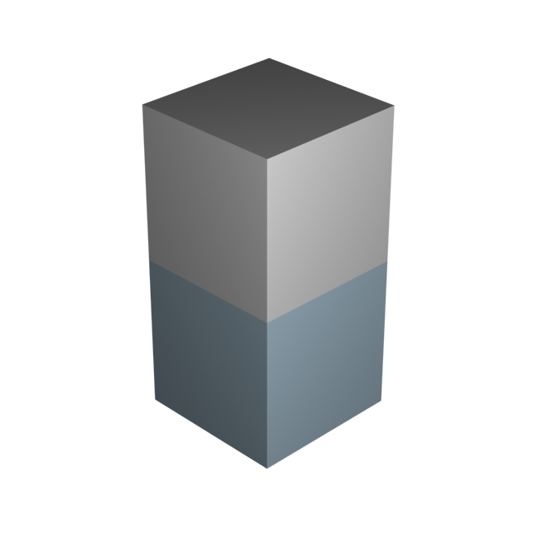
Illumination depends on the orientation of a surface relative to the light source
This surface has the lowest illumination because its orientation faces farthest away from the light source.
This surface has the highest illumination because it is oriented most closely toward the light source.

Slide 4
Perceptual Measures of Light
Lightness – perceived reflectance
Brightness – perceived luminance

Slide 5
Light–Surface Interactions
Matte reflections – light is scattered equally in all directions
Specular reflections – light is reflected primarily in one direction
Indirect reflections – light reflected from one surface illuminates another
Transparency – light passes through a surface and is refracted
Translucency – light passes through a surface and undergoes subsurface scattering

Slide 6
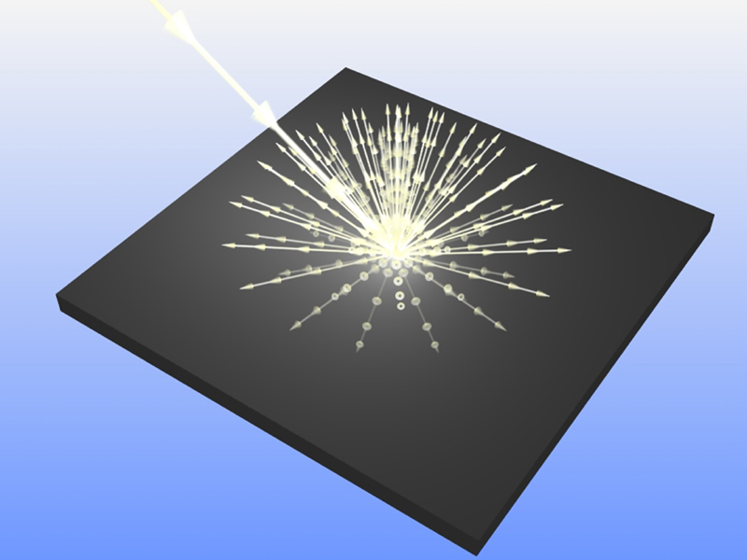
Matte (or diffuse) surfaces scatter light equally in all directions

Slide 7
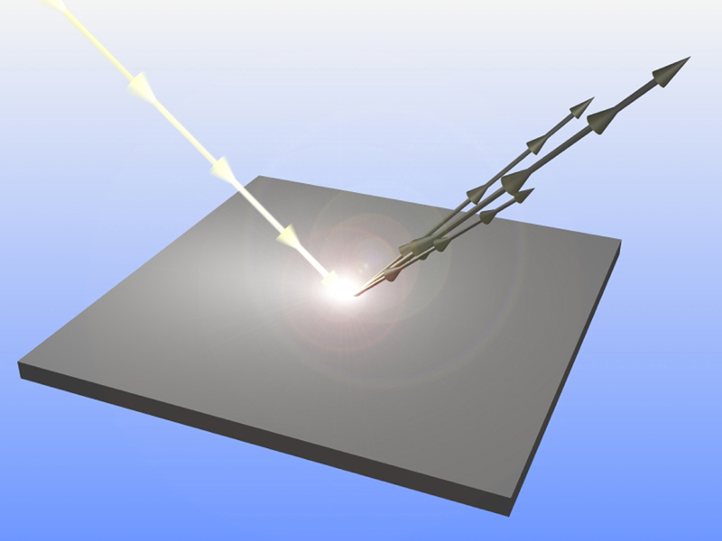
Shiny (or specular) surfaces scatter light primarily in a single direction

Slide 8
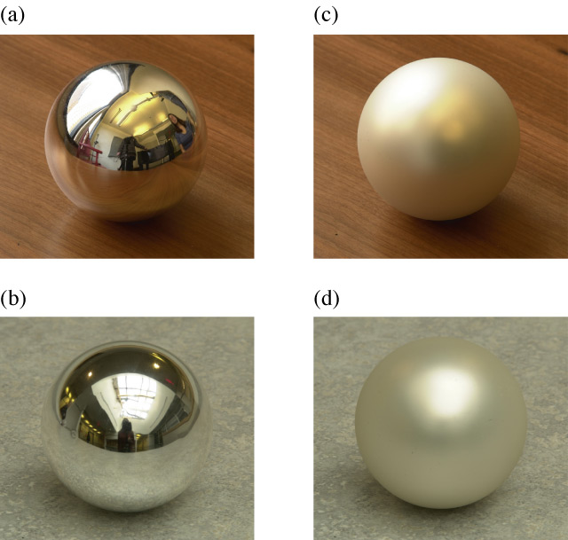
Shiny
Matte

Slide 9
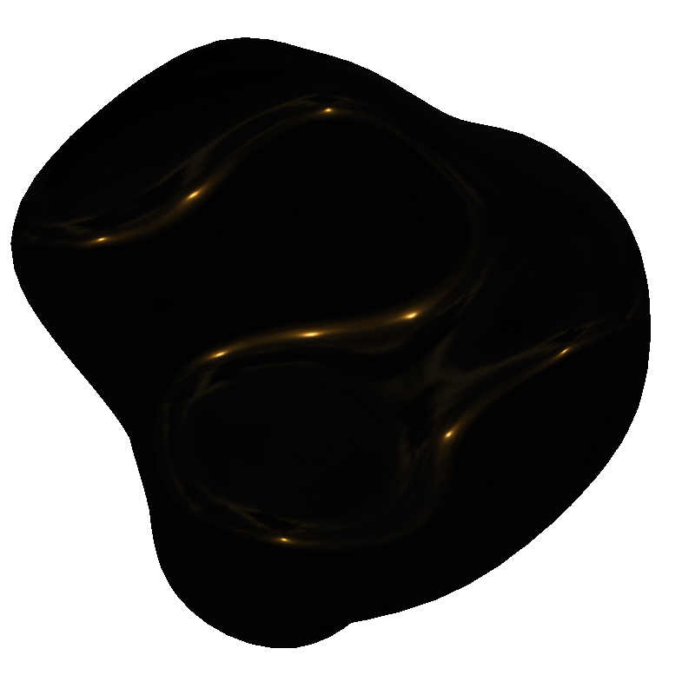
Specular Highlights

Slide 10
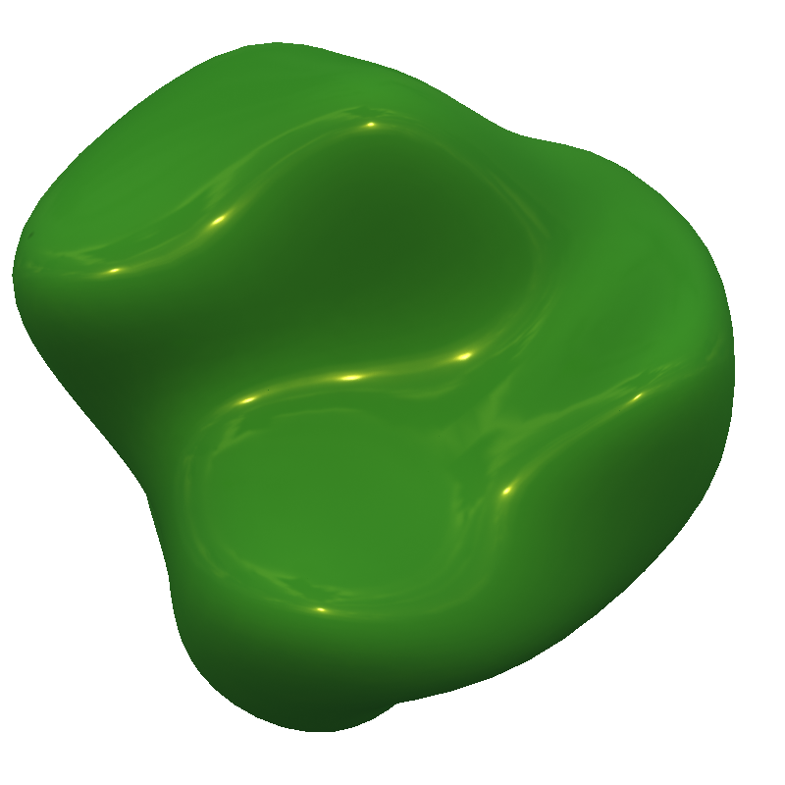
This surface has a combination of diffuse and specular components. Note that the diffuse reflections are the color of the surface, whereas the specular reflections are the color of the light source.

Slide 11
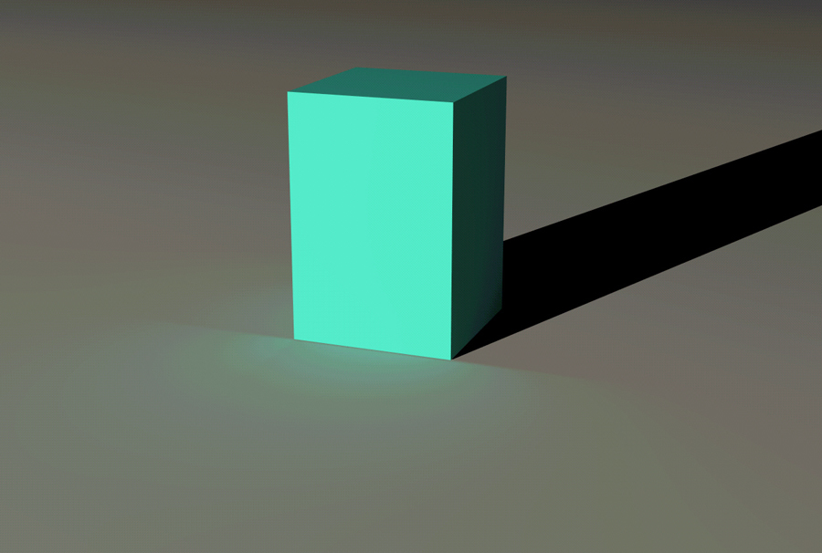
Indirect Illumination
Note the blue tint on the ground. This is due to light reflecting off the box that illuminates the ground

Slide 12
Indirect Illumination
In this case the indirect illumination helps specify that the box is hovering above the ground

Slide 13
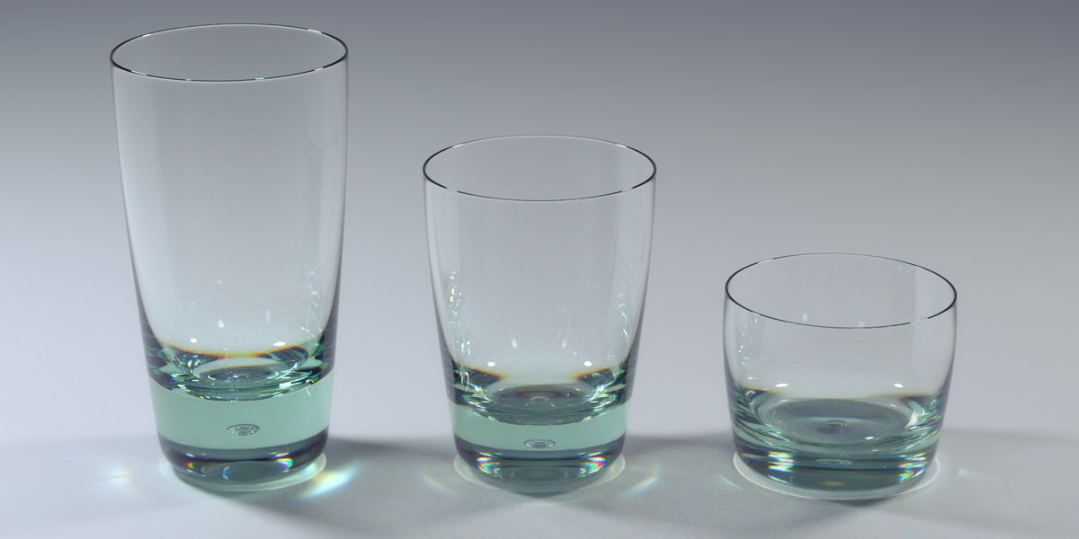
Transparency (Glass)

Slide 14
Translucency (Wax)

Slide 15
Lightness Constancy
The amount of light that reflects from a surface (its luminance) equals the amount of incident light (its illumination) times the surface reflectance.
Thus, the same amount of luminance could be obtained from a dark surface with high illumination or a light surface with low illumination.
How then are we able to accurately perceive surface colors?

Slide 16
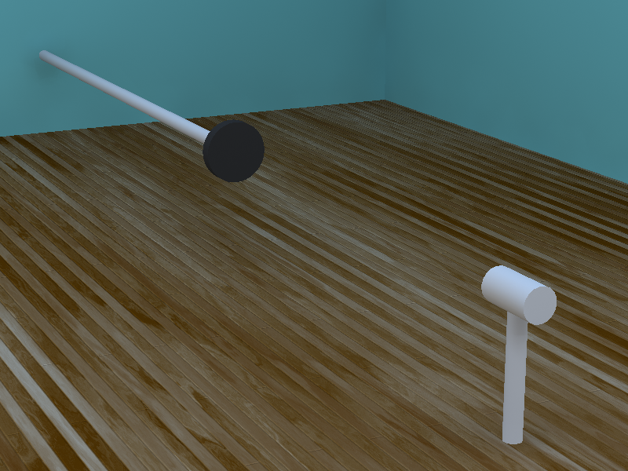
The Gelb Effect
Gelb (1929) presented observers with a black disk suspended above the ground. If the disk is viewed with normal illumination it appears black.

Slide 17
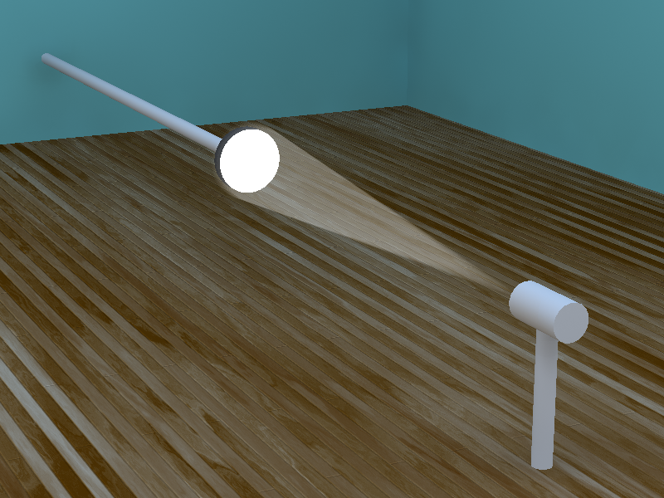
The same disk can appear white, however, if it is illuminated by a spot light that does not shine light on other neighboring surfaces. The increase in illumination is misinterpreted as an increase in reflectance.

Slide 18
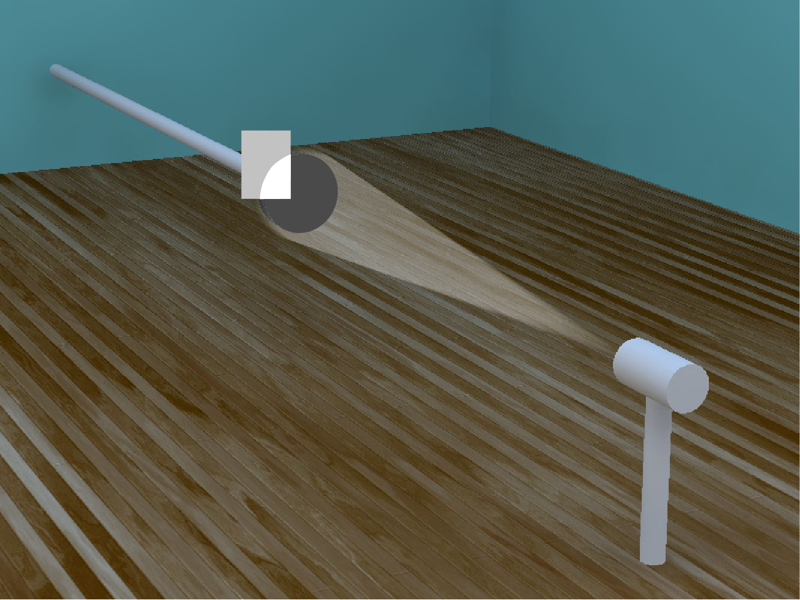
If a white piece of paper is then placed within the beam, the disk will again appear black because its luminance is less than that of the white paper. These findings show that lightness is based on relations among different regions rather than absolute luminances.

Slide 19
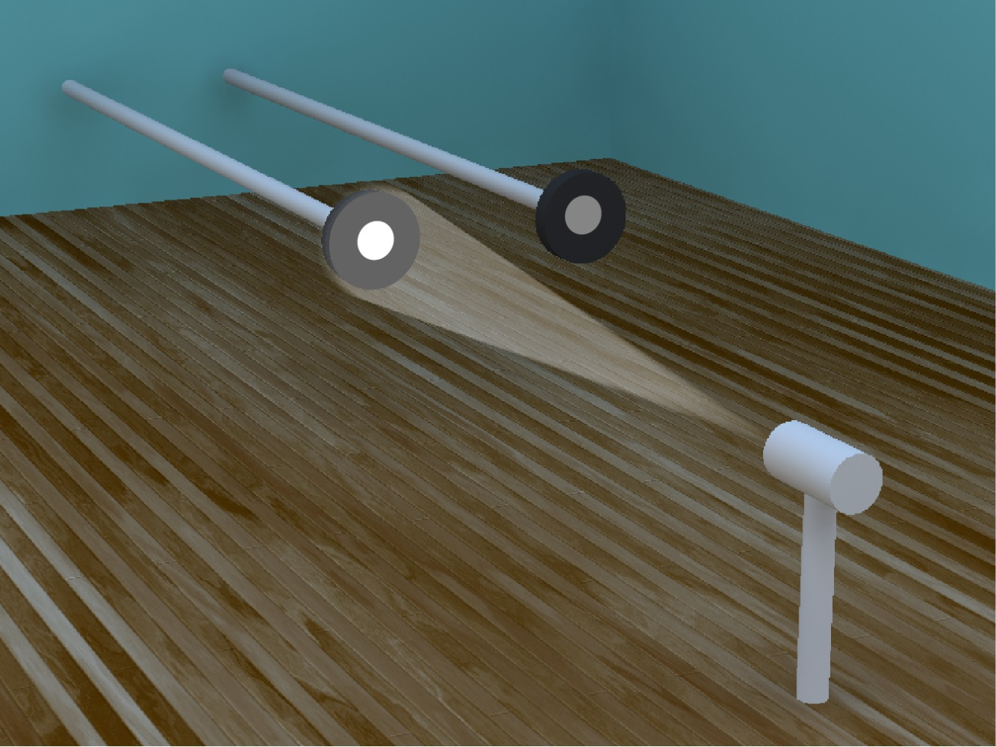
Wallach (1948), presented observers with two disk/annulus displays with different illuminations. He found that disks of different luminance appear equal in lightness as long as the disk/annulus luminance ratios are equal.

Slide 20
Lightness Constancy
The luminance ratio between two surface patches with the same illumination is a useful source of information for estimating their relative reflectance because the ratio is unaffected by the magnitude of illumination.
Following Wallach’s experiments, it was generally believed that lateral inhibition provides the mechanism for measuring luminance ratios, and that lightness constancy is a real world manifestation of the classic phenomenon of simultaneous contrast.

Slide 21
Simultaneous Lightness Contrast
Do the two center squares look the same?

Slide 22
Strong Inhibition
Weak Inhibition
-
-
+
+
The right square appears darker because cells with receptive fields near its border receive less inhibition from the surround.

Slide 24
Hermann Grid
Why do spots appear at the junctions, and why do they disappear when a junction is fixated?

Slide 25
Point of fixation
Spots do not appear at the fixated junctions because receptive fields in the fovea are smaller than in more peripheral regions.
_
Cells with receptive fields at the junction receive more inhibition, so that the junctions appear darker.
_
+
_
_
_
+
_

Slide 26
The Koffka Ring
Although some lightness phenomena can be adequately explained by lateral inhibition, there are many others that cannot. The Gestalt psychologist Kurt Koffka was one of the first to recognize that the configuration of a pattern can have large effects on lightness perception.

Slide 27
Note how shifting the right half of the pattern dramatically alters the perceived lightness.

Slide 28
White’s Illusion
a
b
The region “a” appears darker than the region “b” even though they have identical luminances

Slide 29
White’s Illusion
_
_
_
_
+
_
_
_
+
_
Unlike the phenomenon of simultaneous contrast, this effect cannot be caused by lateral inhibition. Note that the inhibition would be greater for the gray bars on the right, yet those bars appear lighter.

Slide 30
Lightness Constancy
The luminance ratio between two surface patches with the same illumination is a useful source of information for estimating their relative reflectance because the ratio is unaffected by the magnitude of illumination.
Note, however, that this strategy is only valid if the surface patches to be compared have the same illumination, and illumination can vary greatly in different parts of a scene.
Thus it is necessary to have some sort of grouping mechanism that can isolate different parts of a scene that share the same illumination. Perceived lightness can then be determined by the relative luminances within each group.

Slide 31
The Shadow-Checker Effect: In this case the regions in shadow are considered as one group, and the regions not in the shadow are considered as another. Note that A is the darkest region within its group, while B is the lightest region within the shadow. The two regions appear to have different colors, even though they have the same luminance. Is this an illusion?

Slide 32
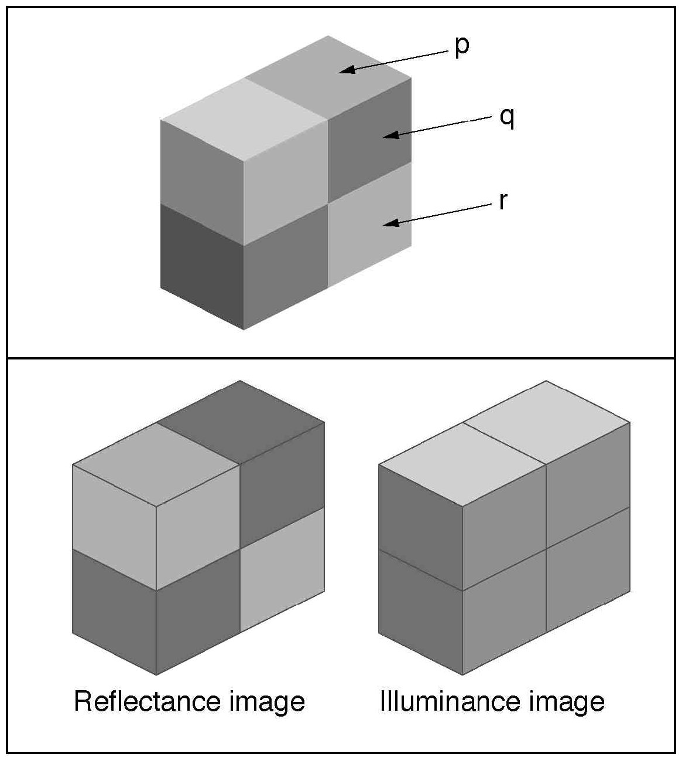
The processes of lightness perception are not designed to accurately measure surface luminance. Rather, they are designed to determine the color (reflectance) of a surface.

Slide 33
Is the difference in image intensity due to surface illumination or surface reflectance?
Information from edges and vertices can help to address this question. Luminance differences at an X vertex are most likely due to reflectance, whereas those at a Y vertex are most likely due to illumination.

Slide 34
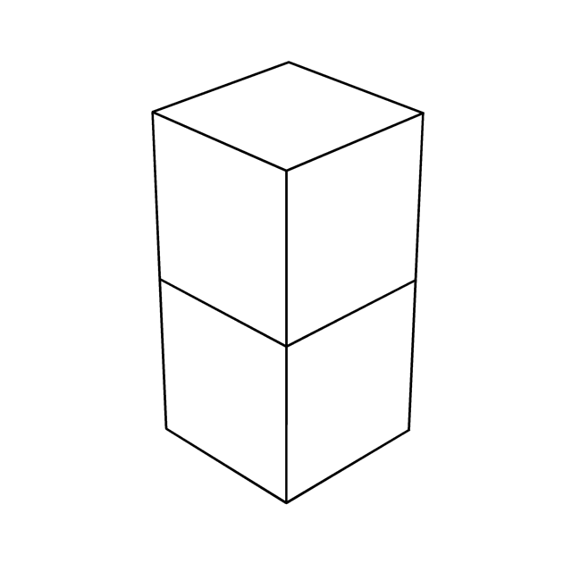
Vertices can help determine whether luminance differences are due to reflectance or illumination
T Vertex,
b an d differ in reflectance
a
Y Vertex, a, b an c differ in illumination
b
c
Ψ Vertex,
bd differ from ce in illumination,
bc differ from de in reflectance
d
e
Arrow Vertex, d and e differ in illumination

Slide 35
White’s Illusion revisited
T Vertex
a
b
The T vertices cause “a” to be grouped with the white horizontal bar and “b” to be grouped with the black horizontal bar. Because of these groupings, “a” appears lighter than “b” even though they have the same luminance.

Slide 36
Ψ Vertex
a
b
The Ψ vertex indicates that “a” and “b” are co-planar, and their luminance difference is therefore perceived as a change in reflectance.

Slide 37
Ψ Vertex
a
b
The Ψ vertex indicates that “a” and “b” have different orientations, and their luminance difference is therefore perceived as a change in illumination rather than reflectance.

Slide 38
a
b
Note that the vertices in this image are inconsistent, creating the impression of an impossible figure.

Slide 39
All of the designated patches below have the same luminance
In this case the Ψ vertices indicate that the two designated patches are in the same coplanar group, and they are perceived to have the same shade of gray.
In this case the two designated patches are in are in different groups. The upper one appears dark because it is the darkest patch in its group, and the lower one appears light because it is the lightest patch in its group.

Slide 40
The central regions of both objects are identical. The differences in apparent color are caused by the pattern of edges and vertices.
Note how the object on the left appears to be composed of two blocks, one of which is darker than the other. The object on the right appears to be composed of two cylinders that both have the same color.

Slide 41
Ψ Vertex
The Ψ vertices cause this image to be organized into four vertical regions. The diagonal rectangles with the same luminance can appear light or dark depending on the other luminances within their respective groups

Slide 42
Transparency – Different types of X vertices
Type 1 – Either of the two large squares can appear transparent
Type 2 – Only the lower right square can appear transparent
Type 3 – There is no possible transparent interpretation
The red arrows show the ordering of luminance around the vertex from lowest to highest

Slide 43
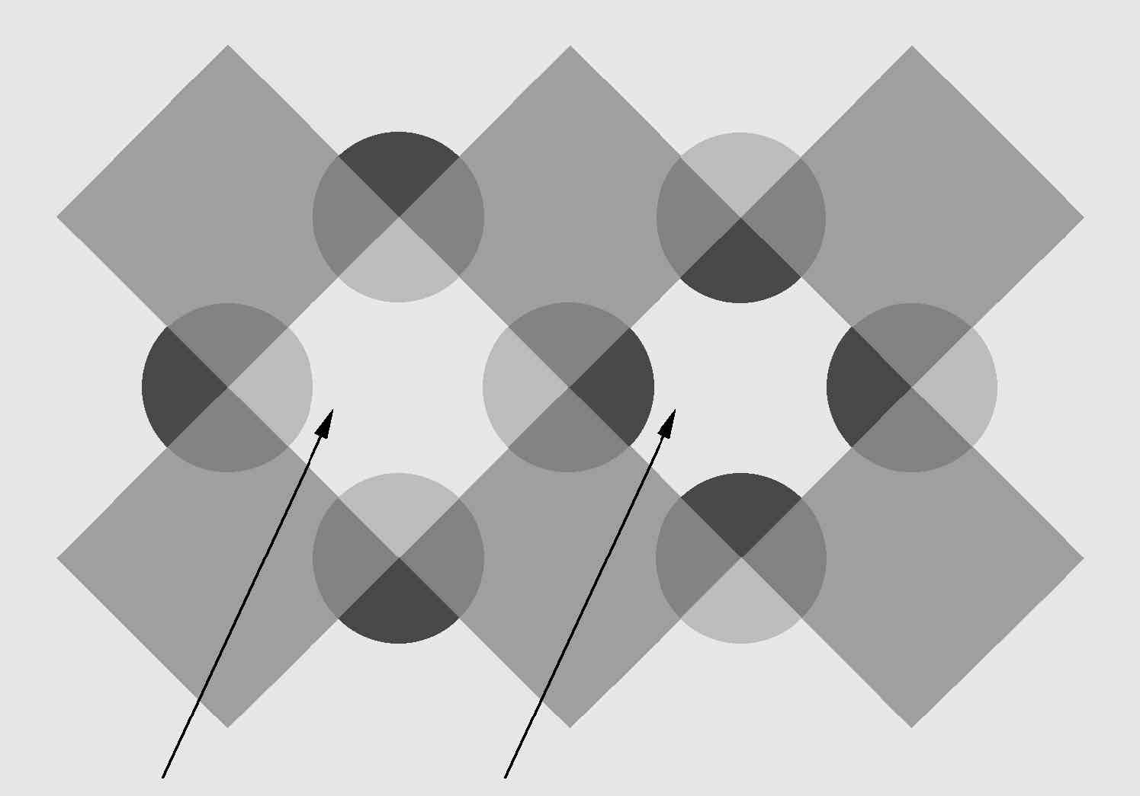
Type 1 Vertex
Type 2 Vertex
The pattern of X vertices indicates that the region on the left is a transparent layer, whereas the one on the right is not. Although both regions have the same luminance, the left one has a foggy appearance arising from the perceived transparency.

Slide 45
All of the diamond shapes have the same luminance. The Type 1 X-vertices cause the pattern to be grouped into horizontal transparent layers, which produces a large difference in apparent lightness among the diamonds in different groups.

Slide 46
The diamonds in this image have the same luminance and the same immediate backgrounds as in the previous slide, but there are no vertices to produce a partitioning into different groups. Note that the diamonds all have approximately the same lightness.

