Slide 1
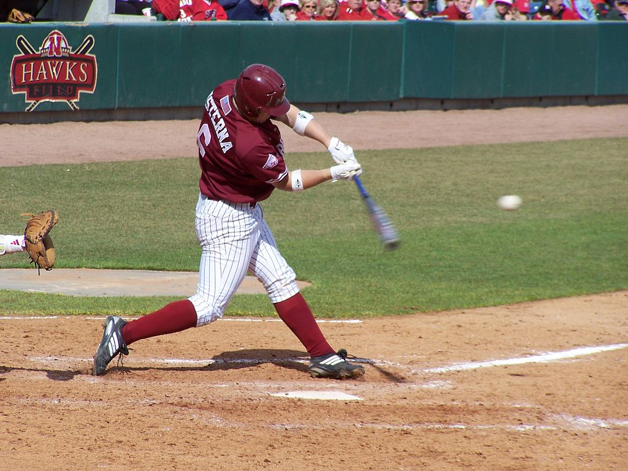
Lecture 15 – Perception & Action

Slide 2
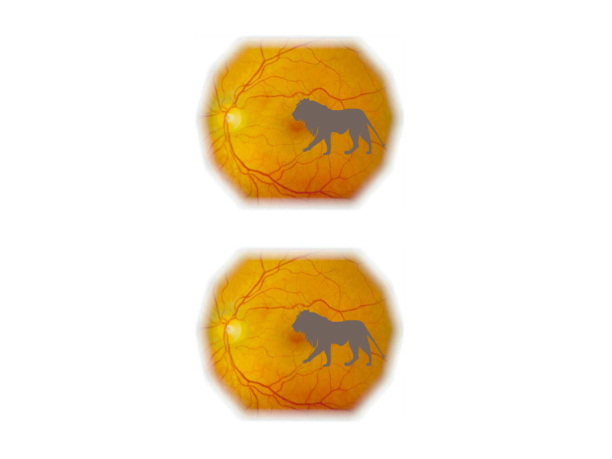
Similar patterns of stimulation are obtained when the eye moves relative to a stationary object and when an object moves relative to a stationary eye.

Slide 3
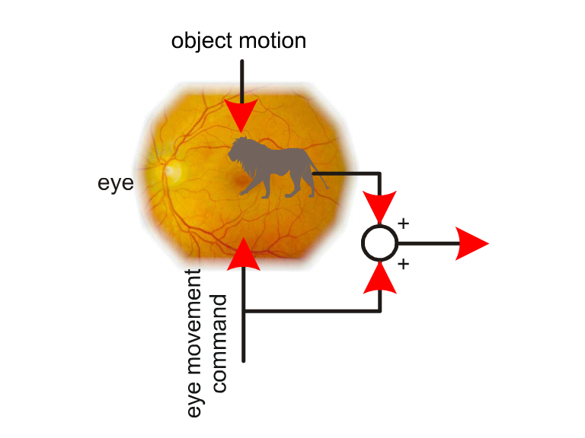
One way of addressing this problem is to exploit information from neural signals to the eye muscles. These signals produce a corollary discharge that is compared with the outputs of motion detectors. If the two signals are opposite, then no motion is perceived.

Slide 4
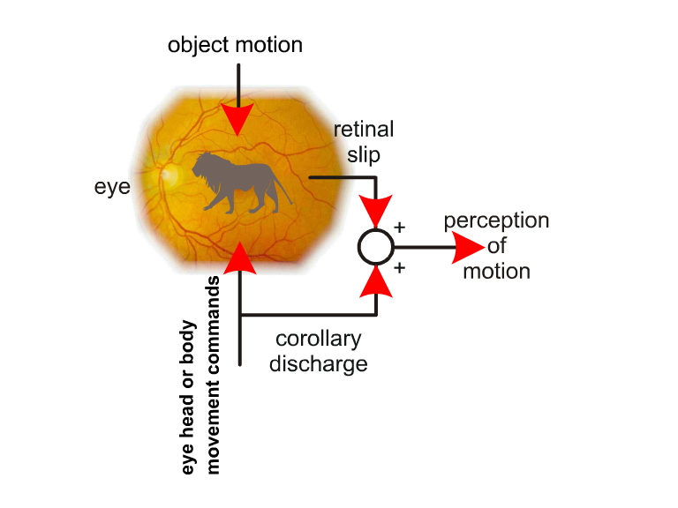
If the output of motion detectors is not opposite to the corollary discharge then motion will be perceived. This system can be fooled if the eyes are moved manually with a finger or if the eye muscles are paralyzed so that intended motor commands have no effect.

Slide 5
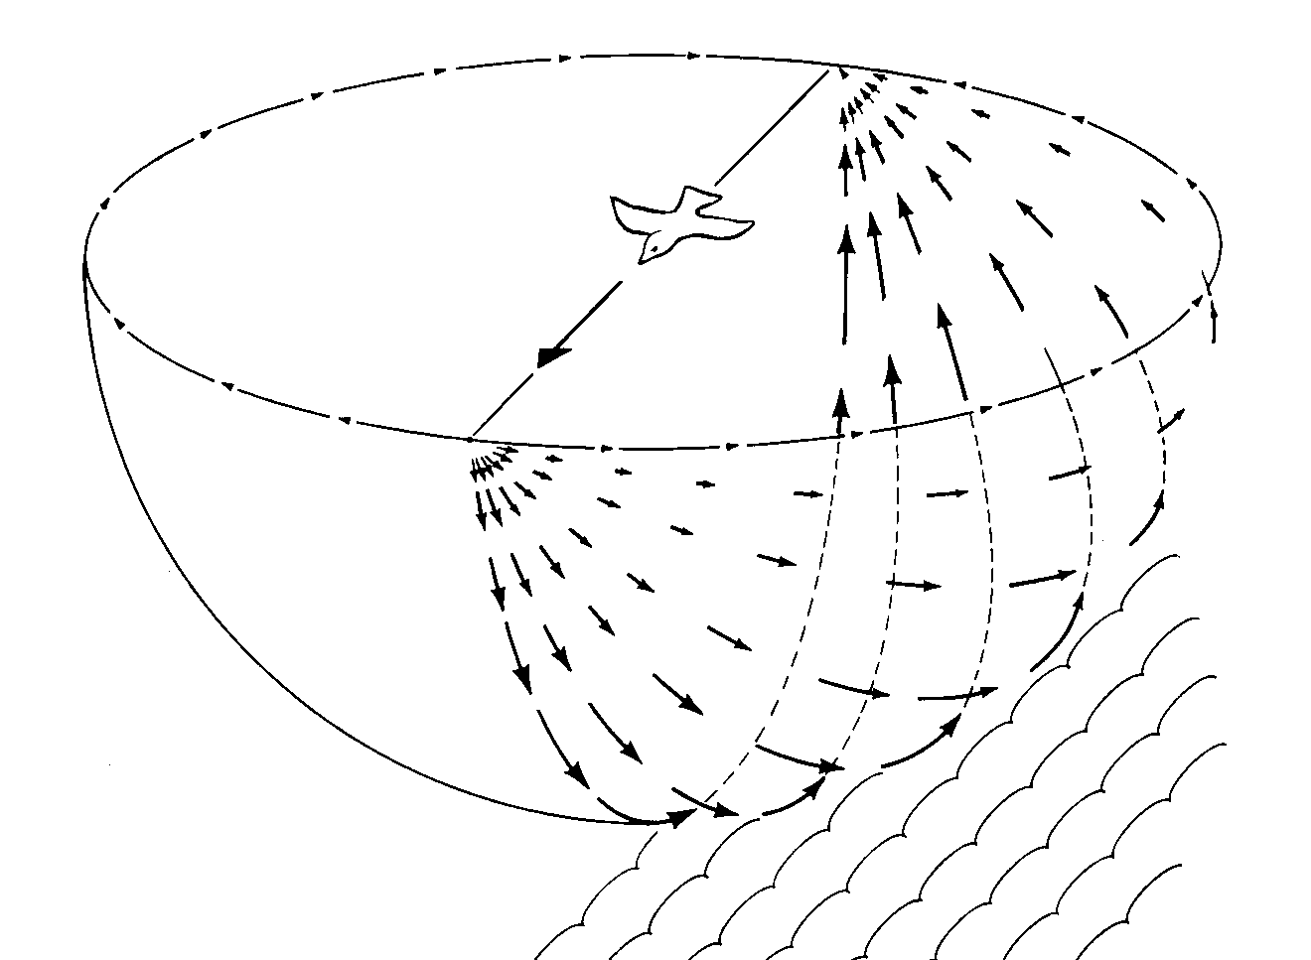
Optic flow (James Gibson, 1950)

Slide 6
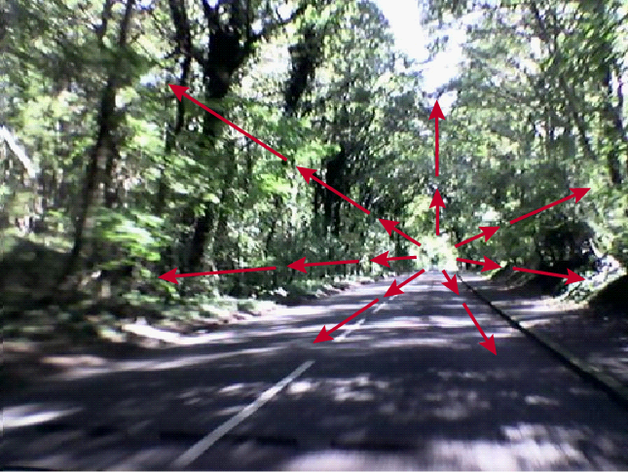
Optic flow is the visual motion in the optic array caused by self-motion. Gibson identified an important property of the optic flow: the rate of flow is zero in the heading direction, this point of the optic array is called the focus of expansion.

Slide 7
Patterns of optic flow can specify particular types of object or observer motion
Flow pattern for an eye movement
Flow pattern while watching a moving object with a stationary eye
Flow pattern while tracking a moving object
Flow pattern for lateral movement over the ground movement
Flow pattern while watching an approaching object with a stationary eye

Slide 8
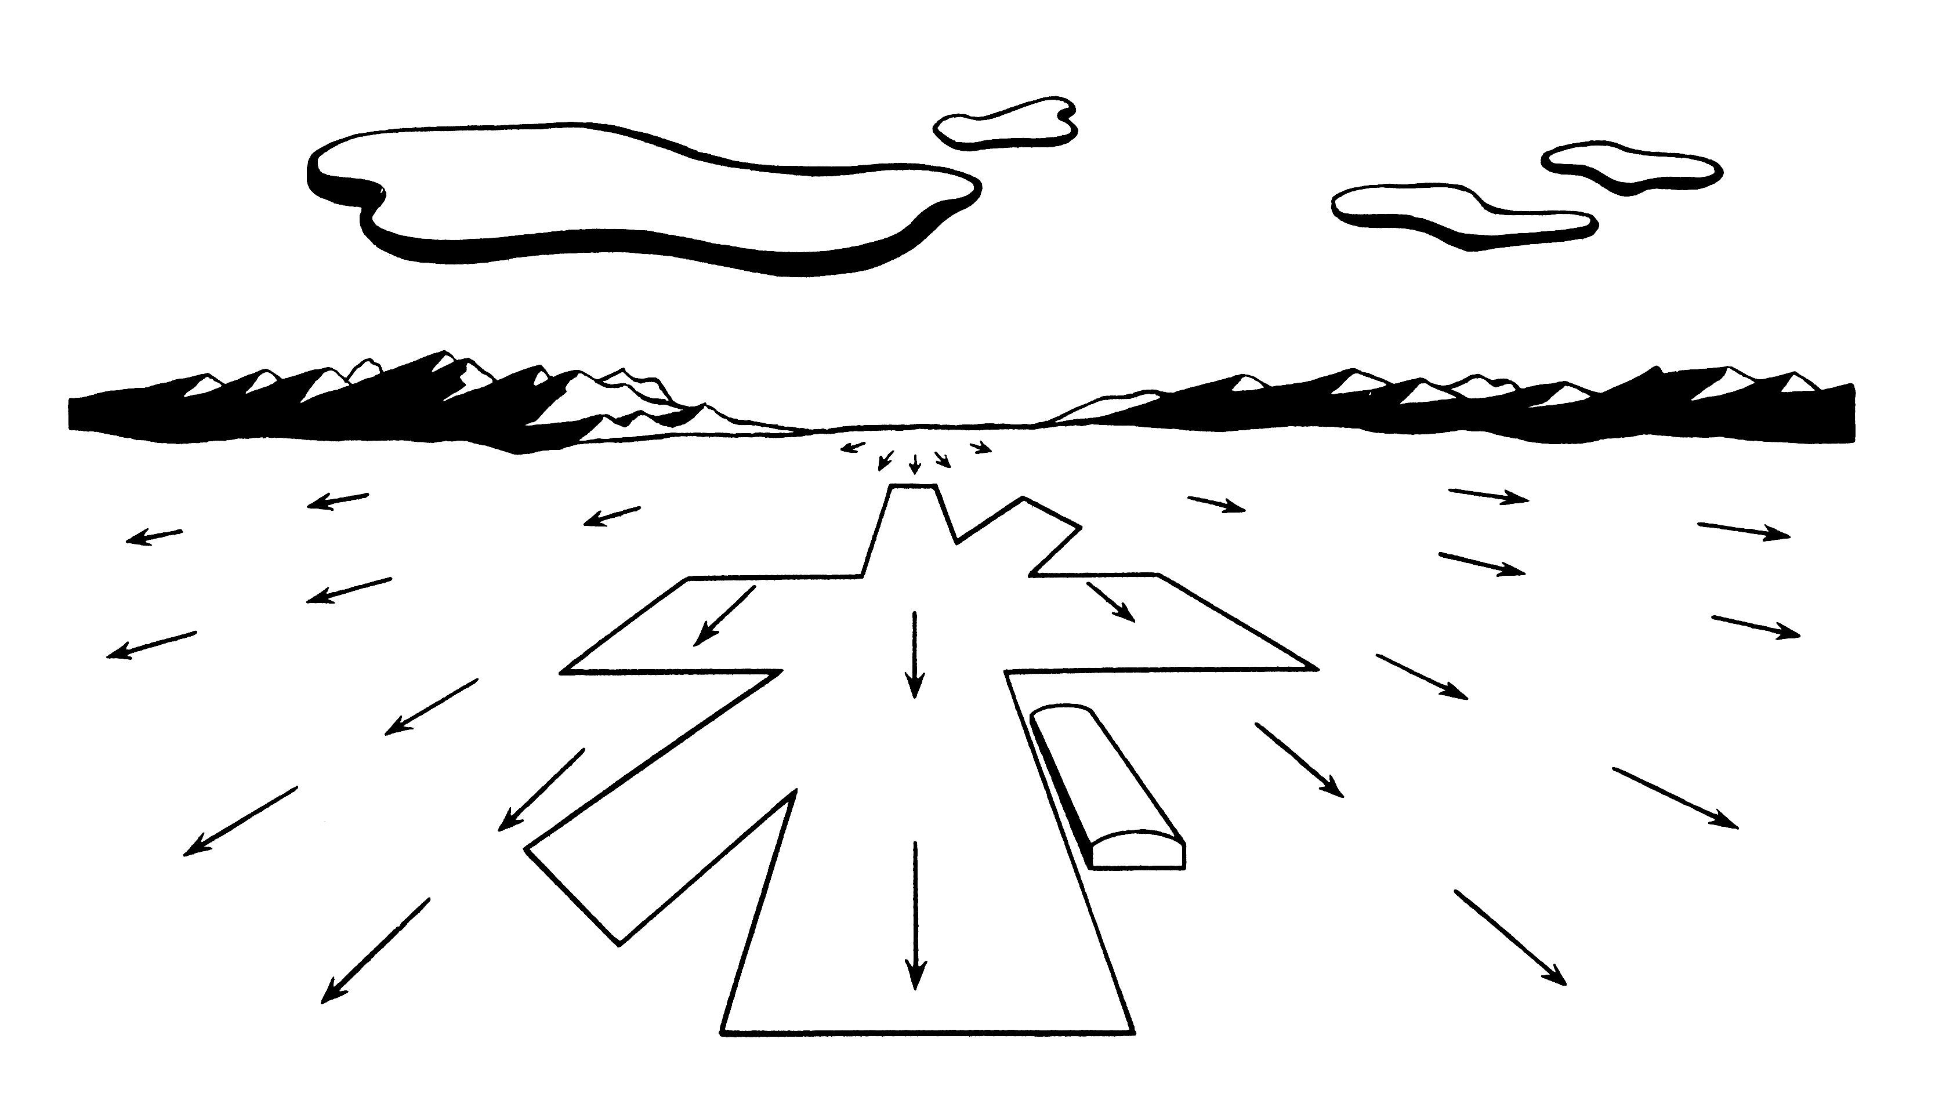
Flow pattern for level flight over the ground in a forward direction

Slide 9
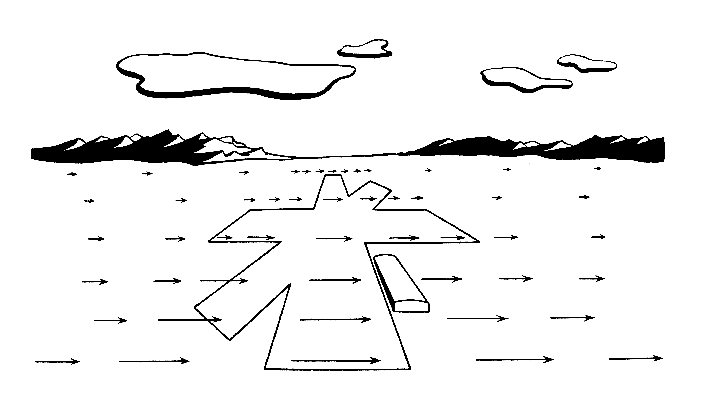
Flow pattern for level flight over the ground in a lateral direction

Slide 10
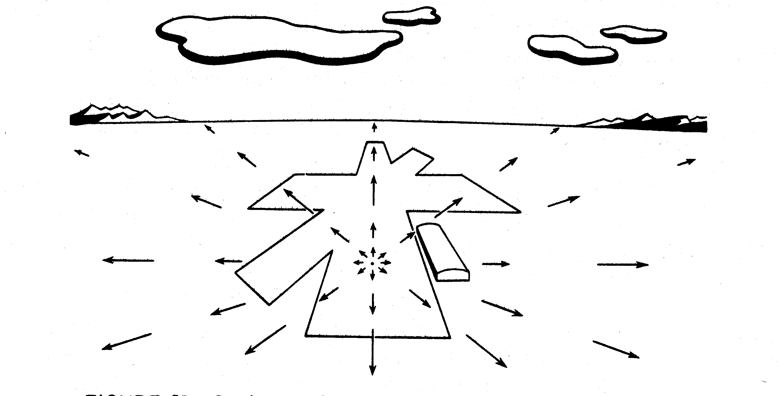
Flow pattern during airplane landing

Slide 11
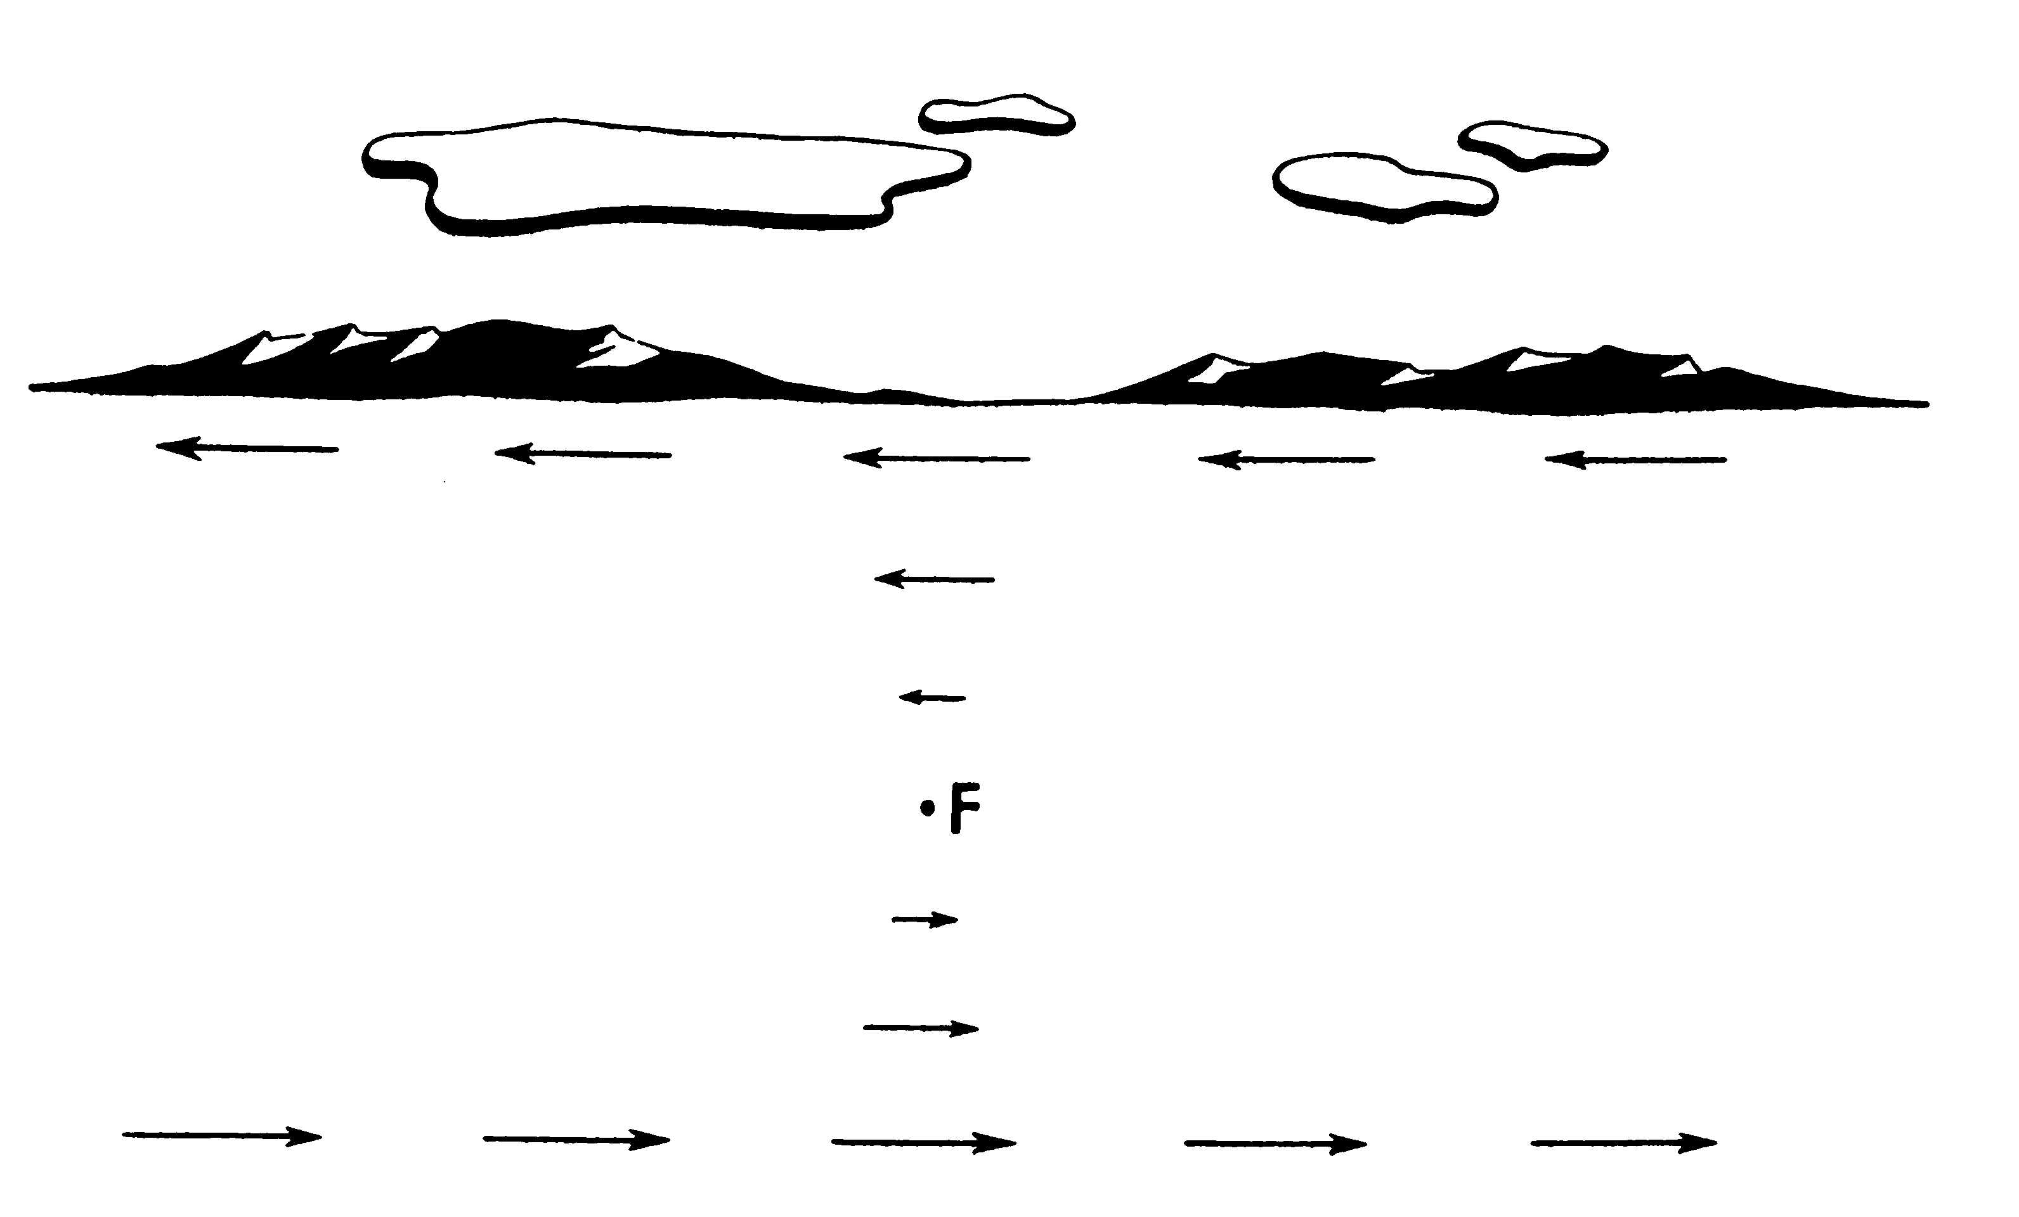
Flow pattern for level flight over the ground in a lateral direction while the eye stays focused on a stationary object on the ground

Slide 12
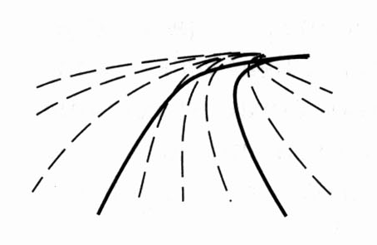
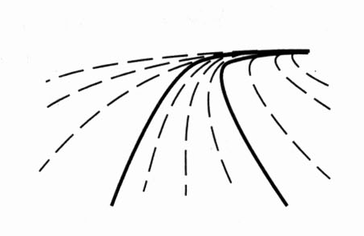
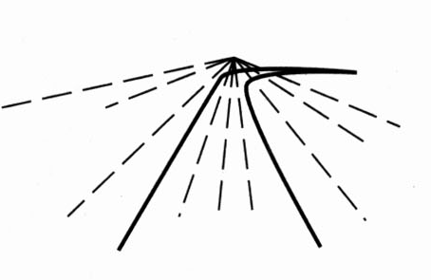
The optic flow pattern can be used to negotiate curves while steering an automobile.
Movement along a straight stretch of road.
Correct negotiation of a curved stretch of road.
Incorrect negotiation of a curved stretch of road. The car will go off the road unless a steering correction is made.

Slide 13

Measuring sensitivity to visual direction -- Warren & Hannon, 1988
Observers viewed a pattern of optic flow like the ones shown above. When the motion stopped, a small bar appeared and observers were required to judge whether the depicted trajectory was to the right or the left of the bar. The results revealed that observers can reliably determine their direction of motion to within 1 or 2 degrees.

Slide 14
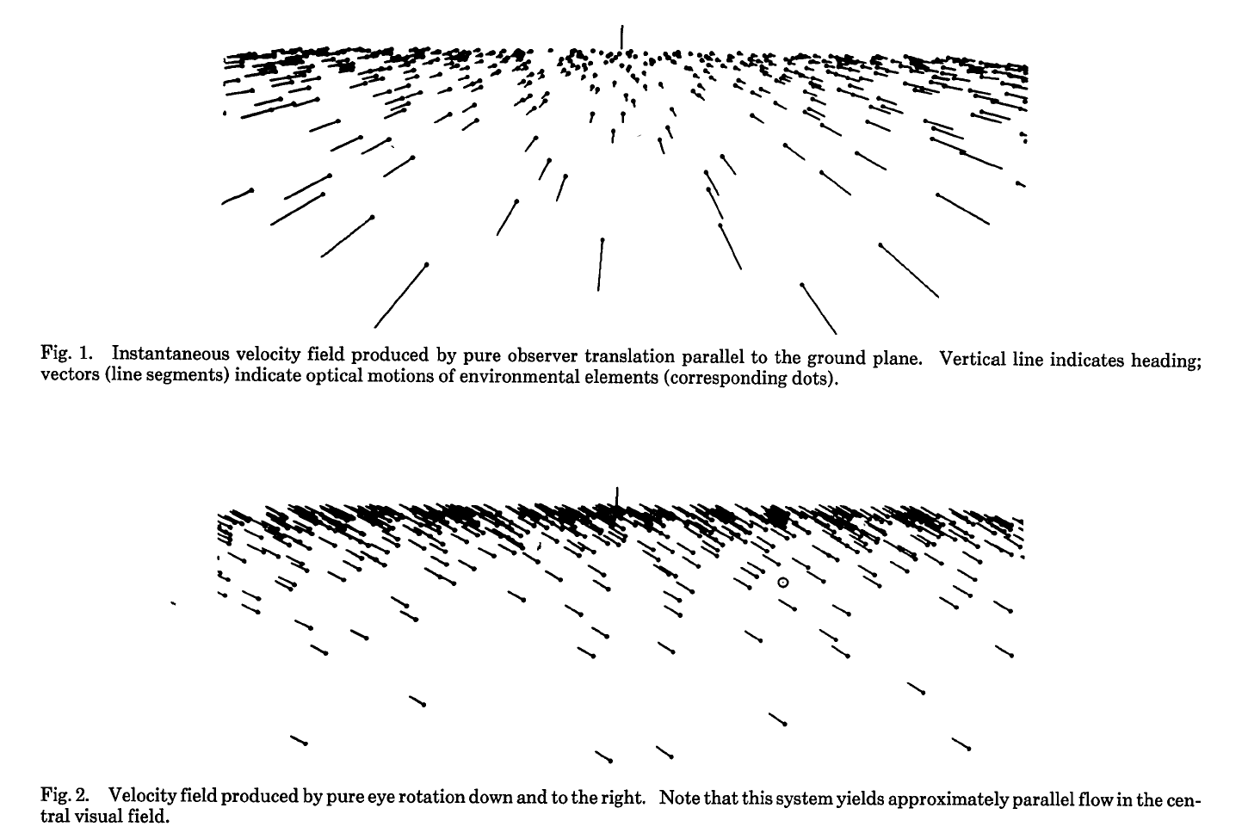

Slide 15
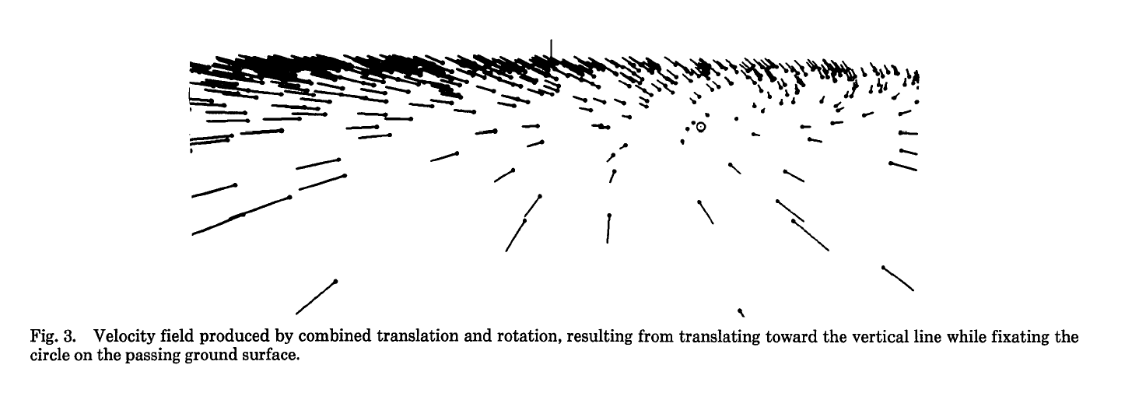

Slide 16
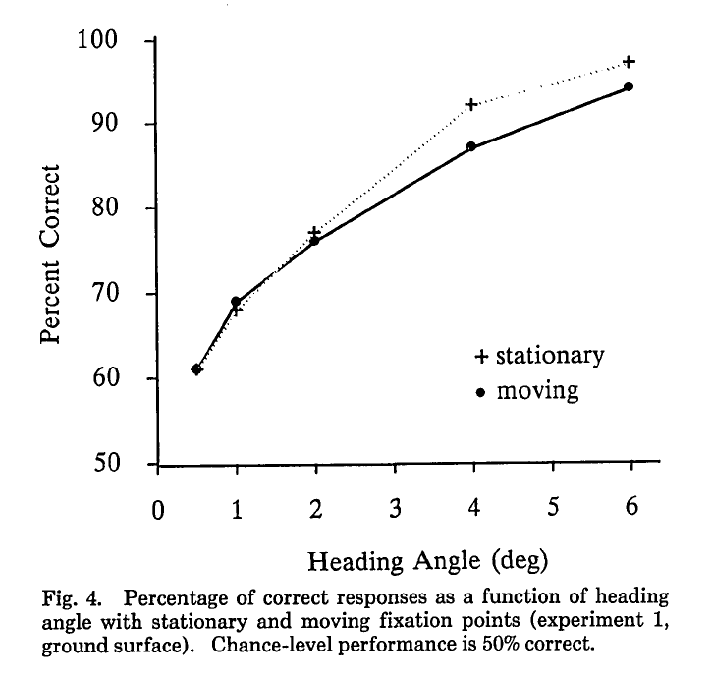

Slide 17
Models of Optical Flow Decomposition
Extra-retinal signals – requires knowledge about movements of the eyes
Differential Invariants – requires motion of a smoothly curved surface

Slide 18
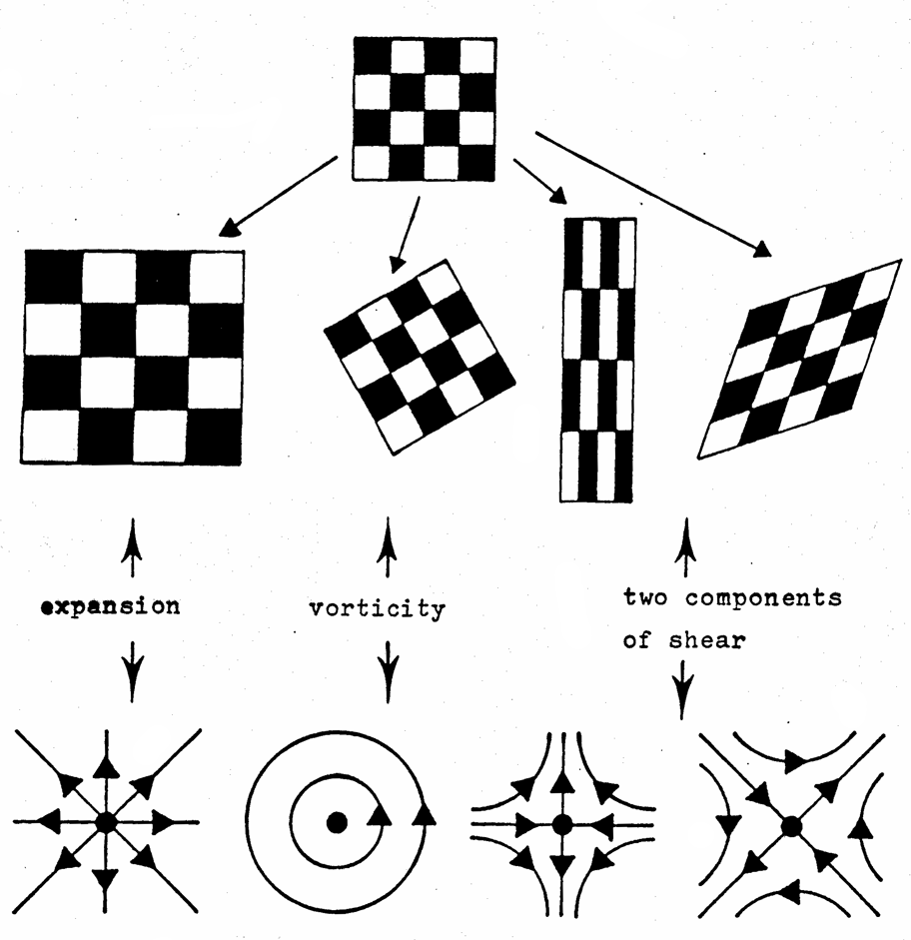
Divergence Curl Shear

Slide 19
Models of Optical Flow Decomposition
Extra-retinal signals – requires knowledge about movements of the eyes
Differential Invariants – requires motion of a smoothly curved surface
Motion Parallax – requires significant depth differences among neighboring points

Slide 20
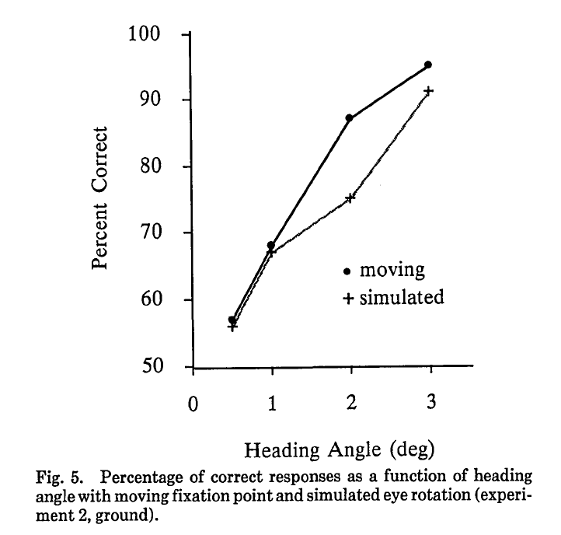

Slide 21
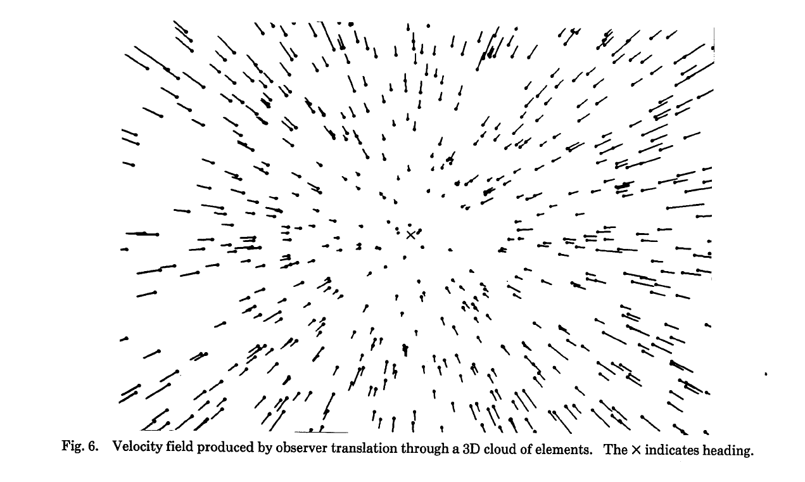

Slide 22
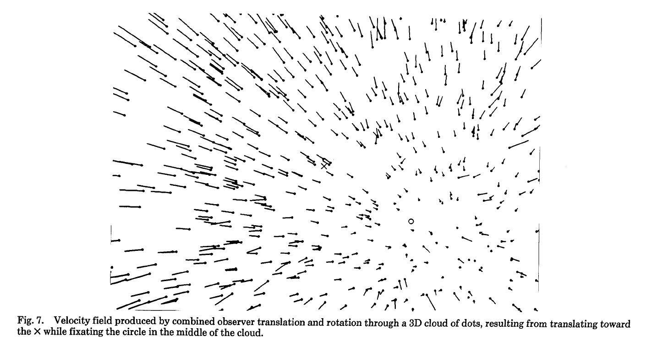

Slide 23
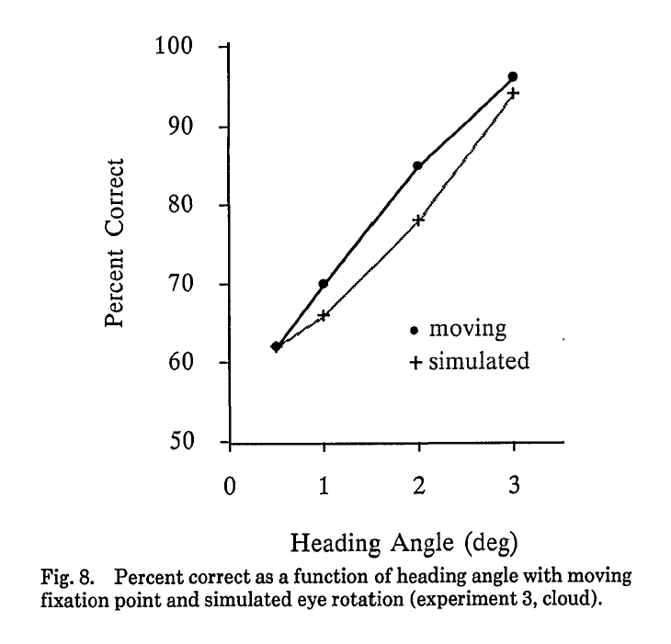

Slide 24
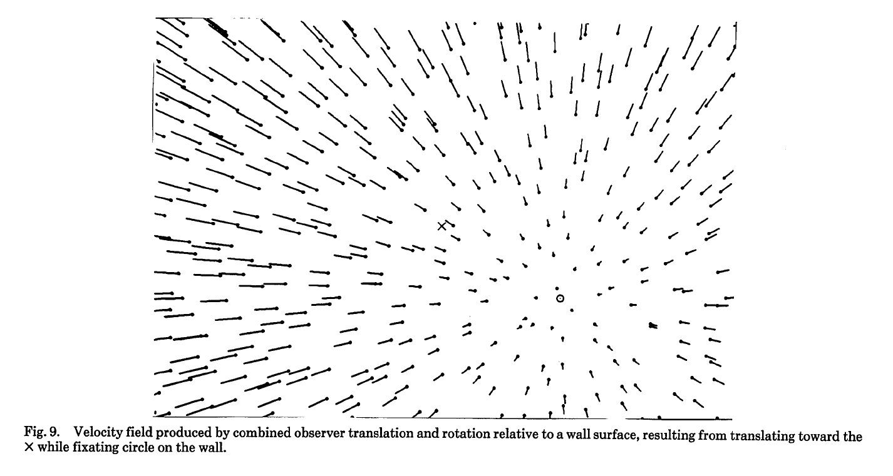

Slide 25
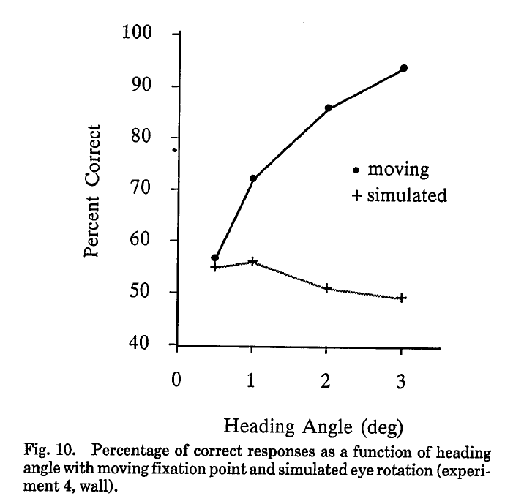

Slide 26
Perception-Action Cycle
Our actions are determined by the patterns of motion we perceive
The patterns of motion we perceive are determined by our actions
The pattern of optic flow
Causes a motor response

Slide 27
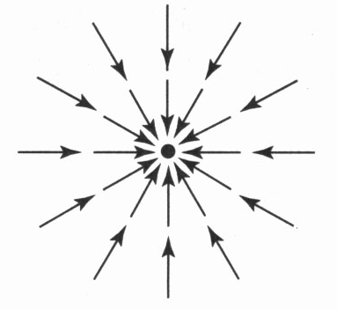
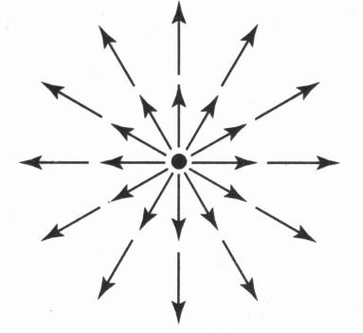
The optic flow pattern is used to maintain balance while standing upright. By constructing a swinging room, Lee and Aronson were able to bowl over toddlers.

Slide 28
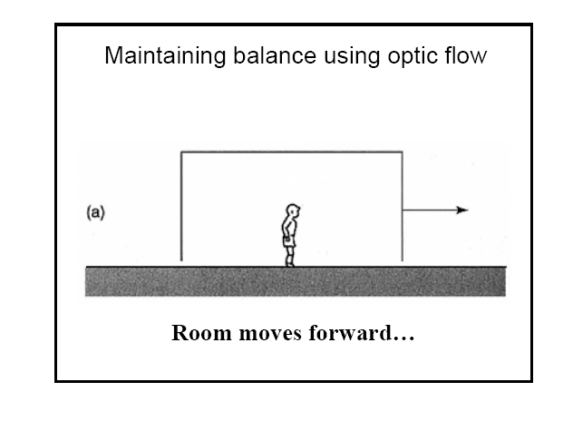

Slide 29
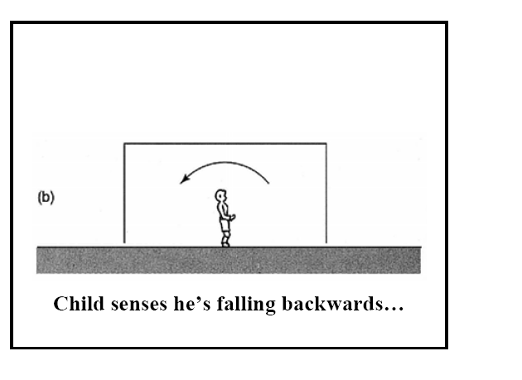

Slide 30
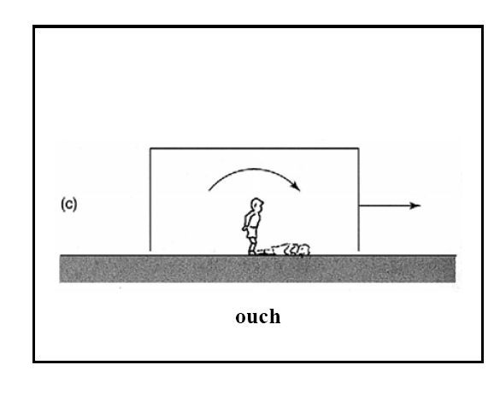

Slide 31

A video of a real moving room. The first scene shows a young toddler who falls down several times as the room is moved either forward or backward. The next scene shows the effects of room motion on an adult. Although he is able to maintain his posture while standing on the floor, the room motion causes him to fall while balancing on a narrow board.

Slide 32

Warren (1997) presented observers with a simulated optical flow pattern while they were walking on a treadmill. In addition to forward translation, the flow simulation contained a swaying motion in a lateral direction (90º), a diagonal direction (30º), or in depth (0º). These swaying motions produced postural sway in the appropriate directions in the observers’ walking movements.

Slide 33
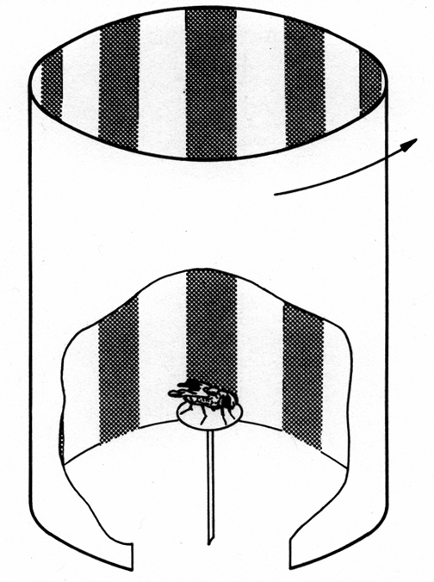
Similar behavior is exhibited by other animals
For example, if a tethered fly is placed in a rotating drum, it will rotate in the same direction to minimize the resulting optical flow. This behavior is called the optomotor response.

Slide 34
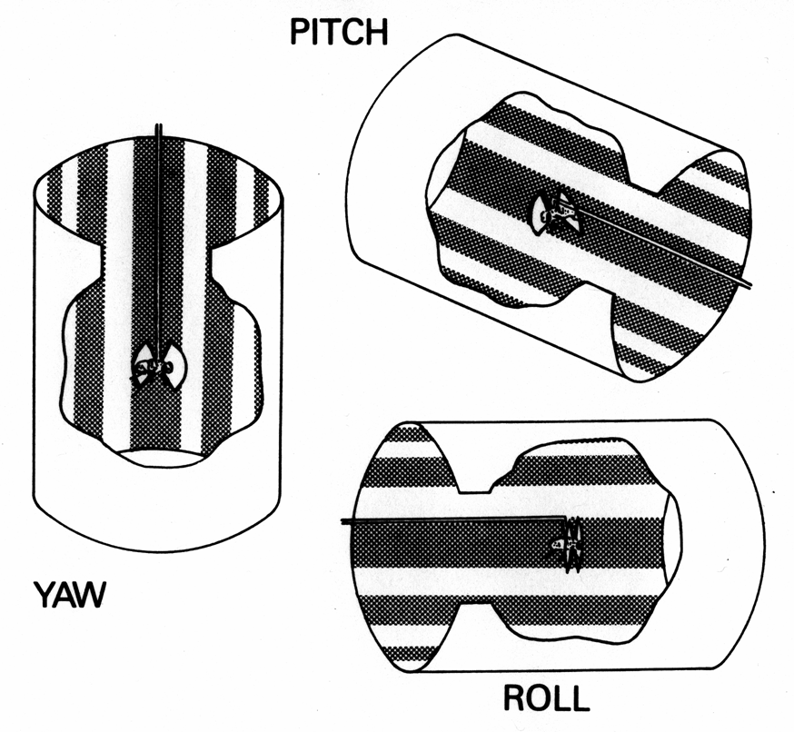
The optomotor response of a tethered fly to rotation of a drum in all three planes. In each case, the fly turns to minimize the velocity of optical flow (Blondeau & Heisenberg, 1982).

Slide 35
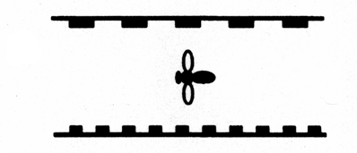
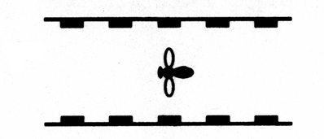
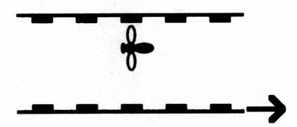
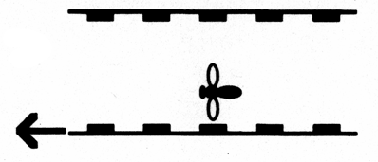
Schematic view from above of a bee flying along a tunnel with striped walls. The bee flies centrally between the walls in (A) and (D), but moves to equalize the optical speed of the walls in (B) and (C): Srinivasan et al, 1991
A) Both walls are stationary
B) The lower wall is moving in the
same direction as the bee’s flight.
C) The lower wall is moving in
the opposite direction to the
bee’s flight.
D) The walls are stationary, but the
stripes are of different widths.

Slide 36
Place-of-Contact
Direct approach: symmetrical expansion, indicates ball will collide with point of observation

Slide 37
Place-of-Contact
Off-axis approach: asymmetrical expansion, indicates ball will pass to the side of the point of observation

Slide 38

Traditional 3D Representation
Speed (S)
Distance (D)
Time to Contact = D/S

Slide 39
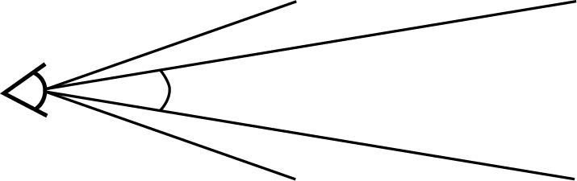
Optic flow specifies time to contact without the need for distance perception.
Angular size θ(t)
Time to contact (TTC) =
Rate of Expansion
θ(t)

Slide 40

Difference in Time to Contact (Todd, 1981)
Which object will hit you first?

Slide 41
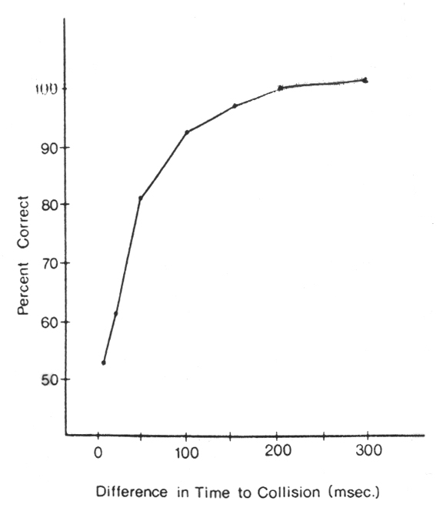
Difference in Time to Contact (Todd, 1981)
Observers were required to judge which of two approaching objects would be the first to hit them. The results showed that observers can reliably perform this task with time to contact differences as small as 50 msec or 1/20 sec.

Slide 42
The Outfielder Problem
?
How does an outfielder run to the right place at the right time to catch a fly ball?

Slide 43

The catch by Willie Mays in the 1954 world series is generally recognized as one of the greatest fielding plays of all time.

Slide 44
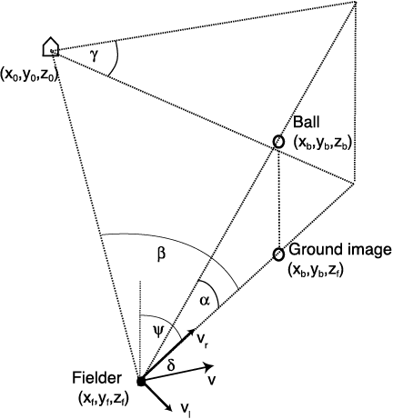
α is angle between the ball and the ground.
β is angle between horizontal ball position and home plate

Slide 45
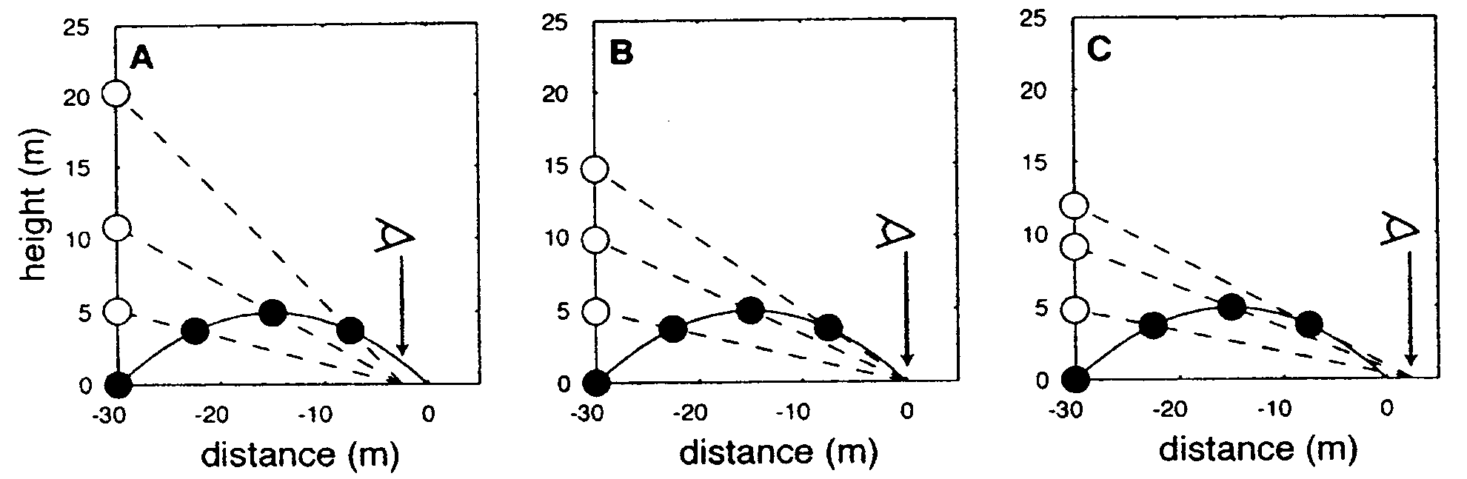
Optical acceleration cancellation (OAC)
Determining whether to charge or move back on a fly ball can be determined in principle by optical acceleration on the retina.
Negative acceleration – ball lands in front of outfielder
Zero acceleration – ball hits outfielder
Positive acceleration – ball goes over outfielder’s head
There is some question, however, about whether observers are sufficiently sensitive to acceleration to make use of this information.
land
behind
land
at eye
land
in front
α
α
α

Slide 46
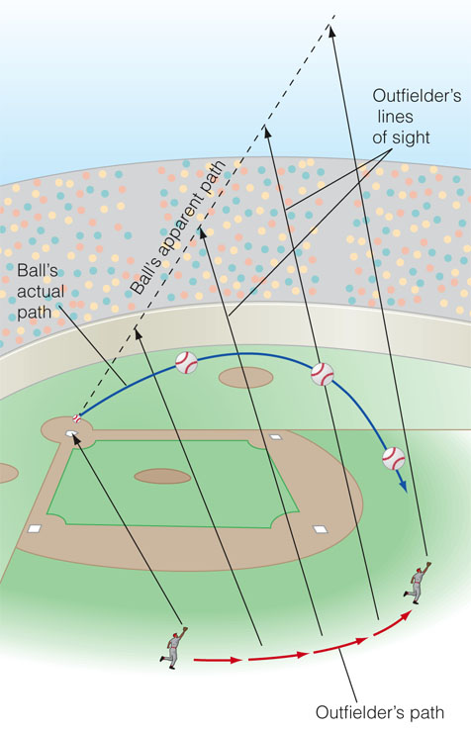
linear optical trajectory (LOT)
The correct lateral movement to catch a fly ball can be achieved by making the ball’s optical projection maintain a linear trajectory on the retina.
The ball’s trajectory will be linear if α/β = k

Slide 47
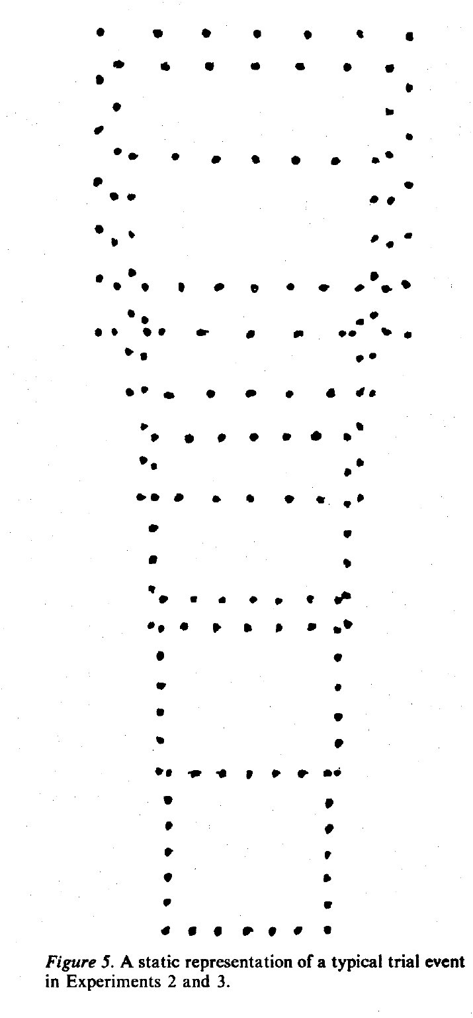
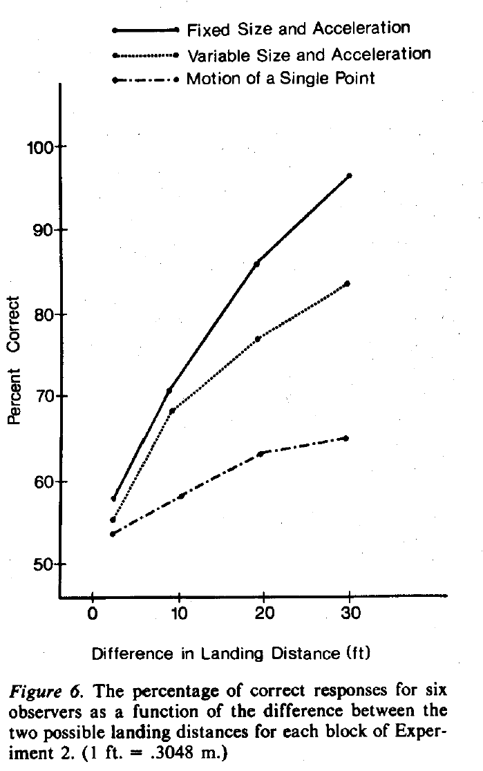

Slide 48
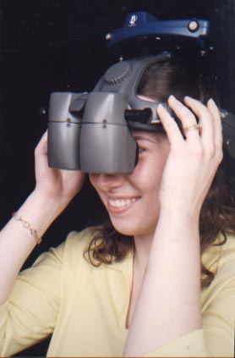
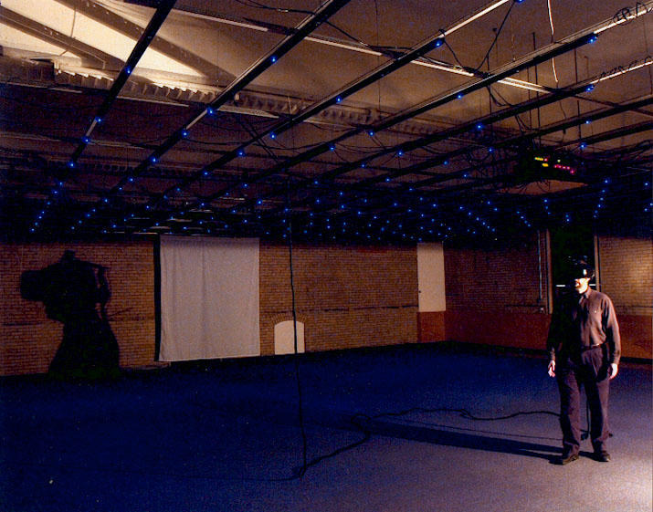
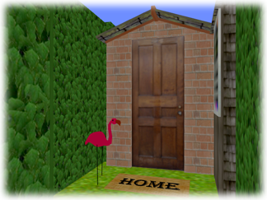
The VENLab
The VENLab
A large-scale ambulatory virtual environment
(12 m x 12 m)
InterSense 900 Tracker:
sonic beacons
microphones
inertia cube
Rockwell Collins HMD
(63˚ x 53˚, 60 Hz, ~70 ms)

Slide 49
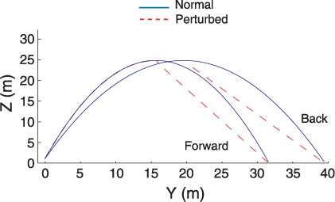
Fink, Foo & Warren, (2009).

Slide 50
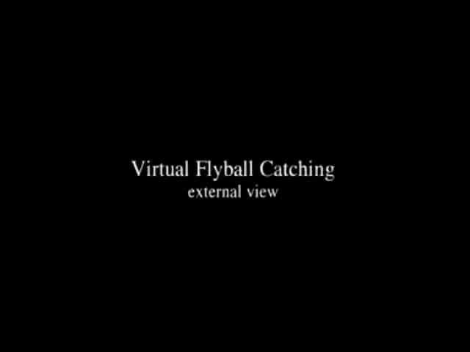

Slide 51
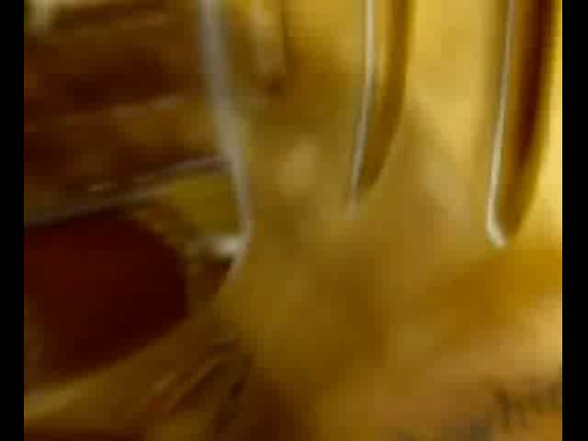

Slide 52
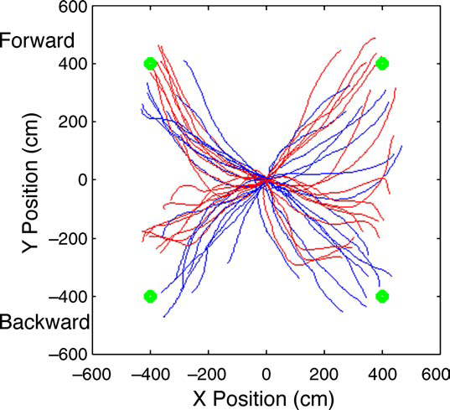
Paths for a representative participant, for normal (blue) and perturbed (red) trajectories. Each trial started at X = 0 and Y = 0, with the ﬁnal ball positions shown with green circles.

Slide 53
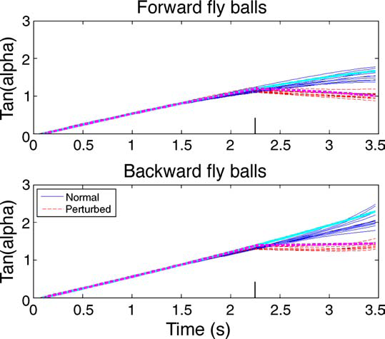

Slide 54
